Slide 1
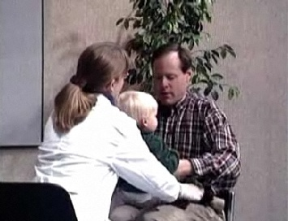
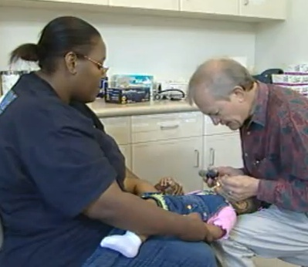
Step 2: Oral Assessment
Perform an inspection of the mouth, teeth, and gums at each health assessment visit (Required by CHDP*)
Sample oral health assessments:
Smiles for Life First Five Oral Health http://www.youtube.com/watch?v=Hw99Aoti7ZE http://www.youtube.com/watch?v=UF4Ra1ZgovI
1
* California Code of Regulations Title 17 Section 6843 “An inspection of the teeth, gums and mouth is part of the health assessment.”
Notes:
Talking Points:
Each of these videos presents a demonstration of “knee to knee” exam and oral health assessment.
This exam can be also be performed on the exam table.

