Slide 1
Supervision of Medi-Cal Peer Support Specialists
Tuesday, May 17, 2022
3:00 p.m. – 4:00 p.m.

Slide 2
Public Health Emergency (PHE) Unwinding
The COVID-19 PHE will end soon and millions of
Medi-Cal beneficiaries may lose their coverage.
Top Goal of DHCS: Minimize beneficiary burden and promote continuity of coverage for our beneficiaries.
How you can help:
  Become a DHCS Coverage Ambassador
  Download the Outreach Toolkit on the DHCS Coverage Ambassador webpage
  Join the DHCS Coverage Ambassador mailing list to receive updated toolkits as they become available
Notes:
The end of the COVID-19 PHE and the Medi-Cal continuous coverage requirements necessitates a coordinated, phased communication campaign to reach beneficiaries with messages across multiple channels using trusted partners called DHCS Coverage Ambassadors. As California plans to resume normal Medi-Cal eligibility operations, beneficiaries will need to know what to expect and what they need to do to keep their health coverage. Most beneficiaries will either remain eligible for Medi-Cal or qualify for tax subsidies that allow them to buy affordable Covered California coverage.
DHCS will engage community partners to serve as DHCS Coverage Ambassadors to deliver important messages to Medi-Cal beneficiaries about maintaining Medi-Cal coverage after the COVID-19 PHE ends. The DHCS Coverage Ambassadors! will be trusted messengers made up of diverse organizations that can reach beneficiaries in culturally and linguistically appropriate ways. Additionally, DHCS Coverage Ambassadors will connect Medi-Cal beneficiaries at the local level with targeted and impactful communication.
Ambassadors may include, but are not limited to:
Local County Offices
Health Navigators
Managed Care Plans
Community Organizations
Advocates
Stakeholders
Providers
Clinics/Healthcare Facilities
Legislative Offices/Other State Agencies

Slide 3
DHCS PHE Unwind Communications Strategy
Phase One: Encourage Beneficiaries to Update Contact Information
  Launch immediately.
  Multi-channel communication campaign to encourage beneficiaries to update contact information with county offices.
  Flyers in provider/clinic offices, social media, call scripts, website banners.
Phase Two: Watch for Renewal Packets in the mail. Remember to update your contact information!
  Launch 60 days prior to COVID-19 PHE termination.
  Remind beneficiaries to watch for renewal packets in the mail and update contact information with county office if they have not done so yet.
Notes:
Two-Phased Approach. A PHE Unwind Communication and Outreach Campaign is currently rolling out in two phases to prioritize and sequence strategies, tactics, and messages across the state to prepare for the resumption of normal eligibility operations.
Phase 1.0 – This phase is designed to encourage beneficiaries to provide updated contact information such as: name, address, phone number, and email in order to be able to contact beneficiaries with important information about keeping their Medi-Cal. This phase is underway.
Phase 2.0 – This phase is designed to encourage beneficiaries to continue to update contact information, report any change in circumstances, as well as check for upcoming renewal packets. Phase 2.0 will begin 60 days prior to the end of the PHE. A Phase 2.0 Outreach Toolkit will be released in the future.

Slide 4
Featured Presenters
Mia Nafziger, Senior Policy Consultant, Integrated Care, Aurrera Health Group
Keris Jän Myrick, Director, National Association of Peer Supporters
Jason Robison, Chief Program Officer, SHARE! (Self-Help And Recovery Exchange)
Khatera Aslami Tamplen, Office of Peer Support Services Manager, Alameda County Behavioral Health

Slide 5
Agenda
Department of Health Care Services Guidance
National Landscape of Peer Supervision
Best Practices in Peer Supervision
Peer Supervision in Alameda County
Questions

Slide 6
Department of Health Care Services Guidance for Medi-Cal Peer Support Specialist Supervisors
Mia Nafziger, Senior Policy Consultant
Integrated Care, Aurrera Health Group

Slide 7
Senate Bill 803
Senate Bill 803 (SB 803) (Beall, Chapter 150, Statutes of 2020) authorized DHCS to add peer support specialists as a Medi-Cal provider type and peer support services as a Medi-Cal benefit.
Effective July 1, 2022, peer support specialist services will be an optional behavioral health Medi-Cal benefit in California.

Slide 8
Peer Support Specialists Outside of Medi-Cal
SB 803 does not impact peer programs under other funding sources.
Counties may continue to provide peer services through other funding streams.
BHIN 20-056 identifies the range of funding sources for peer support specialists that are available outside of the Medi-Cal program.
Examples of other funding streams:
  Private health insurance
  Grants
  Self-pay

Slide 9
County Role in Medi-Cal Peer Support Specialist Services
Each county may decide whether to opt into this benefit.
Counties are responsible for implementing the Medi-Cal peer support specialist services benefit.
Interested peers and peer-run organizations should work with their county Behavioral Health Department to bill Medi-Cal for peer support specialist services.

Slide 10
Certification Programs for Medi-Cal Peer Support Specialists
To receive Medi-Cal reimbursement, peer support specialists must become certified as a Medi-Cal Peer Support Specialist in California.
Counties are responsible for implementing certification programs.
Counties may implement their own certification program or select an entity to provide a certification program for their county.

Slide 11
Peers as Supervisors
BHIN 22-026 states that Peer Support Services must be provided under the direction of a Behavioral Health Professional.
A Peer Support Specialist Supervisor who meets applicable California state requirements is considered a Behavioral Health Professional for the purposes of peer supervision.
Consequently, a Peer Support Specialist can act as a supervisor, as long as they meet the requirements described on the following slides and in BHIN 22-018.

Slide 12
Medi-Cal Peer Support Specialist Supervisors
BHIN 22-018 provides an overview of Medi-Cal Peer Support Specialist Supervisor training requirements for counties.
DHCS recognizes the efficacy of using certified peer support specialists as supervisors.
DHCS highly encourages the employment of peers as peer supervisors.
Variability of county size, infrastructure, and availability of peer workforce can be barriers for counties hiring peers to supervise peers.

Slide 13
Supervisor Training Requirements
An individual may be a Peer Support Specialist Supervisor if they have completed a DHCS-approved peer support supervisory training curriculum and meet at least one of the below qualifications:
  Have a Medi-Cal Peer Support Specialist Certification Program certification and two years of experience working in the behavioral health system; OR
  Have worked as a non-peer behavioral health professional (including registered and certified SUD counselors) in the behavioral health system for a minimum of two years; OR
  Have a high school diploma or GED and four years of behavioral health direct service experience that may include peer support services.
Notes:
https://www.dhcs.ca.gov/Documents/CSD_YV/BHIN/BHIN-22-018.pdf

Slide 14
Supervisor Training Requirements
Medi-Cal Peer Support Specialist Supervisors must take a DHCS-approved peer support supervisory training curriculum within 60 days of beginning to supervise Medi-Cal Peer Support Specialists.
Supervisors must take the DHCS-approved peer support supervisory training at least once, with ongoing training incorporated into a county’s regular continuing education requirements.
Notes:
counties may develop more frequent or more robust training requirements.

Slide 15
Peer Supervisor Curriculum
Counties are responsible for designating a peer supervisor curriculum for peer supervisors in their county.
See BHIN 22-018 for additional information.

Slide 16
National Landscape of Peer Supervision
Keris Jän Myrick, Director, National Association of Peer Supporters

Slide 17

SUPERVISION

Slide 18

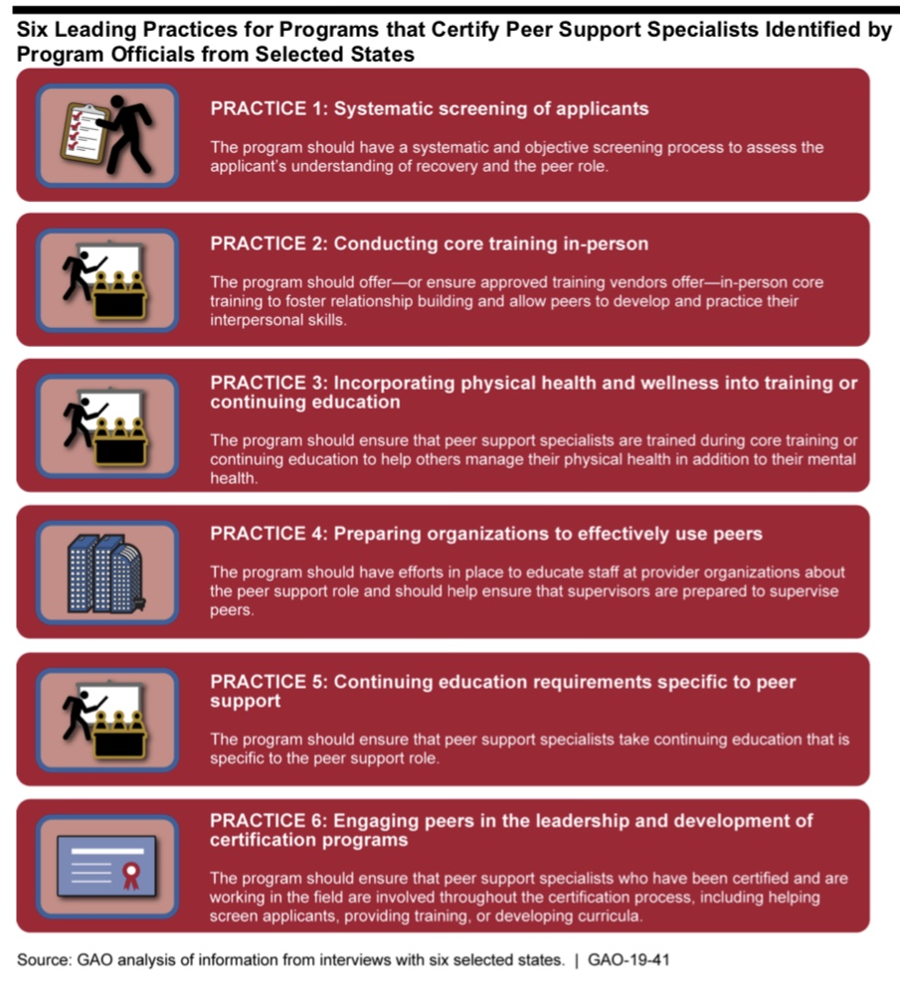
Government Accountability Office
https://www.gao.gov/assets/700/695435.pdf

Slide 19
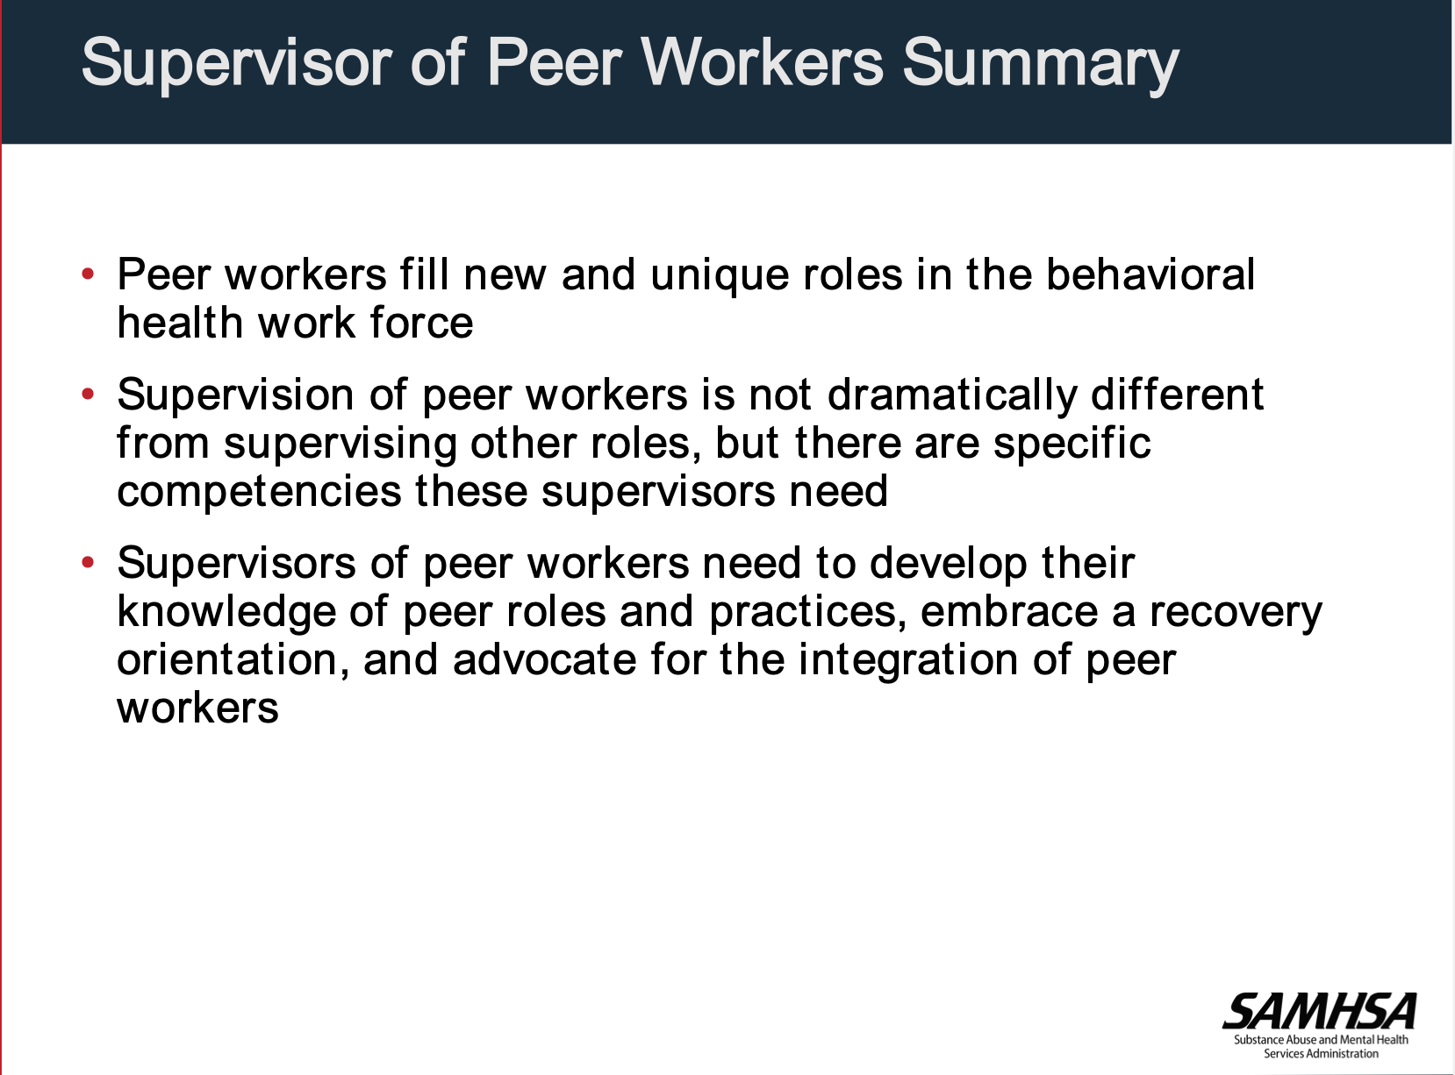

Supervision for Peer Workers
https://www.samhsa.gov/sites/default/files/programs_campaigns/brss_tacs/guidelines-peer-supervision-4-ppt-cp5.pdf

Slide 20
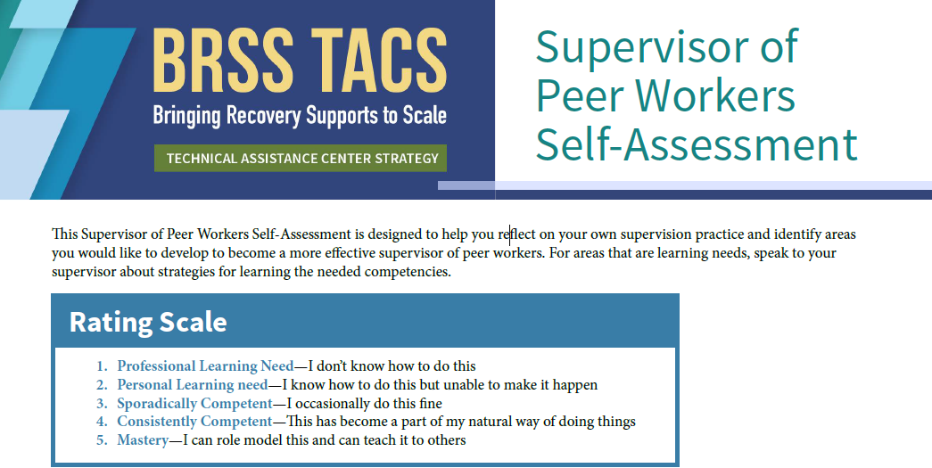
Self-Assessment
https://www.samhsa.gov/sites/default/files/programs_campaigns/brss_tacs/guidelines-peer-supervision-2-self-assessment-cp9.pdf

Slide 21
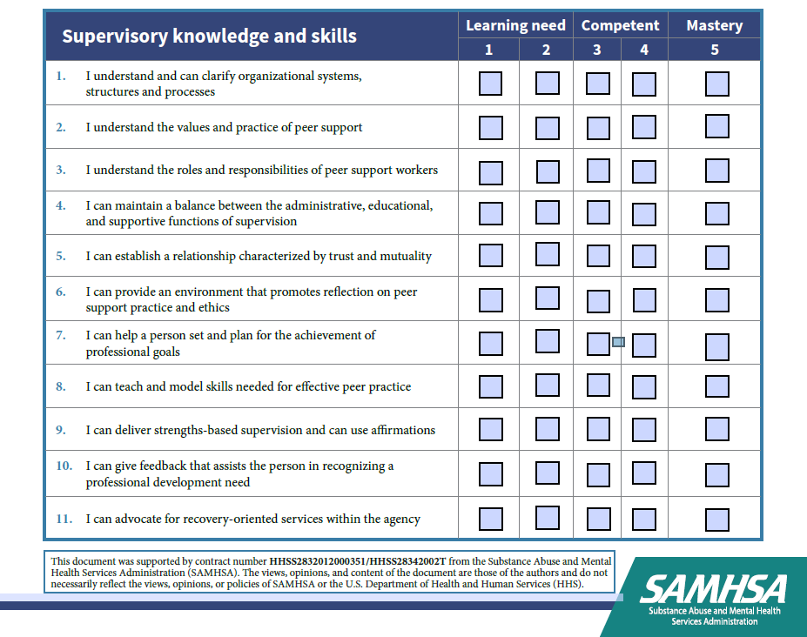
Survey

Slide 22

N.A.P.S.
https://www.peersupportworks.org

Slide 23
ROLE CLARITY
Notes:
The NPG-S provide additional opportunities to increase interdisciplinary team members’ understanding of the peer role and core peer support values in practice. Clinical supervisors may struggle to understand the equally challenging complexities of the nonclinical peer support role. Role clarity is a predictor of job satisfaction for peer support workers ). As the peer support workforce has grown, noticeable increases in role confusion and role drift have occurred. These issues are far more likely to occur when a supervisor unfamiliar with the core values of peer support attempts to act as a mentor or role model for these values and peer support competencies
Perhaps most importantly, the NPG-S can assist supervisors in realigning peer support specialists’ job descriptions and duties to match the underlying core value of mutual support, such as sharing relevant lived experience and reciprocal interpersonal relationships to build hope and trust, to foster identification, and to support choice.

Slide 24
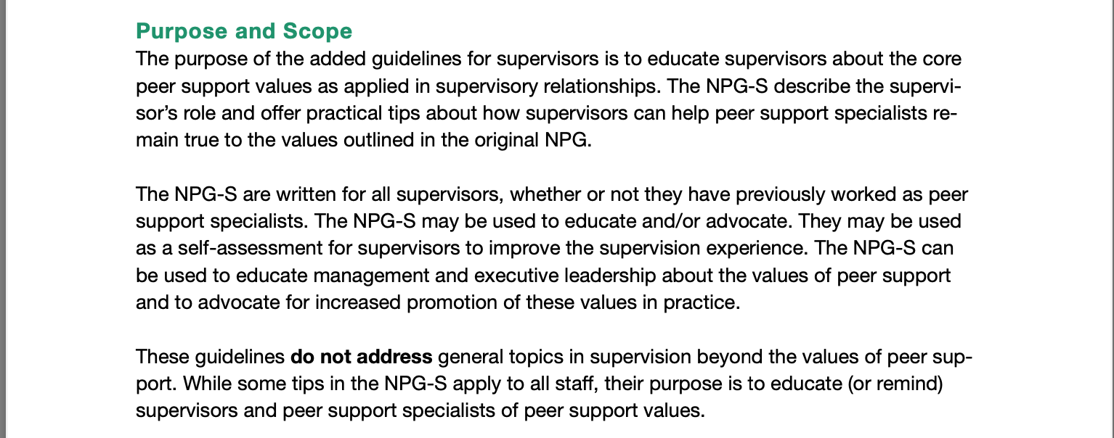

National Practice Guidelines
https://www.peersupportworks.org/wp-content/uploads/2021/07/National-Practice-Guidelines-for-Peer-Specialists-and-Supervisors-1.pdf
Notes:
In 2017, the National Association of Peer Supporters (N.A.P.S.) leadership became aware of growing member concerns about supervision contradicting or conflicting with core peer support values. In response, N.A.P.S. established a work group that revised the association’s 2013 National Practice Guidelines for Peer Supporters to include specific guidance to supervisors (i.e., the National Practice Guidelines for Peer Specialists and Supervisors). The new guidelines are not intended to address administrative or other basic functions of supervision; instead, they offer expertise and practical guidance to supervisors of peer support workers in understanding the core values of mutual support and managing the complexities of the nonclinical role in settings that may have different values and priorities

Slide 25
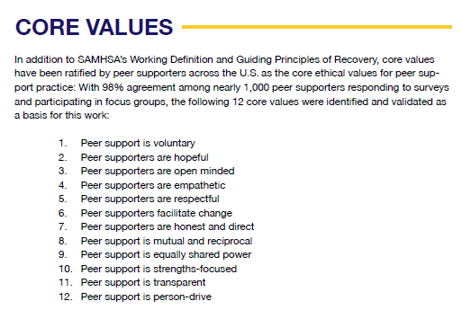
Core Values
https://www.peersupportworks.org/wp-content/uploads/2021/07/National-Practice-Guidelines-for-Peer-Specialists-and-Supervisors-1.pdf

Slide 26
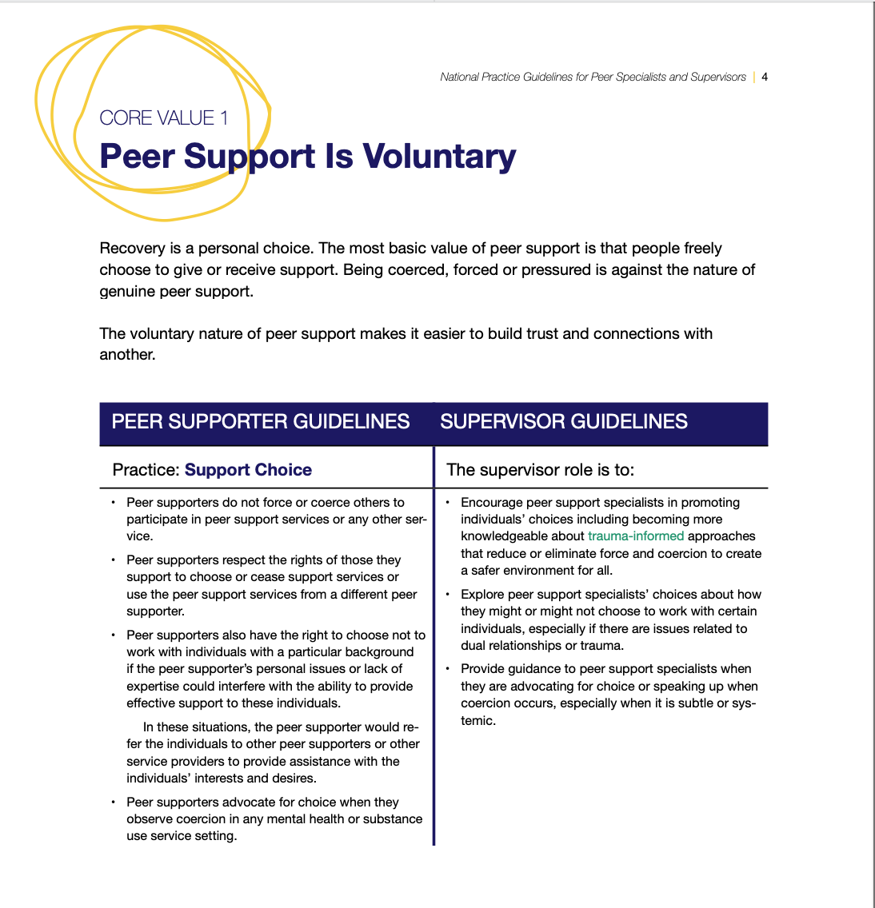
Peer Support is Voluntary
Notes:
https://www.peersupportworks.org/wp-content/uploads/2021/07/National-Practice-Guidelines-for-Peer-Specialists-and-Supervisors-1.pdf

Slide 27

National Landscape of Peer Supervision
Keris Jän Myrick, M.B.A., M.S.,
Policy Liaison & Board Member,
National Association of Peer Supporters
Certified Personal Medicine Coach, CPMC
keris@peersupportworks.org

Slide 28
Best Practices in Peer Supervision
Jason Robison, Chief Program Officer, SHARE!

Slide 29
Supervising the Peer Workforce
Effective supervision of the Peer Workforce is an essential component of a robust public behavioral health system.
Peer Services are an evidence-based practice.
Supervisors of Peer Services in California will be required to be trained in supervision using SAMHSA’s Core Fundamentals.
Historically, implementation of Peer Services has lacked fidelity to the values and core competencies of Peer Support.
To remedy this inconsistency, the Supervision of the Peer Workforce Project identified specific problematic practices and best practices for supervision and for Managers and Administrators.

Slide 30
SAMHSA’s Core Fundamentals (Competencies) for Supervisors
1. Understands Peer Roles and Practices
2. Have Recovery-Orientation and Model Recovery-Oriented Practices
3. Development of the Unique Knowledge and Skills Needed for Peer Support Practice
4. Recognize the Connections between Behavioral Health Conditions and Trauma, Health Disparities, and Social Inequity
5. Use Strengths-based Supervision
6. Provide a Space to Address Ethical and Boundary Issues
7. Advocate for the Integration of Peer Workers in the Workplace

Slide 31
Best Practices in Supervision of Peer Services
Recognition of the impact of traumatic histories on all staff, including peer workers, supervisors and the people being served.
Collaborative supervision such as the Developmental Model of Supervision.
Tracking data using a “Kaizen” approach of continuous improvement based on data.
Continuous training and management actions that reinforce the importance of Peer Services for the best outcomes for the people being served.
Rewarding all staff including peer workers for success and celebrating failure as a path to learning.

Slide 32
Best Practices in Supervision of Peer Services
Incorporating Peer Services into treatment plans, programs, interventions and other agency activities.
Encouraging staff including peer workers to join self-help support groups and/or a peer worker support group to have a place to share issues at work.
Conducting regularly scheduled supervisory meetings.
Incorporate the tools we expect peers to use in their work into the supervision process.

Slide 33
Best Practices in Supervision of Peer Services
Ensuring supervisors of peer workers:
  Have prior experience/knowledge of peer support work
    Are willing to supervise
    Are knowledgeable about supervision concepts and practices
  Receive ongoing supervision
  Understand the difference between supervision and clinical support

Slide 34
Best Practices for Managers and Administrators
Involve peers as you would other staff in the organization’s decision-making process.
Champion peer services and their importance.
Work to eliminate stigma and discrimination from your agency.
  Study after study shows that mental health providers have more stigma against people with mental health issues than the general public,
Supporting the supervisors of all staff including peer workers, so they are not marginalized or treated as having a less important job because they are supervising peer workers.

Slide 35
Best Practices for Managers and Administrators
Do not isolate Peer Workers. Having two or more working together works best.
Consider hiring executive coaches for new supervisors of Peers. Executive Service Corps can help. http://www.escus.org/
Inform all your staff about evidence-based Peer Services and how they can help the people you serve.
  This should include the fact that peer worker boundaries and ethics are different than professional boundaries.

Slide 36
Best Practices for Managers and Administrators
For managers and administrators overseeing peer programs, requiring them to attend a self-help support group relevant to their own issues at least six times to develop competency in understanding the nature of peer relationships.
Create a coalition of peer supervisors from yours and other agencies to provide support to one another.
Supervisors may benefit from training about organizational structure, organizational culture, and how change occurs.
Notes:
Self-help support groups directly relevant to the work include Recovery International (which reduces stress from the trivial matters in everyday life), Co-Dependents Anonymous (which teaches people to improve relationships with themselves and others) are two groups which anyone can benefit from.

Slide 37
Best Practices for Managers and Administrators
Promote diversity and inclusion by identifying and deactivating workplace equity barriers regarding race, ethnicity, culture, gender, sexuality, age, or other aspects.
Organizational leaders, managers and staff understand and address particular ways inequity may be expressed in employee roles, such as ageism towards youth and/or older people, or hiring barriers against criminal justice-involved peers because of previous actions and convictions.
See that peer worker compensation is equitable relative to other organizational roles and positions.
Documentation and billing paperwork needs to be in line with Peer Services, as activities and notes often are different from clinical services.

Slide 38
Problematic Practices in Supervision of Peer Workers
Lack of training on the value and importance of Peer Services.
Using mistakes and failures as justification to reduce peer worker responsibilities or autonomy.
Limiting peer work to mundane tasks.
Segregating peer workers from other staff.
Requiring that peer workers maintain distance and/or clinical boundaries with the people they serve.
Training peer workers in clinical practices and defining their role as clinical assistants.

Slide 39
Problematic Practices in Supervision of Peer Workers
Failing to recognize traumatic histories of peer workers and supervisors.
Exclusively authoritative supervision.
Undermining peer worker confidence by repeatedly asking if they are OK, overwhelmed, needing time off, taking their meds, etc.
Devaluing the role of the supervisor of peer workers.
Lack of education about Peer Services, recovery, recovery values and peer workers.

Slide 40
Problematic Practices in Supervision of Peer Workers
One of the most problematic barriers to effective implementation of Peer Services in the public behavioral health system is stigma in the workplace.
People with mental health issues are the targets of stigma and discrimination.
Historically, the public behavioral health system has intensified people’s experiences of stigma and discrimination in providing services that lack consumer choice, consumer feedback, and a robust stakeholder process.
The emerging workforce of peer specialists often experience stigma as individuals and groups.
Peer Services are added to behavioral health contracts without adequately involving agencies in understanding why.

Slide 41
Peer Supervision in Alameda County
Khatera Aslami Tamplen, Office of Peer Support Services Manager, Alameda County Behavioral Health

Slide 42
Alameda County Behavioral Health d
Supervision of Peer Support Specialists &
Family Peer Supporters
Monthly SB 803 Implementation Meetings with Stakeholders
Develop policy aligned with BHIN 22-026
  Ensure all supervisors of peer support specialists (PSS) & family peer support (FPS) have Peer/Family Supervisory training
Provide ongoing access to supervision trainings

Slide 43
Alameda County Behavioral Health d
Supervision of Peer Support Specialists &
Family Peer Supporters
Encourage providers to hire PSS & FPS as supervisors
  PSS & FPS are “registered” in accordance with applicable State of California licensure requirements (i.e. active Medi-Cal PSS Certification), and are listed as a qualified provider in the State Plan.
  PSS & FPS can be supervisors of peer supporters and family supporters.

Slide 44
Questions
Please submit your questions through the GoToWebinar portal.
Questions after the presentation regarding the peers benefit may be submitted to your County Support Liaison.

