Slide 1
Medi-Cal Managed Care Advisory Group Meeting
June 8, 2023 – (Webex Only)
Webex Event Number (Access Code): 2595 505 89999 Event Password: MCAG*
Join by Phone: +1-415-655-0001 US Toll
Access Code: 2595 505 89999
June 2023

Slide 2




Thank you for joining!
    Please place all calls on mute, not hold, to avoid hold music.
    Once each presenter is done, we ask that you utilize the ‘raise your hand’ function to ask questions.
    To ask the cohost(s)/panelist(s) a question through chat, use the Q&A option in WebEx.
    Presentation operator (lead analyst) will read off questions posed in “Question and Answer” section of the webinar software.
Please note: to send a question or comment during the session, send to all cohosts.

Slide 3
Agenda
Welcome and Introductions
Renewals/Redeterminations
2024 Transition Policy Guide
Memorandum of Understanding
Transportation Benefit
Community Health Worker (CHW)
Population Health Management (PHM)
Enhanced Care Management: Children/Youth POF
Open Discussion

Slide 4
Welcome and Introductions
Dana Durham
Division Chief,
Managed Care Quality and Monitoring Division

Slide 5
Renewals/Redeterminations
Yingjia Huang
Assistant Deputy Director,
Health Care Benefits and Eligibility

Slide 6
2024 Transition Policy Guide
Michelle Retke
Division Chief,
Managed Care Operations Division

Slide 7
Commercial MCP Contracts, Effective Jan. 1, 2024
Managed Care Plans​ | ​Counties​​​
​Blue Cross of California Partnership Plan ("Anthem") | ​Alpine, Amador, Calaveras, El Dorado, Fresno, Inyo, Kern, Kings, Madera, Mono, Sacramento, San Francisco, Santa Clara, Tuolumne
​Blue Shield of California Promise Health Plan | ​San Diego
​CHG Foundation d.b.a. Community Health Group Partnership Plan | ​San Diego
​Health Net Community Solutions, Inc. | ​Amador, Calaveras, Inyo, Los Angeles (with subcontract to Molina for 50% of membership), Mono, Sacramento, San Joaquin, Stanislaus, Tulare, Tuolumne
​Molina Healthcare of California | ​Riverside, Sacramento, San Bernardino, San Diego, (and in Los Angeles subcontractor to Health Net for 50% of membership)

Slide 8
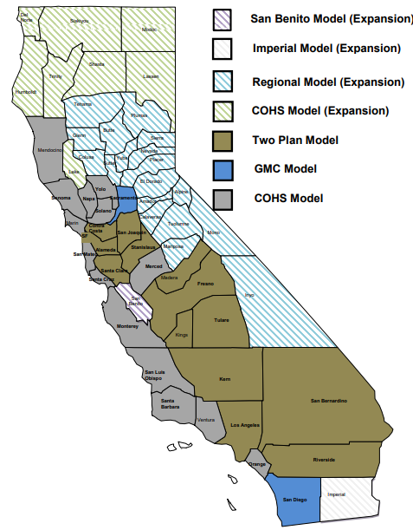
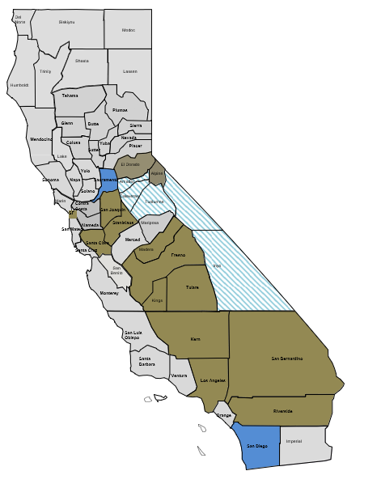


MCP Model Change
17 counties intend to change Medi-Cal Managed Care models
Current Models:
Conditionally Approved 2024 Models:*
(n=1)
(n=1)
Regional Model (n=5)
(n=18)
(n=8)
COHS and Single Plan Model (n=37)
(n=14)
(n=2)
Two Plan Model (n=14)
(n=14)
GMC Model (n=2)
* Pending plan readiness and federal authorization

Slide 9



2024 MCP Transition Policy Guide:
Expectations specific to the 2024 Transition
Purpose
Target Audience
Policy Content
The Policy Guide will contain guidance related to the January 1, 2024, transition of Medi-Cal Managed Care Plans.
The Policy Guide will function as a requirements document for MCPs’ transition activity, incorporating links to existing, applicable All Plan Letters (APLs), as well as new MCP requirements.
The Policy Guide will afford DHCS a nimble approach to respond to feasibility challenges and issues impacting members, providers, and MCPs.
MCP staff impacted by the January 1, 2024, transition, either as an exiting MCP or a new MCP will be the primary user of this Policy Guide.
The Policy Guide will also offer an organized, reference source for DHCS staff charged with monitoring and oversight of the transition.
It is envisioned that the Policy Guide would contain requirements related to the following transition topics:
  Member enrollment
  Continuity of care
  Data transfer
  Payment and program transitions
  Post-Transition Monitoring and Related Reporting Requirements
  Other topics pertinent to the transition, such as Incentive Program participation/ obligations after January 1, 2024
Out of scope: Internal DHCS policies, Operational Readiness.
DHCS released the Policy Guide in May and expects approximately quarterly updates thereafter.

Slide 10
Policy Guide Outline
DHCS anticipates including the below topics in the forthcoming Policy Guide.
Table of Contents
Updates from Prior Version
Introduction
  Context
  Purpose, Scope, Audience
Key Definitions
Member Enrollment
  Noticing
  Enrollment policies for new Medi-Cal members during transition period
  Enrollment policies for members transitioning from exiting plans
  Other Kaiser-related enrollment policies
  Other enrollment policies
Continuity of Care
  Context
  Special populations
  Continuity of Care for Providers
  Continuity of Care for Covered Services
  Continuity of Care Coordination and Management Information
  Additional Continuity of Care Protections for All Members of Exiting MCPs
Transition Policy for Enhanced Care Management (tentative for Q2 release)
Transition Policy for Community Supports (tentative for Q2 release)
Data Transfer:
  From exiting plan to DHCS
  From DHCS to receiving plans
  Plan-to-plan
Payment and Program transitions
  IPP intersection
  HHIP
  PATH
  Acute care payment responsibility
  Network development incentives / considerations
  PHM HRA timing
Post-Transition Monitoring and Related Reporting Requirements
Appendix
  General definitions
The Q2 release will indicate anticipated timeline for subsequent releases for these items
Items within these sections will be ready for release in Q2

Slide 11
Memorandum of Understanding
Amara Bahramiaref
Branch Chief,
Policy, Utilization & External Relations Branch

Slide 12



Objectives for Today’s Discussion
Overview of Memorandums of Understanding (MOUs) and timelines
Review MOUs for 2024 go-live
Review MOUs for 2025 go-live

Slide 13
MOU Requirements
The 2024 Medi-Cal Managed Care Contract (Contract) Exhibit A, Attachment III, Section 5.6. requires Managed Care Plans (MCPs) to execute MOUs with a range of entities, agencies, and programs (e.g., counties, local health departments, Regional Centers) (other party).
The Contract sets forth minimum requirements for what must be included in every MOU executed by the MCP and other party.
The MOU templates that DHCS will release will include the minimum requirements and optional terms that the MCP and other party may choose to include.
Once the MOU templates are developed, DHCS will share them with MCPs and entity stakeholders for review and feedback.

Slide 14
Base MOU Template Requirements
Every MOU template contains the following provisions as required under the Contract.
Services Covered by This MOU: Describes the services that MCP and the other party must coordinate for Members.
Party Obligations: Describes each party's provision of services and oversight responsibilities (e.g., each party must designate a day-to-day liaison to coordinate with the other party).
Training and Education: Requires MCP to provide education to Members about services available and train Network Providers, Subcontractors and Downstream Subcontractors on the MOU requirements and services provided by the other party.
Collaboration: Describes the collaboration required by the parties to ensure MOU requirements are met, such as meeting quarterly to address barriers to coordination and conducting quality improvement activities.
Referrals: Describes the process to make referrals by one party to the other as appropriate. This section also addresses Closed Loop Referrals policies and procedures required as of January 1, 2025.
Care Coordination: Describes the policies and procedures for coordinating care between the parties, addressing barriers to care coordination, and ensuring ongoing monitoring and improvement of care coordination.
Disaster Emergency Preparedness: Requires parties to have policies and procedures to ensure the continued care coordination for services in the event of a disaster or emergency.
Quality Improvement: Describes the MCP's annual reporting on quality of the care coordination, referral processes, and collaboration between the parties, including that the annual report must be submitted to DHCS and made public.
Document Retention: Requires MCP to retain all documents related to the MOU requirements for at least ten years.
Data Sharing and Confidentiality: Describes the minimum data and information that MCP must share with the other party to ensure the MOU requirements are met and describes the data and information the other party may share with MCP to improve care coordination and referral processes.
Dispute Resolution: Describes the policies and procedures for resolving disputes between the parties and the process for bringing the disputes to DHCS (and other departments as appropriate) when the parties are unable to resolve disputes.
General: Sets forth additional general contract requirements, such as that the MCP must publicly post the MOU and how notice will be provided.

Slide 15
Timeline for MOUs
DHCS plans to release an APL attaching MOU base and “bespoke” MOU templates this month.
DHCS aims to engage stakeholders for input on draft MOU templates starting in summer 2023
DHCS will hold an open comment period to obtain written feedback on draft MOUs and will hold a series of webinars for interested stakeholders

Slide 16
Status of MOU Development – 2024 Go Live
Eight MOU templates will be released in advance of January 1, 2024.
Agency/Entity Type | Program(s)
LGA/County Behavioral Health Departments | Specialty Mental Health Services
LGA/County Behavioral Health Departments | Substance Use Disorder Services
Local Health Departments | Including, without limitation, California Children’s Services (CCS), Maternal, Child and Adolescent Health (MCAH), TB Direct Observed Therapy
Local Health Departments | Women, Infant, & Children (WIC)
Regional Centers | Not Applicable
LGA | In-Home Services and Supports (IHSS)
LGA/County Social Services Department | County Social Services programs and Child Welfare
LGA | Targeted Case Management

Slide 17
MOU Development – 2025 Go Live
Eight MOU templates will be released in advance of January 1, 2025.
Agency/Entity Type
HCBS Waiver Agencies and Programs
LGA/Jails, Juvenile Facilities and Probation Departments
Continuum of Care
First 5 Programs
Area Agencies on Aging
California Caregiver Resource Centers
Local Education Agencies (LEAs)
Indian Health Services/Tribal Entities

Slide 18
Transportation Benefit:
.
Non-Medical and Non-Emergency
Medical Transportation Services
Laura Briones
Health Program Specialist II,
Managed Care Quality and Monitoring Division

Slide 19
What is Non-Emergency Medical Transportation?
NEMT is for members with a medical and physical condition who cannot be transported by ordinary means of public or private conveyance such as by Uber/Lyft, taxi, bus, private vehicle, etc.
The member must have a signed Physician Certification Statement (PCS) form authorizing NEMT by their provider in order to request an NEMT ride.
22 CCR Section 51323 outlines the four NEMT modalities:
  Ambulance services
  Litter van services
  Wheelchair van transport
  By Air

Slide 20
Transportation Providers vs. Brokers
Transportation brokers have their own network of NEMT and/or NMT providers to provide rides to members. Brokers conduct administrative activities on behalf of the MCP such as maintaining a call center for the members to request NEMT or NMT rides, scheduling, and arranging rides for members.
Transportation providers provide the ride and are required to meet the Medi-Cal enrollment requirements in order to provide the service.
MCPs are required to ensure transportation brokers and providers comply with all contractual requirements, including timely access, grievances and appeals, enrollment of NEMT or NMT providers as Medi-Cal providers, and utilization management.

Slide 21
Policies Addressing
Missed/Delayed Rides
  The transportation APL 22-008 was updated in August 2022 to include specific policies to mitigate the issues surrounding missed/delayed rides.
  Added the requirement for a transportation liaison role within the MCP to address urgent time sensitive issues when a broker/provider cannot provide a resolution for the member/provider.
  Specified in the APL that MCPs must monitor late arrival and no-show rates and ensure that NEMT and/or NMT providers arrive with 15 minutes of their scheduled appointments times.
  Added tracking and monitoring requirements to identify specific drivers based on service date, time, pick-up/drop-off location, and member name.
  Added the requirement for MCPs to impose corrective action on transportation brokers and network providers if non-compliance is identified.

Slide 22
Transportation for members in SNFs
Problem/Issue: Members residing in Skilled Nursing Facilities are experiencing transportation access issues to critical appointments such as Dialysis.
DHCS has directed MCPs to 1) identify all member residing in SNFs who are in need of dialysis 2) Ensure the members are receiving consistent and timely transportation services and have standing orders for recurring appointments so dialysis appointments are not delayed or missed 3) Ensure recurring transportation needs for SNF members are identified and arranged for.
DHCS is working closely with the MCPs and conducting ongoing monitoring of the transportation benefit to ensure MCPs are compliant with APL 22-008.

Slide 23
Focused Audits

Slide 24
Questions

Slide 25
Community Health Worker (CHW)
Frances Harville
Chief,
Policy and Housing Programs Section

Slide 26
Background
The Department of Health Care Services (DHCS) added Community Health Worker (CHW) services as a Medi-Cal benefit starting July 1, 2022.
Community Health Worker (CHW) services are preventive health services to prevent disease, disability, and other health conditions or their progression; to prolong life; and promote physical and mental health.
CHW services are considered Medically Necessary for beneficiaries:
  With one or more chronic health conditions (including behavioral health),
  Exposure to violence and trauma,
  Who are at risk for a chronic health condition or environmental health exposure,
  Who face barriers meeting their health or health-related social needs, and/or who would benefit from preventive services,
  Results of a social drivers of health screening indicating unmet health-related social needs, such as housing or food insecurity or exposure to Adverse Childhood Event.
    See DHCS CHW Manual for full list of Eligibility Criteria.

Slide 27
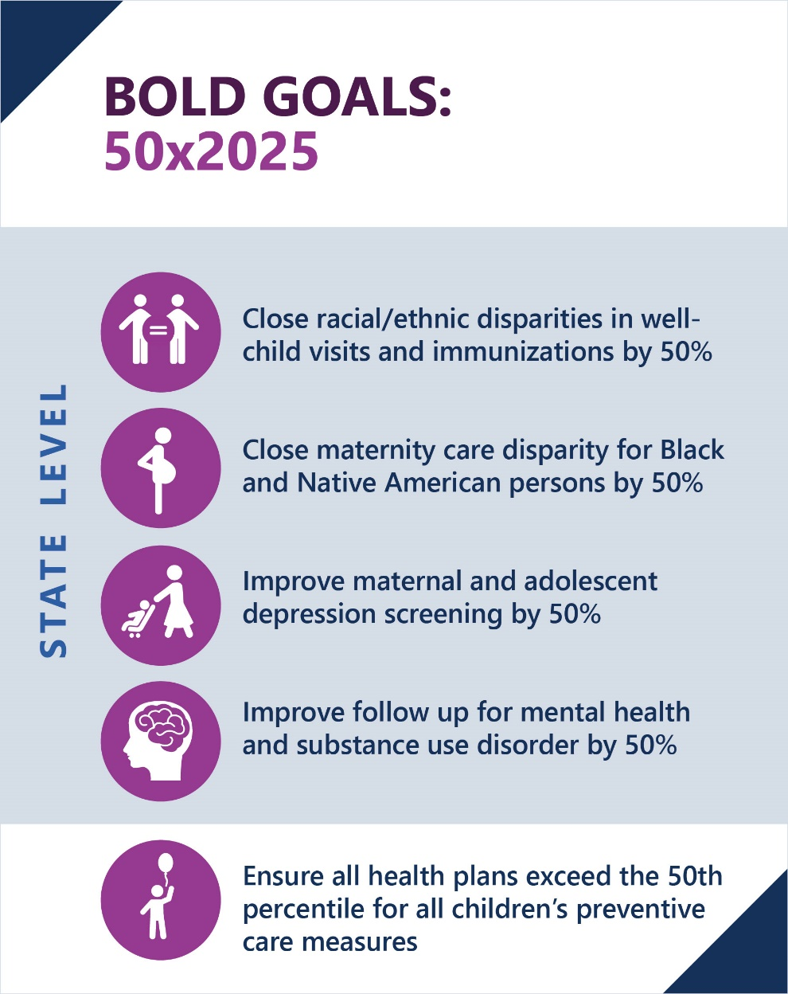
Covered CHW Services
Health education
Health navigation
Screening and assessment
Individual support or advocacy
Violence Prevention Services

Slide 28
Member Eligibility Criteria for CHW Services
CHW services require a written recommendation submitted to the MCP by a physician or other licensed practitioner of the healing arts within their scope of practice under state law.
CHW services are considered medically necessary for Members with one or more chronic health conditions:
  Including Behavioral Health or exposure to violence and trauma,
  Those who are at risk for a chronic health condition or environmental health exposure, who face barriers in meeting their health or health-related social needs,
  And/or who would benefit from preventive services.

Slide 29
CHW Provider Requirements and Qualifications
CHWs must have lived experience that aligns with and provides a connection between the CHW and the Member or population being served.
CHWs may include individuals known by a variety of job titles, including:
  Promoters,
  Community Health Representatives,
  Navigators,
  Other non-licensed public health workers, including violence prevention professionals, with the qualifications specified in the next slide.

Slide 30
CHW Provider Requirements and Qualifications
Work Experience Pathway:
At least 2000 hours working as a CHW in paid or volunteer positions within the previous three years.
May provide CHW services without a certificate of completion for a maximum period of 18 months.
A CHW must earn a certificate of completion within 18 months of the first CHW visit provided to a member.
Certificate Pathway:
CHW Certificate: A valid certificate of completion of a curriculum that attests to demonstrated skills and/or practical training relating to a CHW.
Violence Prevention Professional Certificate: For individuals providing CHW violence prevention services only.

Slide 31
Supervising Provider
Ensures that CHWs meet the qualifications, oversees CHWs and the services delivered, and submits claims for services provided by CHWs.
Supervising Providers must maintain evidence of this experience.
Qualified Supervising Providers are enrolled Medi-Cal providers and include:
  Individual licensed Providers
  Hospitals
  Outpatient clinic
  Local Health Jurisdiction (LHJ)
  Community-Based Organization (CBO)

Slide 32
Plan of Care
For members who need multiple ongoing CHW services or continued CHW services after 12 units of services as defined in the Medi-Cal Provider Manual.
Written document developed by one or more licensed providers describing CHW-provided supports and to address ongoing needs for a beneficiary.
The Provider ordering the plan of care does not need to be the same Provider who initially recommended CHW services or the Supervising Provider for CHW services.
Plan of care may not exceed a period of one year.
CHWs may participate in the development of the plan of care and may take a lead role in drafting the plan of care if done in collaboration with the Member’s care team and/or other Providers referenced in this section.

Slide 33
CHW Contracting
As part of their Network composition, MCPs must ensure and monitor sufficient Provider Networks within their service areas, including for CHW services.
DHCS strongly encourages MCPs to contract with organizations that include CHWs including:
  Local public health departments
  CBOs including those working with specific populations of focus through ECM or Community Support providers (to the extent there is no duplication of services/payment)
  Community based Providers with imbedded CHWs

Slide 34
Resources
DHCS recommends MCPs review and utilize the resources provided by the California Health Care Foundation.

Slide 35
Summary of Population Health Management (PHM) Readiness
Deliverable Submissions
DHCS Review Findings, Question 20
December 2022

Slide 36
Intersection with Enhanced Care Management (ECM) and Community Supports (CS) (b)
Contracting with organizations with CHWs on staff to serve as ECM and/or CS Providers.
Ensuring non-duplication between payment for ECM/Community Supports and the new CHW benefit.
Responses:
All attested they contract with CS Providers who have CHW staff serving members, all but one attested the same for their ECM Provider network.
Provide out to CHW Providers.
Provide education to Providers on guidelines for CHW’s scope of benefits and non-duplication services.
Majority of non-duplication strategy: claims utilization review.
Innovative approaches to avoid non-duplication: automation in utilization software, Member intake screening protocol, routine executive CHW utilization review.

Slide 37
Building Provider Networks for the CHW Benefit (c)
Whether the MCP has any CHWs on staff and what tasks they perform.
MCP’s strategies for recruiting and growing the CHW provider network.
MCP’s referral pathways to CHW services, including how the MCP ensures Closed Loop Referrals.
Responses:
  CHWs are identifying, locating and navigating community and medical services, accompanying members to medical appointments, and assisting in completing forms and applications to access services.
  MCPs providing outreach and support to educate members about covered services, need for preventive care, self-management, and access to other services such as Community Supports, ECM and other community resources.
  “Close the loop” by tracking the progress of the referral, conducting follow-up calls to the member to verify member received the help they needed and provide additional connections to community resources.

Slide 38
CHW Benefit Outreach & Education on CHW Scope of Practice, Benefit, and Services Availability for Providers and Members (d)+(e)
Member communication strategy and tools in culturally and linguistically appropriate manner to inform members how to utilize CHW services.
Provider training on CHW scope of practice, care team integration , and Member referral processes for CHW services.
Responses:
  Providing information via Member’s handbook, Member’s websites.
  Disseminate marketing information in communities, settings, and situations where our members live and seek services.
  Identify members who may benefit from these services and identify how to direct members to these services.
  Develop provider training inclusive of the CHW scope of practice, integration, and referral process.

Slide 39
Bright Spots: Workforce Development
MCPs attested they are already working with, or plan to work with, State/local agencies, colleges and CBOs to provide CHW training.
MCPs stated they already directly hire or contract with CHWs or intend to train CHW-like staff to attain CHW certification.

Slide 40
Bright Spots: Access to Care Facilitation
Some MCPs are indicating leveraging place-based data to focus efforts in underserved and communities: Healthy Places Index, “Heat Maps”, zip codes, stratifications informed by CQS Bold Goals.
Various MCPs indicate current or future PHM strategy includes embedding CHWs into acute and primary care settings, street teams, and other community catchment areas to support referral linkage.
Many MCPs indicate current or planned use of FindHelp.org, 211, or similar external resource registry to promote CHW integration and/or referrals.

Slide 41
Looking Ahead
CHW Provider Networks
MCP Support

Slide 42
References
All Plan Letter (APL) 22-016
Readiness Deliverable

Slide 43
Questions

Slide 44
Overview of CalAIM Population Health Management (PHM), Enhanced Care Management (ECM), and Preventive Services Report
Quality and Population Health Management

Slide 45
Agenda
Population Health Management (PHM)
PHM Monitoring
Transitional Care Services
Population Needs Assessment
PHM Service and Risk Stratification, Segmentation and Tiering
Enhanced Care Management (ECM)
ECM Overview
Children and Youth Population of Focus
Q&A
Preventive Services Report
15 min
15 min
15 min

Slide 46
Population Health Management

Slide 47
PHM Program Overview
DHCS has established a cohesive, statewide approach to Population Health Management (PHM) through which managed care plans (MCPs) and their networks and partners are responsive to individual member needs within the communities they serve. PHM also sets forth a common framework and set of expectations for MCPs.
Managed care plans must have a whole person-centered PHM program that identifies and addresses members’ preventive, physical, behavioral health, and social needs.
Several of the key elements of PHM were already in place in the Medi-Cal program through both Department of Health Care Services (DHCS) policies and MCPs’ own programs.
PHM is a journey rather than a destination. Over time, the program will evolve to support more integration across delivery systems, moving beyond the current MCP requirements.

Slide 48
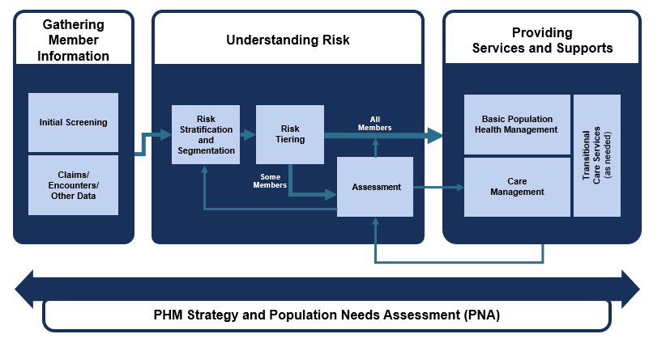
PHM Program Framework
Today: Progress Update on Risk Stratification and Segmentation Working Group
Today: Enhanced Care Management
Today: Update on Population Needs Assessment Redesign
Next: Population Health Management Program Evaluation
Population Health Management Strategy and Roadmap (ca.gov)

Slide 49
PHM Program Monitoring Approach for MCPs
The purpose of DHCS’s PHM Program monitoring approach is to assess the implementation and effectiveness of each MCP's PHM Program.
MCPs should be responsive to individual member needs within the communities they serve—
inclusive of preventive, physical, behavioral health, and social needs.
Monitoring Approach
Quality Measures
Existing Reporting (ECM, IPP)
New Key Performance Indicators
Through these metrics, DHCS will be able to track:
PHM Program implementation, operations and effectiveness measured at the plan level;
Gaps for additional DHCS guidance or clarifications;
PHM Program impact on outcomes over time; and
Priority issue areas that require DHCS follow-up with MCPs.
CalAIM: Population Health Management (PHM) Policy Guide
ECM = Enhanced Care Management, IPP = Incentive Payment Program

Slide 50

PHM Program Monitoring Approach for MCPs
DHCS’s goal for the PHM monitoring process is to gain a holistic perspective on PHM Program implementation at each MCP. The monitoring approach will be organized into domains.
Domains | Categories
PHM Program Areas/Themes | Basic Population Health Management (BPHM)
 | Prevention Services
 | Primary Care Engagement/ Appropriate Utilization
 | Chronic Disease Management
 | CHW Integration
 | Risk Stratification Segmentation and Tiering (RSST)
 | Complex Care Management (CCM)
 | Enhanced Care Management (ECM)
 | Transitional Care Services (TCS)
Populations | Children and Youth
 | Birthing Populations
 | Individuals with Behavioral Health Needs
Cross Cutting | Equity (include all stratified measures)
Quarterly submission by MCPs for Plan-focused performance.
Stratified by age, race, ethnicity, language.
Launching soon!
First submission 8/15/23
Initial focus: Understanding landscape
DHCS discussions with “outliers” in performance.
CalAIM: Population Health Management (PHM) Policy Guide, starting pg. 33
New Key Performance Measure

Slide 51
Reminder: Overview of Transitional Care Services
Care Transitions Definition:
When a member transfers from one setting or level of care to another, including but not limited to, discharges from hospitals, institutions, other acute care facilities, and skilled nursing facilities to home or community-based settings, Community Supports, post-acute care facilities, or long-term care settings.
Goals for Transitional Care
Members can transition to the least restrictive level of care that meets their needs and is aligned with their preferences in a timely manner without interruptions in care.
Members receive the needed support and coordination to have a safe and secure transition with the least burden on the Member as possible.
Members continue to have the needed support and connections to services that make them successful in their new environment.

Slide 52



Reminder: MCP PHM Requirements on
Transitional Care Services
Knowing When Member is Admitted/
Discharged/Transferred (A/D/T)
Processing Prior Authorizations
In a Timely Manner
MCP Responsibilities
Assigning/ Notifying Care Manager
Discharge Risk Assessment:
Coordination with Discharging facility
Information Sharing/Discharge Planning Document
Shared with patient, PCP, and other providers
Care Manager Responsibilities (function may live at provider level)
Follow Up
Follow-up Doctor Appointments/ Medication Reconciliation / Referrals
End Services/ Assessment for Further Care Management or other needs (ECM/CCM/CS)

Slide 53
Reminder: Phased Transitional Care Implementation
While Transitional Care Services requirements are only fully implemented for high-risk members in 2023, MCPs should be working to establish ADT feeds with all facilities¹ and ramping up to serve all members undergoing a transition by Jan. 2024.²
Formal Guidance on Phased Implementation of Transitional Care Services | Draft Policy Recommendation for Discussion: DHCS to issue formal guidance phasing implementation of transitional care services
By 1/1/23 | MCPs must ensure all transitional care services are complete (including having a care manager/single point of contact) for all high-risk members as defined in the PHM Policy Guide. MCPs must implement timely prior authorizations and know when members are admitted, discharged or transferred for all members. MCPs must develop and execute a plan to ramp up transitional care services. The plan must address how the MCPs will meet the timeline and requirements.
By 1/1/24 | MCPs are required to ensure all transitional care services are complete for all members. As noted in the PHM Policy Guide, MCPs are strongly encouraged to contract with hospitals, Accountable Care Organizations, PCP groups, or other entities to provide transitional care services, particularly for lower- and medium-rising- risk members.
1. Include participating hospitals and SNFs based on the soon to be released CalHHS Data Exchange Framework requirements.
2. Per the PHM policy guide: For dual-eligible individuals enrolled in Dual-Eligible Special Needs Plans (D-SNPs) the D-SNP is responsible for TCS and the MCP is not responsible for assigning a care manager or ensuring the care manager tasks are complete. For all other dual-eligible member, MCPs are responsible per guidance.

Slide 54






Re-imagining the Population Needs Assessment (PNA)
To support the success of the PHM Program, DHCS is re-designing MCP requirements for developing a PNA (which historically has been the mechanism that MCPs use to identify the priority health and social needs of their members, including health disparities).
Vision for the modified PNA:
Promote deeper understanding of member needs, particularly social drivers of health (SDOH)
Advance upstream interventions that look beyond the four walls of health care
Deepen relationships between MCPs, public health and other local stakeholders
Reduce community fatigue
Strengthen a focus on equity by integrating more diverse sources of data
Support public health’s response to emerging trends, especially in areas where MCPs can intervene by providing coverage, education, and outreach
To achieve this vision, DHCS proposes a central requirement for MCPs to collaborate
with Local Health Departments (LHDs).

Slide 55
The Modified PNA: Proposed Approach
DHCS proposes that starting in 2024, MCPs will fulfill their PNA requirement to DHCS by participating meaningfully in the collaborative Community Health Assessment processes already led by county LHDs.
The proposed MCP CHA/CHIP participation requirement will apply wherever MCPs serve members.
  Where multiple MCPs serve the Medi-Cal population in a single county, all MCPs will be expected to participate in the single LHD CHA/CHIP process for that county.
  When an MCP has contracts in several counties, that MCP will participate in LHD CHA/CHIP processes for each county it serves.
Meaningful MCP participation could entail:
  Providing MCP data on a de-identified basis.
  Participating or leading the CHA/CHIP steering committee/decision-making body.
  Participating in or leading one or more CHA/CHIP work groups.
  Exploring how to meaningfully engage with tribal partners in CHA/CHIP processes via MCP tribal liaisons.
  Providing staff support to core activities.
  Providing funding to support convenings, project management, and/or analytics.
  Collaborating with LHDs and other local leadership to develop joint action plans to address public health issues.

Slide 56

Next Steps/Upcoming Guidance
May:
  Concept paper detailing proposed approach for the modified PNA. See below for more details.
  A new, high-level All Plan Letter (APL) to provide near term guidance to MCPs on the modified PNA and PHM Strategy (will be superseded by former PNA APL-19-011).
By end of 2023, more detailed guidance will be issued in the PHM Policy Guide.
DHCS will accept comments on the PNA concept paper through end of day, June 2, 2023. Please email your comments to PHMSection@dhcs.ca.gov with subject line “Comments on the PNA Concept Paper”.

Slide 57





Population Health Management Service
The Population Health Management Service is a part of the overall Population Health Management Program.
PHM Program
A core part of the CalAIM initiative that requires Medi-Cal delivery systems to develop and maintain a whole system, person-centered PHM program.
PHM Service
Supports DHCS’s PHM vision by integrating data from disparate sources, performing population health functions, and allowing for multi- party data access and sharing.
Delayed!
TIMELINE
1/1/23 launch
Timeline TBD

Slide 58
Risk Stratification, Segmentation, and Tiering
“Risk stratification, segmentation, and tiering” (RSST) is a process of using data to predict a person’s risk of harm or a bad outcome.
  By identifying members at moderate/rising or high risk, Health Plans can perform assessments to offer services and supports to keep them as healthy as possible.
DHCS is developing a state-wide risk stratification methodology:
  Looks beyond “medical” risks and outcomes, such as emergency department use.
  Seeks to consider behavioral health and social needs, as well as address data gaps and potential bias.
Two groups working on this effort
RSST Work Group | RSST Scientific Advisory Council
Goal to create a state-wide, transparent, standardized scoring mechanism and risk tiers. | Goal to provide input and feedback from multiple stakeholder perspectives to the RSST Work Group.

Slide 59
Enhanced Care Management (ECM)
Children & Youth Populations of Focus (POF) Launch Updates

Slide 60
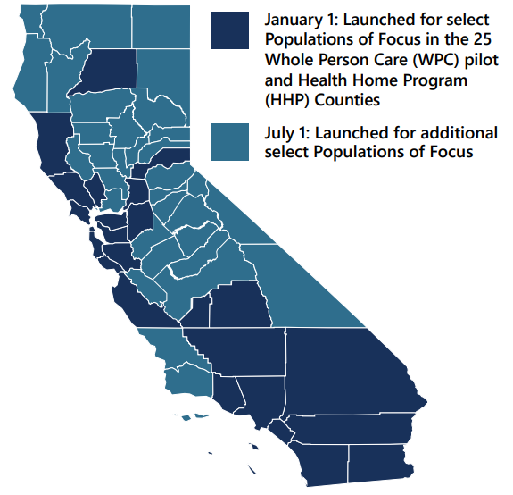
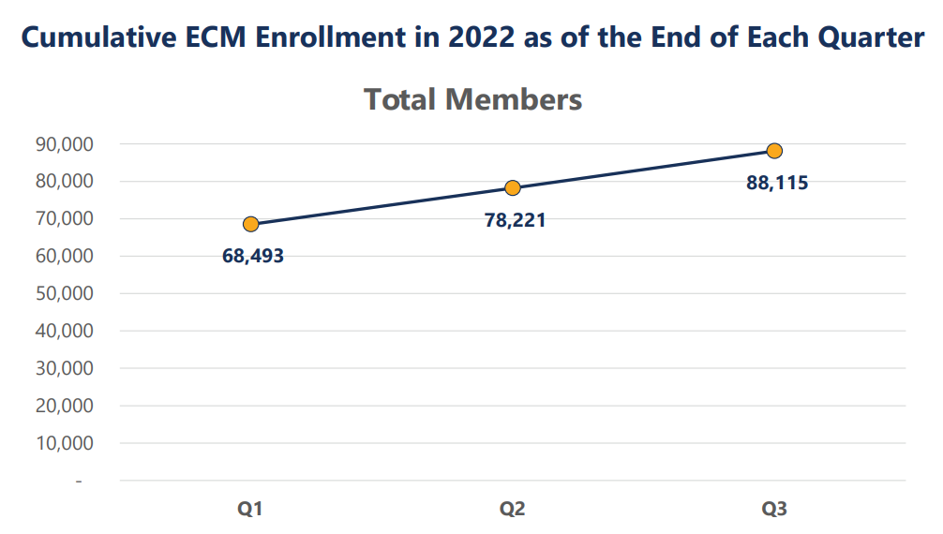
ECM Implementation Data:
January - September 2022
ECM Expanded Statewide in 2022
88k total members were enrolled in ECM in January through September 2022.
Cumulative ECM Providers to Date
March 2022 | June 2022 | September 2022
692 | 759 | 956
For details, see Updated Implementation Data for ECM and Community Supports (Q1-Q3 2022). All figures subject to adjustment upon MCP resubmission.

Slide 61
ECM within Levels of Care Management in Medi-Cal Managed Care
level of need/risk
Enhanced Care Management
Complex Care Management
Basic Population Health Management
Intended for highest risk members who need long-term coordination for multiple chronic conditions, social determinants of health issues, and utilization of multiple service types and delivery systems.
Intended for high-risk members who need coordination of services for complex conditions or episodic need.
Intended for members who require support with planning and coordination that is not at the highest level of complexity, intensity, or duration.

Slide 62
ECM for Children and Youth Launches on 7/1/2023
Throughout 2022, DHCS gathered feedback from key stakeholders, including Advisory Groups, Plans, and Public Health Provider Representatives on the design of ECM for children and youth.
Launch milestones for the Children and Youth Populations of Focus
October 2022
PHM Readiness Deliverable
MCP Submission. DHCS review & approval. Deliverable elements inclusive of ECM generally
December 2022
Updated ECM Policy Guide
Released with finalized Children and Youth POF definitions and guidance
February 2023
Model of Care submissions with revised Policies & Procedures
Details MCP plans for operationalizing ECM for Children and Youth
April 2023
ECM Provider Network submissions
Early indication of MCP contracting efforts with Providers to serve the Children and Youth POFs
June 2023
Expected approvals by DHCS of all Policies & Procedures / Provider Networks
July 2023
ECM Children and Youth POFs Launch

Slide 63
ECM for Children and Youth Implementation Readiness Themes
Both the MOC reviews and ongoing conversations with providers, counties
and other stakeholders reveal implementation barriers in three interrelated areas:
1. Overlaps with Existing Programs serving Children/Youth
2. Provider Networks to Serve the Diverse Needs of Children/Youth
3. Identification and Referral Pipeline to ECM for Children/Youth

Slide 64
Bright Spots & Innovations Identified in MOC Reviews
MCP group coordination for network growth activities
ECM training programs to develop new qualified Providers
Data sharing agreements w/ county programs when unable to contract
Mapping/Data-informed outreach methods
Using IPP funds to expand/support ECM
Standardized Provider Interest Forms

Slide 65
Preventive Services Report (PSR)

Slide 66
Background Summary
The 2021 Preventive Services Report (PSR) presents statewide and regional results for a total of 19 indicators that assess utilization of preventive services by MCMC (Medi-Cal Managed Care program) children and adolescents during measurement year 2020, and includes regional and demographic trends, findings, and recommendations.
DHCS requested that Health Services Advisory Group, Inc. (HSAG) produce an annual Preventive Services Report beginning in 2020; to analyze child and adolescent performance measures.
Data was captured from 25 full scope MCPs (Manage Care health Plans) for measurement year (MY) 2020.
the Preventive Services Report is an additional tool that DHCS can use to identify and monitor appropriate utilization of preventive services for children in MCMC.

Slide 67
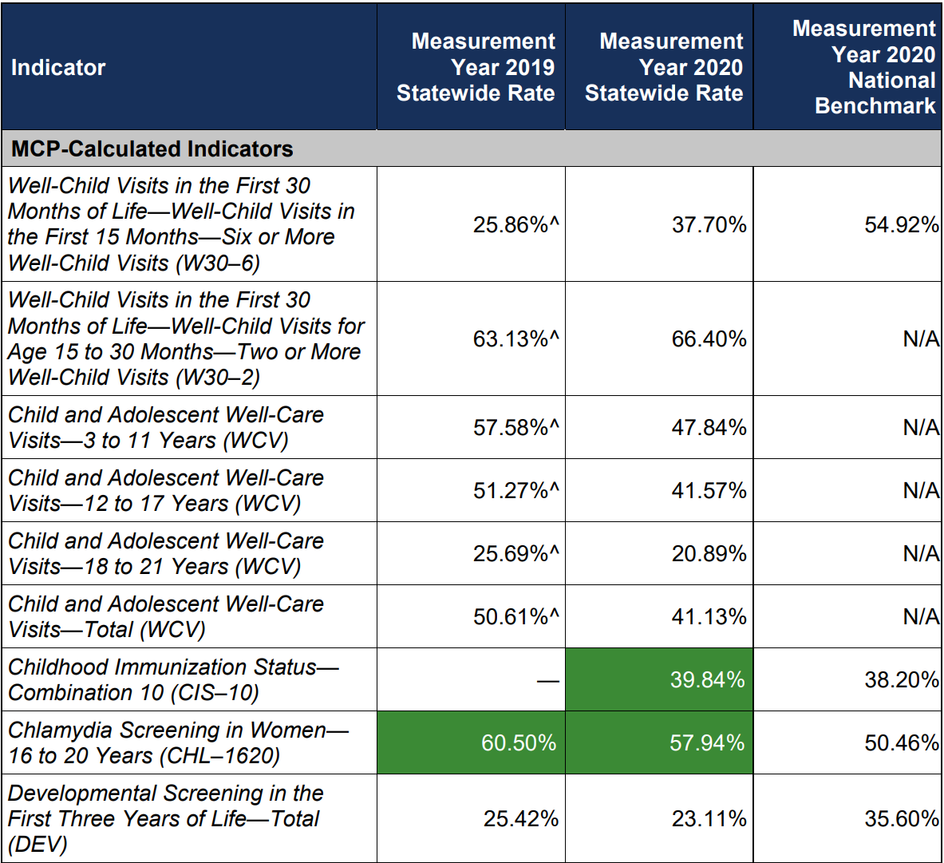
PSR Measures
PSR Measures

Slide 68
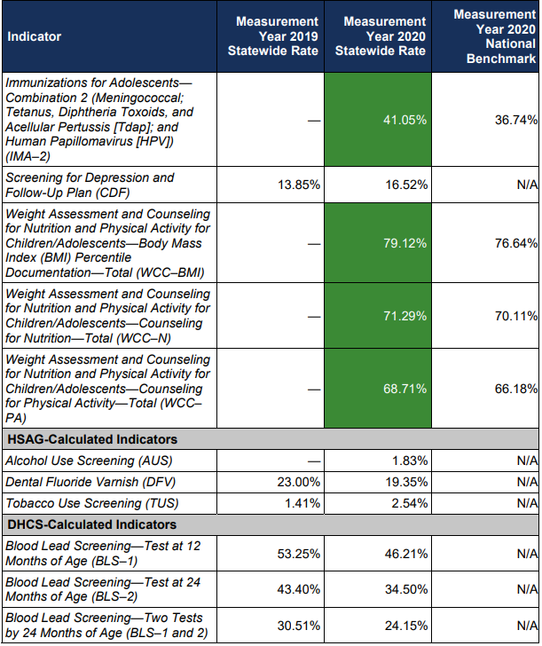
PSR Measures Cont.
PSR Measures Cont.

Slide 69
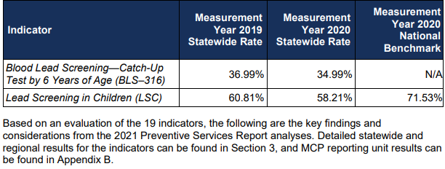
PSR Measures Cont.

Slide 70
Key Finding 1
Performance for measurement year 2020 declined from measurement year 2019; however, exceeded national benchmarks 2020.
  A majority of the measures for Well-Child visits and blood lead screenings decreased.
Conclusion & Considerations:
  DHCS continues to make progress on the outreach activities.
  California Advancing and Innovating Medi-Cal (CalAIM) will work with MCP to keep members healthy by focusing on preventative and wellness services.

Slide 71
Key Finding 2: Performance is Regional
Counties in the Central and Sacramento Valley and Southern California regions demonstrated more favorable performance for measurement year 2020.
Performance in the North and Far North regions continues demonstrate opportunities for improvement.
Conclusion & Considerations:
  MCPs operating in lower-performing rural counties should consider expanding the use of telehealth visits, where appropriate, and assess ways to expand the managed care provider networks to improve performance.

Slide 72
Key Finding 3
Statewide performance varies based on race/ethnicity and primary language.
Nine of 19 (47.37 percent) indicator rates for the Asian racial/ethnic group and eight of 19 (42.11 percent) indicator rates for the Hispanic or Latino racial/ethnic group were above the statewide aggregate by more than a 10 percent relative difference.
For measurement year 2020, all 19 indicator rates for the American Indian or Alaska Native racial/ethnic group were below the statewide aggregate by more than a 10 percent relative difference. For Black or African American, White, and Native Hawaiian or Other Pacific Islander racial/ethnic groups, respectively, 17, 13, and 12 indicator rates were below the statewide aggregate by more than a 10 percent relative difference.

Slide 73
Key Finding 3 Cont.
Majority rates for Chinese, Farsi, Hmong, Spanish, and Vietnamese primary language groups were higher than the statewide aggregate by more than a 10 percent relative difference.
Rates for the Armenian and Russian primary language groups were lower than the statewide aggregate by more than a 10 percent relative difference.
Conclusion & Consideration:
  MCPs have opportunities to use this information to address lower rates in their population needs assessment (PNA) process.
  MCPs should leverage information from the Preventive Services Report to assist in their PIP processes.
  MCPs should leverage information from the Preventive Services Report to assist in their PIP processes for addressing health disparities.

Slide 74
Key Finding 4
Overall performance across California’s six largest counties (Los Angeles, San Bernardino, Riverside, San Diego, Orange, and Sacramento counties) is high for a majority for indicators and account for approximately 59 percent of the pediatric MCMC population.
Conclusion & Consideration:
  Implementing efforts to improve Well-Child visits within the six largest counties, may contribute to substantial improvement for California overall.
  DHCS continues to make progress on the outreach activities to encourage utilization of preventive services for children under age 21 but should continue to monitor the impacts of COVID-19 on Well-Child visits and blood lead screenings for measurement year 2021.

Slide 75
Key Finding 5
Less than half of younger children receive Well-Child visits but receive immunizations and counseling for nutrition/physical activity at higher rates than seen nationality.
Conclusion & Considerations:
  MCPs should continue to ensure children and adolescents receive all their necessary Well-Child visits, especially for children 15 months and younger. Well-Child visits are an opportunity for parents to
  MCPs should leverage best practices shared through the CMS Infant Well-Child Visit learning collaborative group on improving rates of infant Well-Child visits during the first 30 months of life.
  MCPs should continue to educate providers on the importance of administering comprehensive preventive care during these visits, including the administration of vaccines, provision of developmental screenings, and application of dental fluoride in a clinical setting by a primary care provider (PCP).

Slide 76
Key Finding 6
Adolescent rates for well care visits are lower than rates for younger children, but adolescents do receive immunizations at higher rates then seen nationally.
Conclusion & Considerations:
  Opportunities exist to improve the provision of critical adolescent screenings (i.e., screenings for depression and alcohol and tobacco use) in adolescents ages 11 to 21 years during comprehensive well-care visits with PCPs and obstetricians/gynecologists (OB/GYNs).
  MCPs should leverage information from the Preventive Services Report to assist in their PIP processes.

Slide 77
Key Finding 7
Over half of MCMC children receive a blood lead screening by their second birthday, but MCMC children received blood lead screenings at lower rates than seen nationally.
Conclusion & Considerations:
  DHCS continues to make progress on the outreach activities to encourage utilization of preventive services for children under age 21 and MCPs should continue their efforts to provide educational materials and make calls to parents/guardians of MCMC children to help them understand the services, including available preventive care.

Slide 78
Key Finding 8
Decline in performance from measurement year 2019 to measurement year 2020 impacts all racial/ethnic groups.
From measurement year 2019 to measurement year 2020, rates for the following indicators declined by more than a 10 percent relative difference for at least six of eight (75.00 percent) racial/ethnic groups:
  Blood Lead Screening—Test at 12 Months of Age
  Blood Lead Screening—Test at 24 Months of Age
  Blood Lead Screening—Two Tests by 24 Months of Age
  Dental Fluoride Varnish
  Child and Adolescent Well-Care Visits—Total

Slide 79
Key Finding 8 Cont.
Conclusion & Consideration:
  While all racial/ethnic groups had rate declines across the majority of indicators, likely due to COVID-19, Well-Child visits, dental services, and blood lead screenings were most impacted.
  DHCS should continue to evaluate the impacts of COVID-19 on Preventive Services utilization among racial/ethnic groups and utilize this information to target quality improvement and outreach efforts to communities most impacted.

Slide 80
Questions

Slide 81
Open Discussion
If you have questions or comments, or would like to request future agenda items, please email:
advisorygroup@dhcs.ca.gov.

Slide 82
Thank you

