Slide 1
Identifying Potential Target Populations: High-Cost Homeless Beneficiaries
Sharon Rapport,
Associate Director, California Policy, CSH
December 16, 2014

Slide 2
What to Fund: Evidence on Effective Models, Core Components of Models, Gaps in Funding
Sharon Rapport,
Associate Director, California Policy, CSH
December 16, 2014

Slide 3
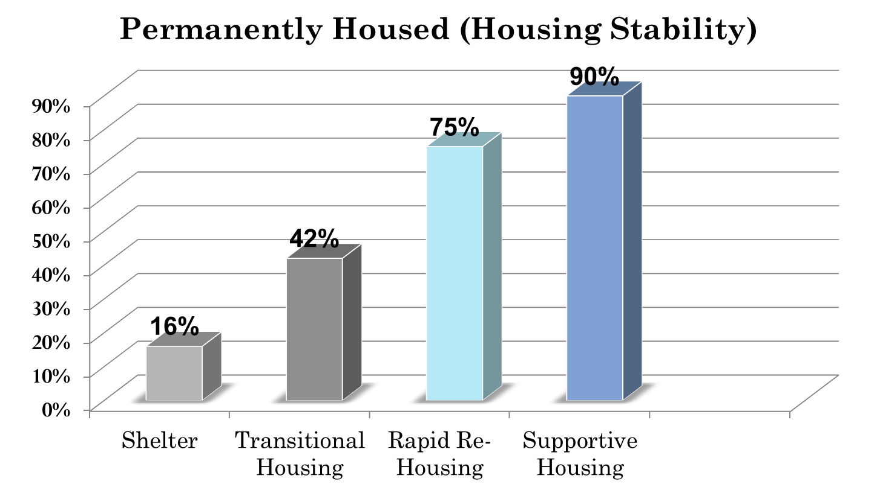
What Works: Housing for Homeless People

Slide 4
Core Components: CMS Recognize as Fair Housing Compliant (Housing First)
Core Components of Housing
Provider-Owned Housing
A
A
A
Integrated w/Others in Community
Options for Beneficiary
Privacy
Independence in Choices
No Coercion
Choice in Services
Has Own Lease/Rental Agreement
Privacy (lockable unit, choice of roommates)
Controls Own Schedule
Visitors at Any Time
Accessibility for People w/Disabilities

Slide 5
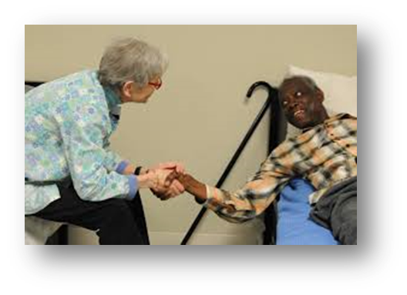

Bridge Housing/Respite Care
Bridge Subsidies: short to medium term rental payments
Respite/Recuperative Care
Bridge Subsidy
Long-term subsidy
Notes:
In deciding the type of housing to be funded, also need to consider bridge housing subsidies and payments for operating and services costs in respite or recuperative care.

Slide 6
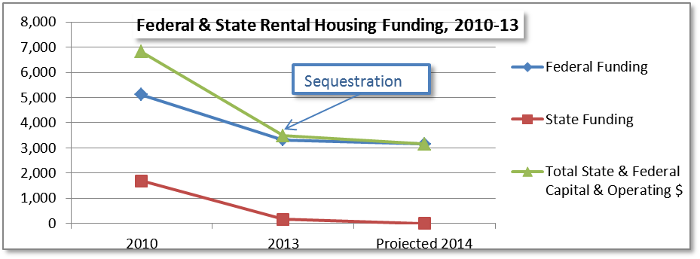
Gaps in Funding: Rental Housing in California
Notes:
CA has seen a 40% loss in federal funding, and a 90% loss in state funding for affordable rental homes over the last 3 years—trend is getting worse, not better, for foreseeable future

Slide 7
Gaps in Funding: Housing Not an Entitlement

Slide 8
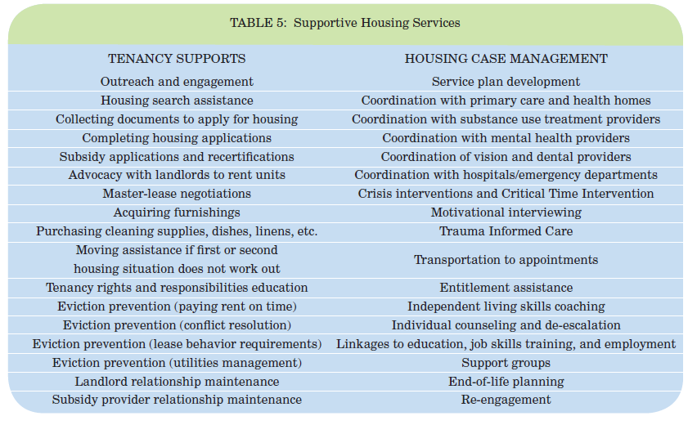
What Works: Services for Homeless People in Supportive Housing

Slide 9
Core Components: Services in Supportive Housing
Housing-Based
Delivered in Housing
Housing Retention
Face-to-Face & Frequent
Low Ratios of Case Managers to Clients (1:20)
Intensive Services Decrease Over Time, Increase During Crises or Relapse
Outreach & Engagement
To Locate Beneficiary
To Form Trusting Relationships
Housing Not Contingent on Participation

Slide 10
Gaps in Funding: Services
Homeless People with Serious Mental Illness
Rehabilitation Option & Mental Health Services Act:
Billing for Rehab Option on per-minute basis (high admin. costs)
No outreach or engagement
SMI only
People with Substance Use Disorders
Block Grant & Drug Medi-Cal:
Ltd, mostly delivered in licensed facilities
Inadequate resources & providers
People w/o Behavioral Health Conditions
No current Medi-Cal funding for services outside of behavioral health systems.

Slide 11
Factors of Eligibility
Sharon Rapport,
Associate Director, California Policy, CSH
December 16, 2014

Slide 12
Factors
Return on Investment: Costs of Housing & Services, Costs Avoided
Need for Housing Stability to Improve Health Outcomes
Health Conditions That Warrant Housing & Housing-Based Services
Systems Costs: Risk of Institutionalized Care

Slide 13
Housing Stability Improves Health Conditions for People Experiencing . . .
Chronic Homelessness
Homelessness & Combination of Conditions
Homelessness & History of Institutionalization (jail/prison, hospitalization, residential treatment)
Discharge from Institutional Setting & Recent/Repeated History of Homelessness

Slide 14
Combination of Factors Drive Costs: Data
Common Risk Factors for High-Costs: | Homelessness + Admission to Hospitals Over Last 3 Years + Common Conditions/Combinations of Conditions: Mental Illness (esp. psychoses) Substance Use HTN Cardiovascular Conditions (dysrhythmias) Respiratory Conditions Liver Disease OR Homelessness + Specific High-Risk Conditions: HIV, Cirrhosis, Drug-Induced Mental Illness or Neurological Conditions

Slide 15
Costs of Housing
Operating: Based on HUD Fair Market Rent
$687-857/month
Operating + Capital: Based on $260,000 Development Costs, Affordable for 55 Years
$1,165/month

Slide 16
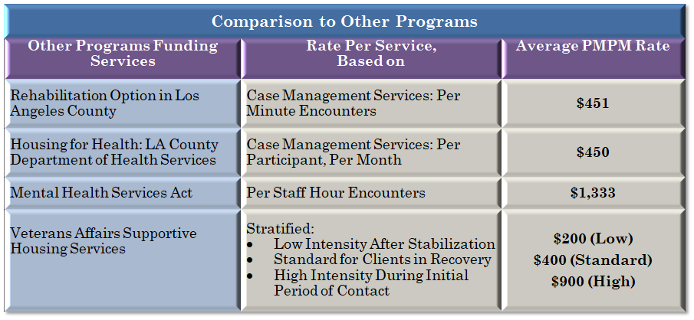
Costs of Services
Homeless & High Acuity Needs | $532
Low-Acuity Needs or Receiving Other Benefits | $266

Slide 17
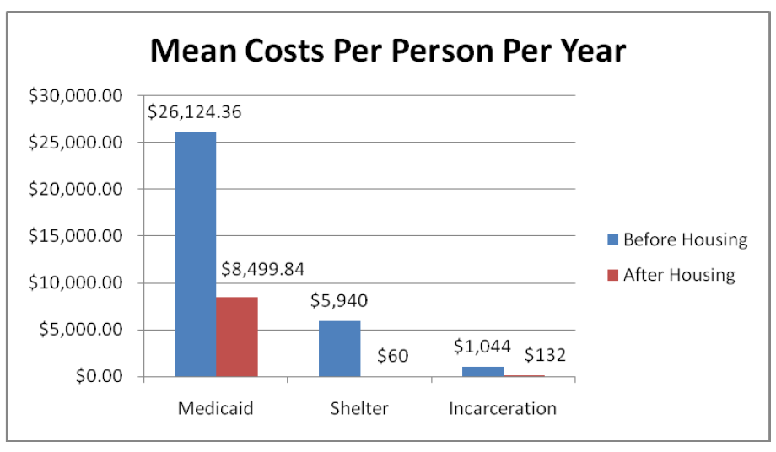
Evidence of Costs Avoided: in Massachusetts: Chronically Homeless Beneficiaries

Slide 18
Costs of People Experiencing Homelessness
Boston Rough Sleepers: 119 People Over 5 Years
Dennis Culhane Cost Study: Data Match on 4,679 People in New York

Slide 19
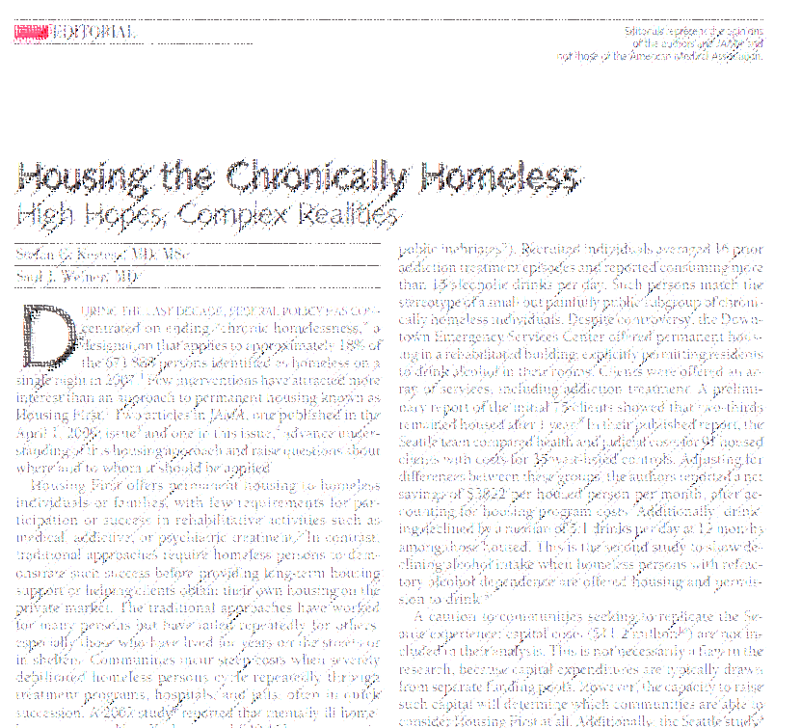

Cost Savings
Costs Avoided Among People Experiencing Chronic Homelessness:
All chronically homeless people (Chicago control-group study):
  $9,790/year in health cost reductions (not including costs of housing)
High-cost chronically homeless people with severe alcohol use (Seattle study):
  $45,864/year in health cost reductions (not including costs of housing)

Slide 20
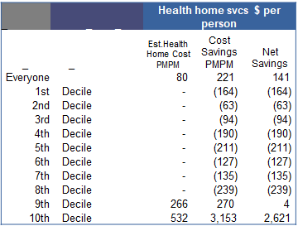
.
10% of Highest-Cost Homeless People Were Extremely Expensive
Source: 2,907 homeless GR recipients in LA County. Reported in Crisis Indicator, Economic Roundtable.
Average Monthly Costs in All Months by Decile for Homeless GR Recipients
Monthly costs of $6,529 → Annual cost: $78,348
Hospitals: $3,452 per month annual cost: $41,424
More with jail medical & mental health.
LA County CEO office’s Service Integration Branch (SIB) linked service and cost records across county departments for a representative sample of General Relief (GR) recipients to produce this exceptionally valuable data

Slide 21
Financial Modeling of Housing & Services
Sharon Rapport,
Associate Director, California Policy, CSH
December 16, 2014

Slide 22
Potential Eligibility Criteria
Services
Chronically Homeless People
Supportive Housing Residents
Housing & Services
Homeless & Likely to Incur High Costs:
Leaving Institutional Settings & Homeless Upon Admission
Homeless & Co-Morbidities
Admission to Hospital in Last 2-3 Years + Conditions Common to High-Cost Populations
Specific High-Risk Conditions
Tri-Morbidities

Slide 23



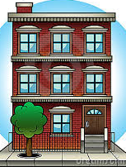

Numbers: Homeless & Formerly Homeless Californians Needing Housing & Services
People Experiencing Homelessness on a Single Night/During Year:
113,952/
~250,000
Chronically Homeless People: Single Night/
During Year:
28,200/
~63,000
Units of Permanent Supportive Housing, Dedicated to Chronically Homeless People:
12,835
(+ 2,550/year in potential turn-over PSH units)
Permanent* Supportive Housing Units in California:
28,335
*Permanent housing unit: no limitation on length of stay in the unit.

Slide 24
Financial Model for Services
Number of People Served: Chronically Homeless Californians + Supportive Housing Residents | 41,035
Number of People Served: Other Homeless People Who Need Services (Leaving Institutional Settings/Co-Morbidities) | ~20,000
Monthly Medicaid Costs Avoided | $816
Monthly Costs of Services | $266-$532
Monthly Costs for All Beneficiaries | ~$24,000,000-32,000,000
Net Monthly Savings for Chronically Homeless Beneficiaries | $284
Net Monthly Savings for Chronically Homeless Beneficiaries | $11,653,940
Return on Investment | 35%

Slide 25
Financial Model for Housing & Services
Number of People Served: 20% Highest-Cost Homeless Californians 30% Highest-Cost Homeless Californians | 22,790 34,186
Average Monthly Medicaid Costs Avoided 20% Highest-Cost 30% Highest-Cost (averaged costs among top 30%) | $1,712 $1,473
Monthly Costs of Housing & Services With Capital & Operating Costs Highest-Cost 20% Highest-Cost 30%/Other Servs. $ ($266 servs.) With Operating Costs Only | $1,697 $1,431 $1,304
Net Monthly Savings (with only operating) 20% Highest-Cost 30% Highest-Cost (assuming same servs. costs) | $408 $169
Net Monthly Savings for All Beneficiaries (highest 20%) | $9,298,320

Slide 26
Sharon.Rapport@csh.org
(323) 243-7424 (c)
(213) 623-4342, x18 (o)
\

