Slide 1

California’s 1115 Waiver Renewal: Demographics and Workforce Projections
Sunita Mutha, MD, Joanne Spetz, PhD,
Janet Coffman, PhD, and Margaret Fix, MPH
Center for the Health Professions at UCSF
December 11, 2014

Slide 2
Population Projections

Slide 3
Overall Demographic Projections
Source: California Department of Finance Demographic Unit

Slide 4
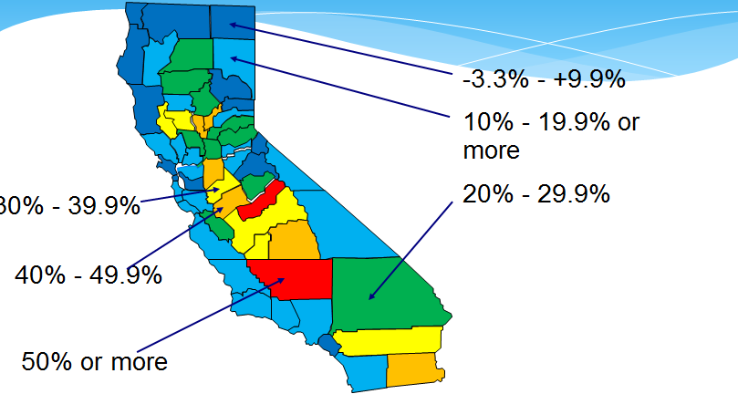
Projected Population Growth by County, 2010-2030

Slide 5
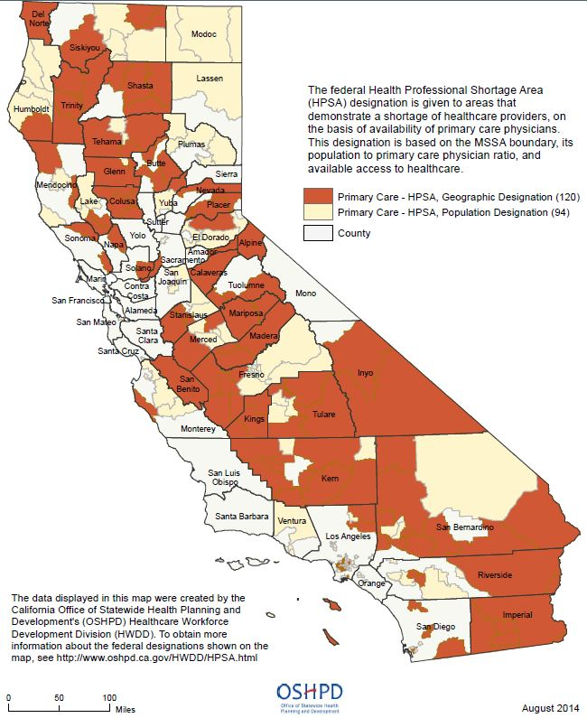
Projected Population Growth vs. Primary Care HPSAs
Population Growth 2010-2013
Primary Care HPSAs

Slide 6
Take-Aways
Northern rural areas don’t expect much population growth, but have primary care shortages.
Central Valley and Imperial/Riverside expect a lot of population growth and have primary care shortages.
Lake/Colusa/Sutter/Yuba expect a lot of population growth, but primary care supply is mostly adequate for now.
County level data do not reveal other potentially important patterns.

Slide 7
Racial/Ethnic Demographic Projections
Number of Californians (in millions)
 | 2010 | 2020 | 2030
White, not Hispanic/Latino | 15.0 | 14.9 | 15.1
Black, not Hispanic/Latino | 2.2 | 2.3 | 2.3
Am Indian, not Hispanic/ Latino | 0.2 | 0.2 | 0.2
Asian, not Hispanic/Latino | 4.9 | 5.4 | 6.0
Native Hawaiian and other Pacific Islander, not Hispanic/Latino | 0.1 | 0.2 | 0.2
Hispanic or Latino | 14.1 | 16.6 | 19.0
Multi-Race, not Hispanic/Latino | 0.9 | 1.2 | 1.4
Source: California Department of Finance Demographic Unit

Slide 8
Age Demographic Projections
Number of Californians (in millions)
 | 2010 | 2020 | 2030
Pre-school (0 – 4 yrs) | 2.5 | 2.7 | 2.8
School age (5 – 17 yrs) | 6.7 | 6.7 | 7.3
Young adults (18 – 24) | 3.9 | 3.9 | 4.0
Working age adults (25 - 64) | 19.8 | 21.2 | 21.8
Young retirees (65 – 74) | 2.3 | 3.6 | 4.6
Mature retirees (75 – 84) | 1.4 | 1.7 | 2.8
Seniors (>85 yrs) | 0.6 | 0.7 | 1.0
Source: California Department of Finance Demographic Unit

Slide 9
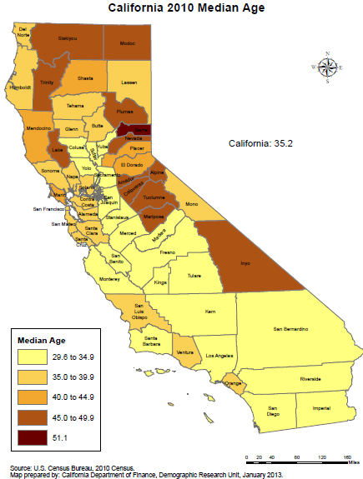
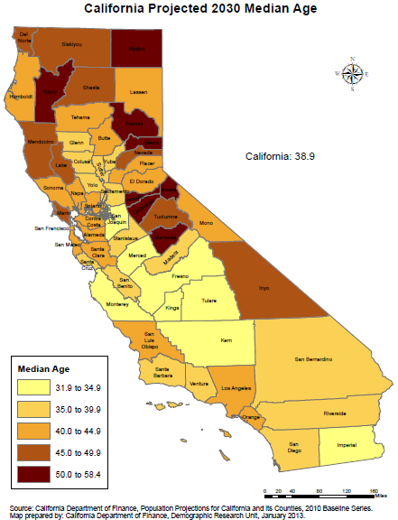
Map

Slide 10
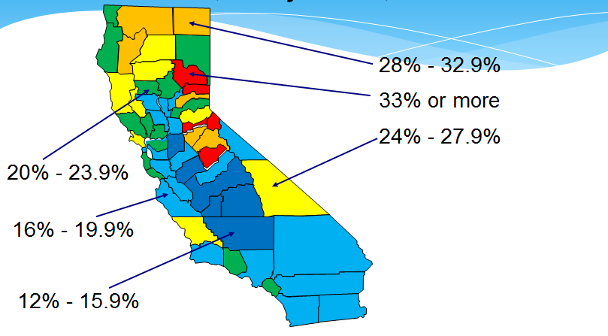
Percent of Population Over 65 Years, Projected, 2030

Slide 11
Projected Population Share 65 and Older vs. Primary Care HPSAs
Percent 65 Years & Older, 2030
Primary Care HPSAs

Slide 12
Take-Aways.
Northern Sierra and Gold Country: expected to have a high share of senior residents, and there are primary care shortages
Northern counties: expected to have a high share of senior residents, and have primary care shortages in the more rural areas
Inyo county: will have a large senior population and has a primary care shortage
Mendocino, Lake, Marin, and SLO counties: will have large senior populations but do not have shortages now
County level data do not reveal other potentially important patterns.

Slide 13
Health Workforce Projections

Slide 14
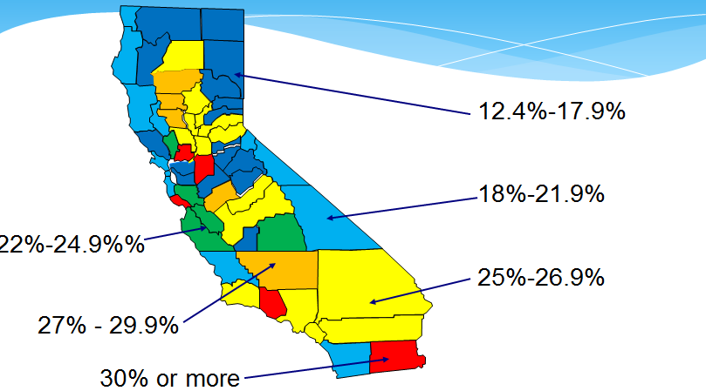
Projected Health Care Job Growth by County, 2010-2020
Source: California Employment Development Department

Slide 15
Projected Health Care Job Growth by County vs. Primary Care HPSAs
Source: California Employment Development Department

Slide 16
Regional Health Care Job Growth due to ACA, 2012-2021
EDD projects 420,000 total job growth in health care 2010-2020
ACA impact - by 2021, ~45 to 47K new health care jobs due to the ACA (about 12% of overall growth)
  Average ACA 10-year growth rates of 5% to 6%
  Fastest ACA growth rate estimated for San Joaquin Valley
  Largest numbers of ACA-driven jobs estimated for Los Angeles and other Southern California
Source: Spetz, Jacobs, Frogner, Oberlin, Parente, Roby, Lo, Watson, & Needleman. Impact of the 2010 Affordable Care Act on the California Labor Force, January 24, 2014

Slide 17
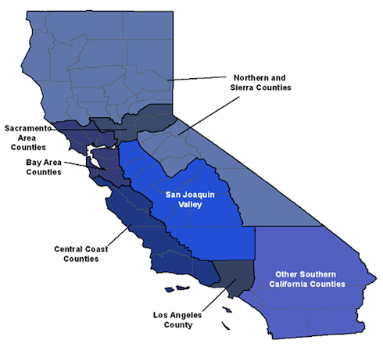
Regions Used in ACA Analysis
Seven regions analyzed
  Northern CA and Sierra Counties
  Greater Bay Area
  Sacramento Area
  San Joaquin Valley
  Central Coast
  Los Angeles County
  Other Southern CA
Regional definitions based on the California Health Interview Survey (CHIS)
from the UCLA Center of Health Policy Research

Slide 18
Regional Health Care Job Growth due .to ACA, 2012-2021
Source: Spetz, Jacobs, Frogner, Oberlin, Parente, Roby, Lo, Watson, & Needleman. Impact of the 2010 Affordable Care Act on the California Labor Force, January 24, 2014

Slide 19
Regional Health Care Job Growth Forecasts due to ACA, by Setting
Job growth, 2012-2021 by Region | Physician offices | Dentist offices | Outpatient care centers | Hospitals
N. CA & Sierra Counties | 1.02% | 0.82% | 0.45% | 0.30%
SF Bay Area | 0.98% | 0.90% | 0.46% | 0.33%
Sacramento Area | 1.06% | 1.51% | 0.50% | 0.37%
San Joaquin Valley | 1.05% | 1.49% | 0.59% | 0.36%
Central Coast | 1.00% | 1.17% | 0.56% | 0.34%
Los Angeles | 1.01% | 1.01% | 0.49% | 0.34%
Other So. CA | 1.03% | 1.15% | 0.53% | 0.35%

