Slide 1
Cost Report Training
Fiscal Year 2012-13
August 22, 2013
Paradox Refresher

Slide 2
Paradox Information
Recap the Paradox program
  Where to find the application to download
  What the requirements are for installation
How to maneuver in the Paradox application
Create / Edit / Delete records
Send Paradox application to DHCS - FMAB

Slide 3
The Paradox Application
Relative Database used to collect expenditure reporting from Counties.
It has been around for over 18 years
  Still applicable for use today
  Technology is running away
Stand alone application on each end
Files transferred via e-mail
3

Slide 4
Money pools for reporting expenditures
  Several options to chose from:
  Behavioral Health Services subaccounts (BHS)
  DMC reimbursement for eligible clients
  County funds
  Carry forward funds FY 2011-12
  SAPT Block Grant
  Other funding sources
When a government program doles out money
  It will have restraints and requirements attached
  Report of expenditures
4

Slide 5
Money Pool Restrictions
Not all available money is unrestricted or discretionary in its availability to use.
Certain expenditures disqualify certain types of money available to use
Fiscal Data Element Report is an excel tool that allows users to see the appropriate Service Code Program Code combination for each type of money
http://www.dhcs.ca.gov/provgovpart/Pages/CostReportSupportFiles.aspx
5

Slide 6
Cost Reporting with respect to
Substance Use Disorder
Prescribed annual Cost Reporting process
Due on November 1 (Health and Safety Code)
    Following the end of the previous fiscal year
    Noted in Annual or Amended contract(s) with State
It will consist of
    Signed County Certification letter
    Paradox Application
    Supporting Drug Medi-Cal documents (if applicable)
6

Slide 7
First Step, obtaining Paradox
Paradox Application is available online for download.
http://www.dhcs.ca.gov/provgovpart/Pages/CostReportParadox.aspx
Will run in a Windows 7 32 bit environment or lower
Currently two patches associated with Provider Files and Narcotic Treatment Programs
http://www.dhcs.ca.gov/provgovpart/Pages/NTP_Patch.aspx

Slide 8
Providers and Partners Tab
Dept. of Health Care Services
Providers and Partners Tab
Scrolling to the bottom
On the lower left hand side
Link for Substance Use Disorder , SUD Services
On the right side, Fiscal / Cost Reporting Bar

Slide 9
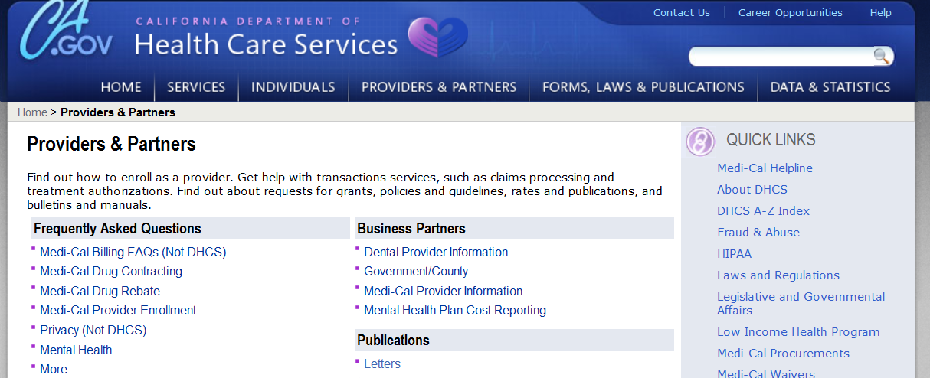
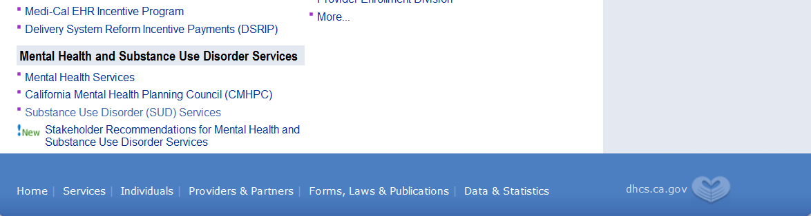
Providers and Partner’s Tab
Scroll Down

Slide 10
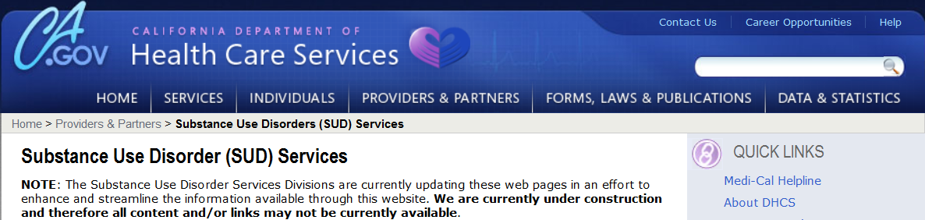
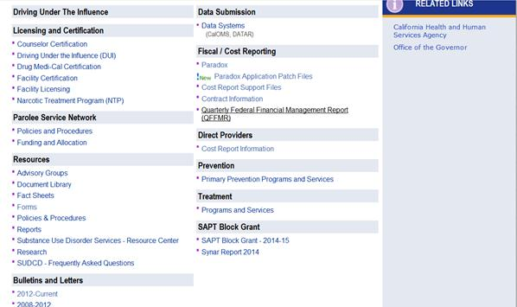
Substance Use Disorder (SUD) Servies

Slide 11
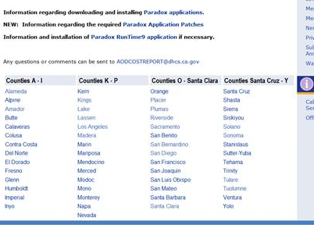
Paradox is located on the Web
http://www.dhcs.ca.gov/provgovpart/Pages/CostReportParadox.aspx

Slide 12
New this year - .zip file
Paradox packaged into a .zip file
Installation files will be have to be extracted first
Installation EXE file will work just like last year
Save to your local computer, C:\ (or shared drive if applicable)
Paradox Application program C1213_0
Will create a load icon to place on your desktop

Slide 13
Help for Paradox Application
Call your assigned Fiscal Management and Accountability Branch (FMAB) analyst
Email AODCOSTREPORT@dhcs.ca.gov
  E-mail box is monitored for questions as well as Cost Report submissions

Slide 14
Recording in Paradox (PDX)
Create multiple records in Paradox for same Service / Program
Based upon DMC reimbursement or not
  Non-DMC
  DMC
  Other
Different set of federal or state requirements

Slide 15
Paradox and the Cost Report Complex Combination Report
57 different county business processes
Combines non-DMC and DMC information
Combines mixed funding sources
      Federal
      Local Realignment
      Other
Distills information into one uniform report

Slide 16
Gathering field (providers) information
Multi-step process – talk to your providers
Crosses internal business procedures and protocols
Gathered and distilled to Cost Report requirements
    Cost Report in PDX
    DMC Forms in Excel
    Funding Restrictions
16

Slide 17
Help is available
Cost Report training and information
  Changes, requirements and DMC Forms
Paradox
  Control Space Bar
  Look up tables
Assigned analyst – phone call or e-mail away
Fiscal Data Element Report
  Formatted and filtered in Excel
17

Slide 18
DMC Settlement Forms
Data Entry Form
Only form where inputs can be made (except for NTP)
Collects all
    Costs by categories
    Submitted and Denied unit information
    Revenue collected as required by law
Data is only as good as the information that is entered
18

Slide 19
Information manually transfers from DMC Forms to PDX -
Units
Individuals
Costs
Groups
Other as necessary
Non-DMC
DMC
Minor Consent
Admin
Annually each November 1 (per HSC)
Cost Report is due to DHCS
19

Slide 20
When DMC Reimbursement = $0.00
Services have been provided, Costs were incurred
UOS is denied for DMC reimbursement = $0.00
Non-DMC program absorbs costs associated with the denied / disallowed DMC unit
  From DMC to Non-DMC
Reflected on returning 835 as a $0.00 reimbursement
20

Slide 21
Sorting a Mixed Group
5 people in one group session
2 people are DMC eligible
2 people are NOT DMC eligible
1 person is DMC eligible Minor Consent
21

Slide 22
How would you report
2 UOS (claims) for DMC eligible clients
    1 Record in PDX for DMC (33/97)
1 UOS (claim) for DMC Minor Consent
    1 record in PDX for DMC M/C (33/92)
1 record in PDX for NNA (33/1)
    2 individuals
1 group session 5 participants 3 records
22

Slide 23
Reporting Number of Sessions
Total Sessions = 100, Participants = 600
Pro-Rate by participant mix ratio
Participants No of Sessions
  Minor Consent – 100 17
  NNA – 200 33
  DMC – 300 50
Distribute DMC ADMIN costs as applicable within the DMC program codes

Slide 24
Submit Cost Report to DHCS
COMPLETE and ACCURATE Cost Report is due NOVEMBER 1 from the close of the previous fiscal year
    County Certification signed and attested to its accuracy
It’s outlined in the county contract
24

Slide 25
Who says, November 1
Exhibit D – County Contract – Final
ARTICLE V. INVOICE/CLAIM AND PAYMENT PROCEDURES
    C. Year-End Cost Settlement Reports
      …. Pursuant to HSC Section 11758.46 (j)(2) Contractor shall submit to the State, on November 1 of each year, … previous fiscal year:
      (a) Document 2P, County Certification Year-End Claim for Reimbursement
      (b) – (f) Appropriate Drug Medi-Cal Forms by provided service type
Document 2P(a) - 2P(i), (if applicable)
      (g) Electronic program as prescribed by the State that contains detailed cost report data

Slide 26
Submit the Cost Report
By e-mail
  Scanned copy of County Certification (followed by original in the mail or overnight service)
  Paradox Files
  DMC Forms
  aodcostreport@dhcs.ca.gov
By Mail / Overnight – Attn: Irma Nieves
  Original Signature County Certification
  DMC Forms
  Do NOT send to your assigned analyst
26

Slide 27
US Mail Address
Overnight Mail Address
Irma Nieves
Dept. of Health Care Services
SUD – PRTSD – FMAB
1700 K. St. Mail Stop 2629
Sacramento, CA 95811
Irma Nieves
Dept. of Health Care Services
SUD – PRTSD – FMAB
PO Box 997413 Mail Stop 2629
Sacramento, CA 95899-7413

Slide 28
Received at DHCS
Series of desk-edit criteria of submitted information
    Looking for omissions of information
    Looking for reasonable entries
    Looking for complete records in PDX
28

Slide 29
The Paradox Past
Developed in 1992 by the Borland Company
DOS 3.0 attributes
    Support for 10MB disks and tree-structure filing
    File Allocation Tables (FAT16) for 20MB disks
Relational database program
Corel and Integrated with C++

Slide 30
Paradox at DHCS / Cost Report
Requires the RUNTIME 9 engine on local computer
Paradox Application can be loaded onto
      Desktop (single user)
      Network (multiple users)*
Downloaded from DHCS’s Website
FAQ posted for additional assistance

Slide 31
Paradox Platforms
Will work only in a Windows Platform
Is compatible with Window’s 7 32 bit
Paradox is:
  NOT compatible with Windows 7 64 bit, Windows 8
  NOT compatible with Apple OS

Slide 32
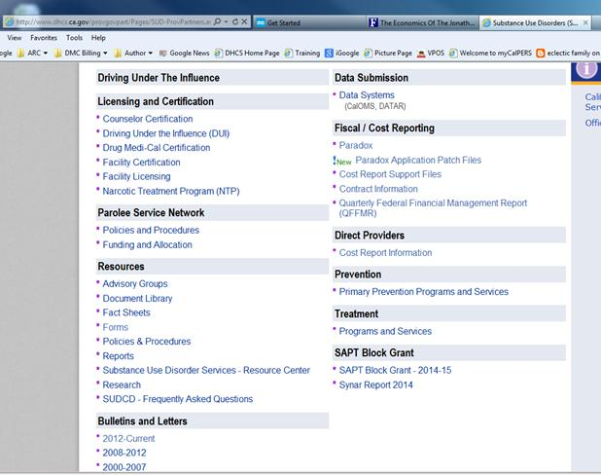
Cost Report Information

Slide 33
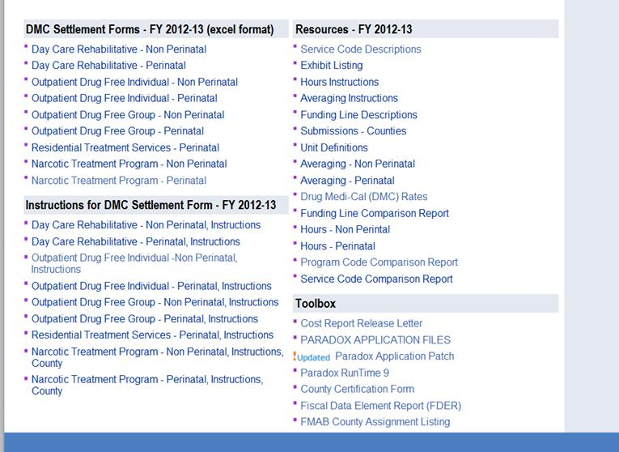
Cost Report Support Files

Slide 34
Paradox Application

Slide 35
What do you get at download
Preloaded data from FY 2011-12 V.0
Provider File – Patch available
  If missing providers from FY 2011-12
NTP_Patch required
  if NTP services (SC 48) offered
New Formats for FY 2012-13
FY 2012-13 Funding Tables
      Will give funding errors

Slide 36
How does Paradox work
Logic of something true / false
Logical Sequencing of order, for example, If – Then
Numeric 0 – 9, Alpha a – z
Provider – numerically (6 digit)
Service Code
Provider Code
Funding line

Slide 37
Framing a Paradox Record
Provider Name and 6-digit Provider Code
Service provided
Program type identified
  Program defines client makeup
Type of and quantity of money expended
Number of people and / or units
Other unique data as required

Slide 38
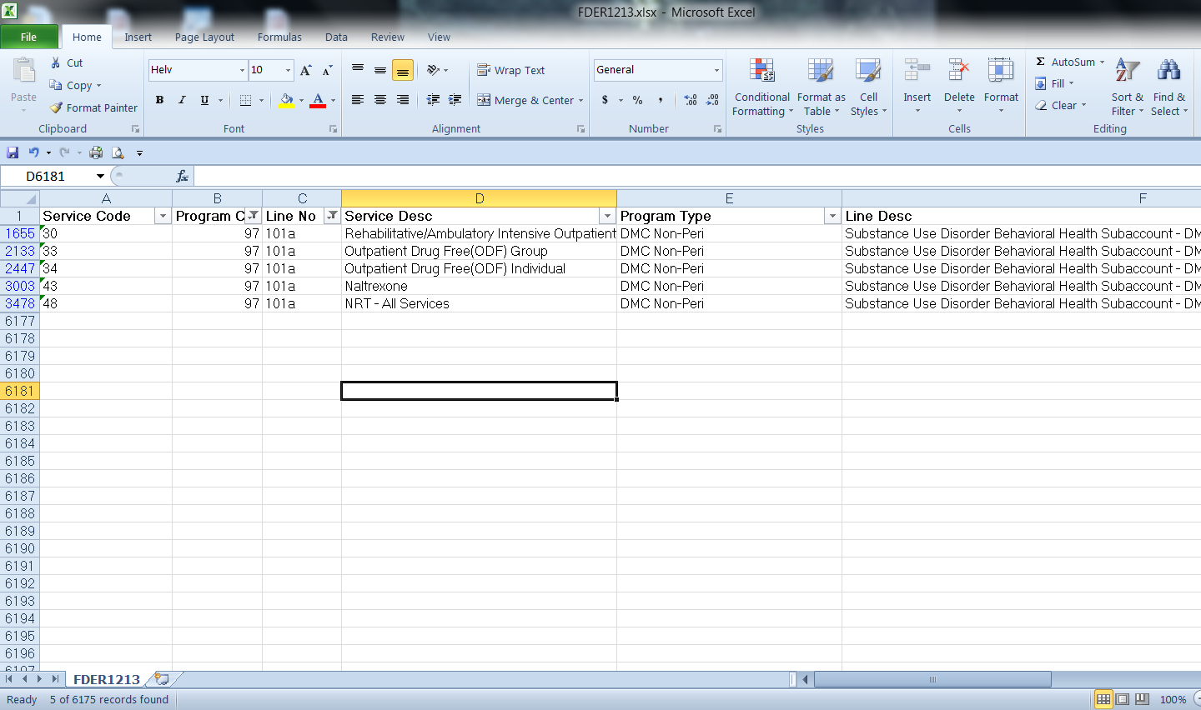
Fiscal Data Element
Report - FDER

Slide 39
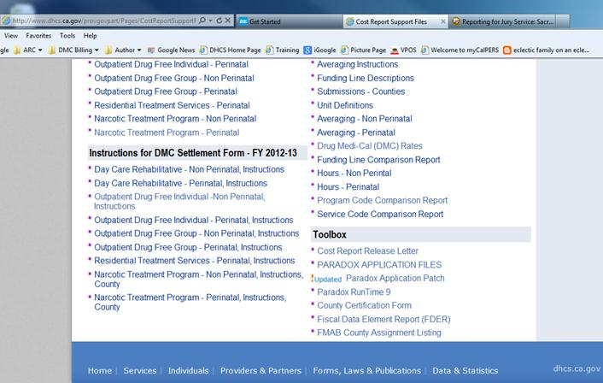
Where to find 1213 FDER
From the Cost Report Support File webpage.

Slide 40
Paradox Make-Up
Database tables work behind scene
Each Record Contains:
    Provider Information
    Service Codes
    Program Codes
    Funding Lines
    Additional information as required
  Must separate DMC regular and DMC Minor Consent

Slide 41
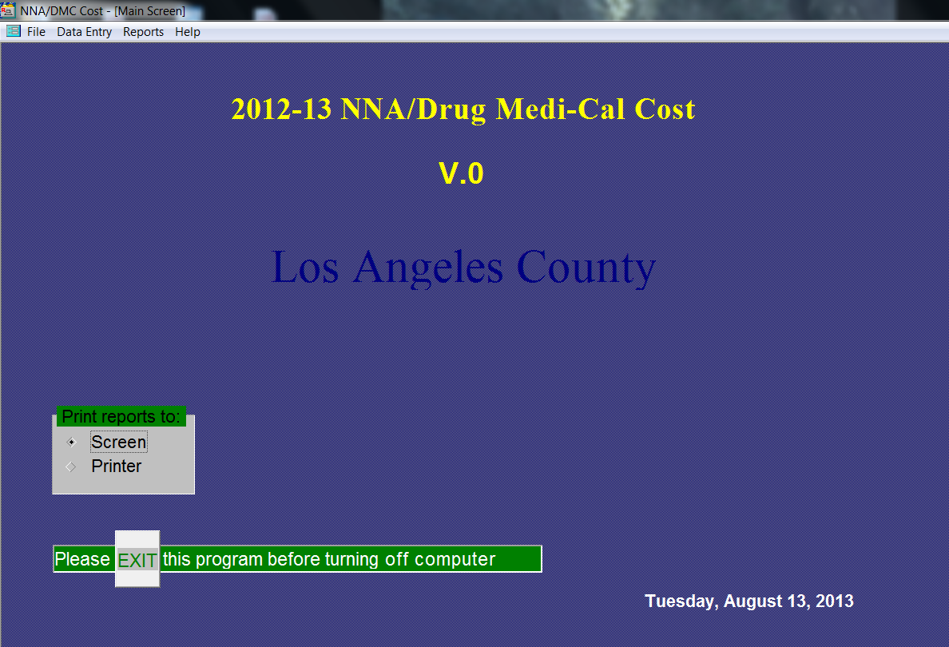
Opening Paradox

Slide 42
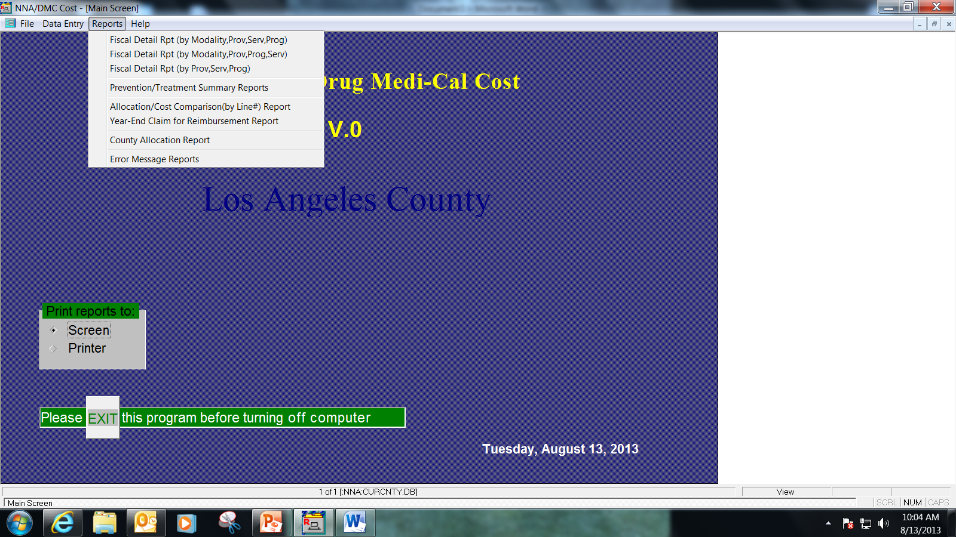
Running Reports
Indicates where the information will be displayed.

Slide 43
Paradox Navigation and Help
Arrow buttons for movement
      Left / Right and Up / Down
      Scroll through and drill into
Control Space Bar
      Help Menu
Control Delete
      Funding Line or Amounts
      Program or Service Code

Slide 44
Moving through Paradox
Provider 1 | Provider 2 | Provider 3 | Provider 4
Service 1 | Service 1 | Service 1 | Service 1
Service 2 | Service 2 | Service 2 | Service 2
Service 3 | Service 3 | Service 3 | Service 3
Service 4 |  | Service 4 | Service 4
Service 5 |  |  | Service 5

Slide 45
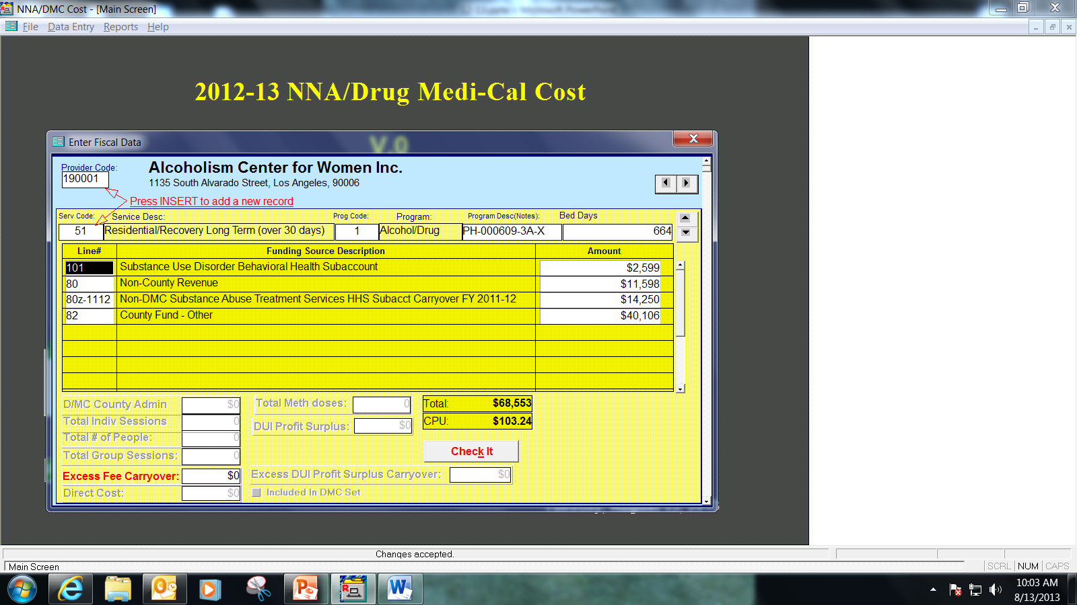
Moving around in PDX records
No ancillary data requirements

Slide 46
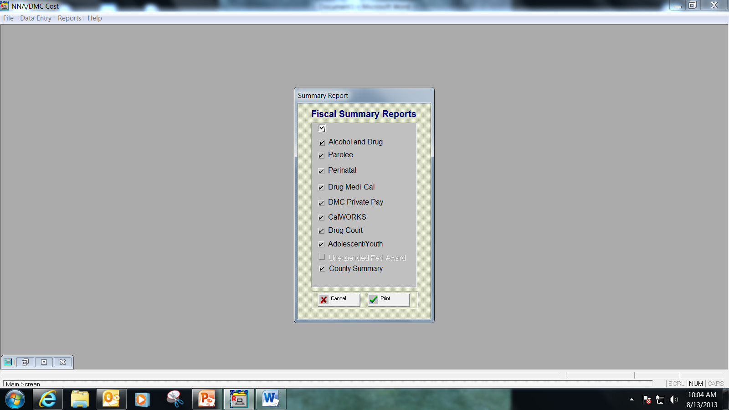
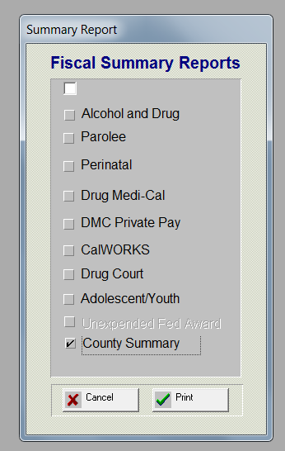
Selecting Print Targets

Slide 47
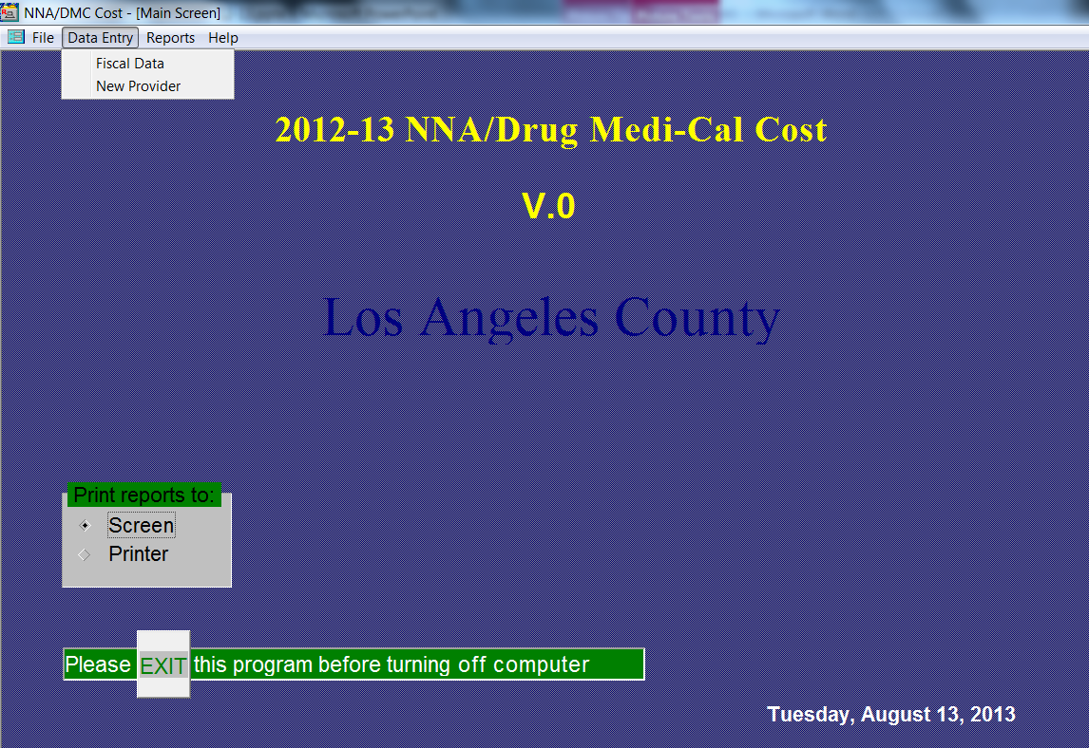
Creating (Editing) a record
From the Data Entry tab, the Fiscal Data link

Slide 48
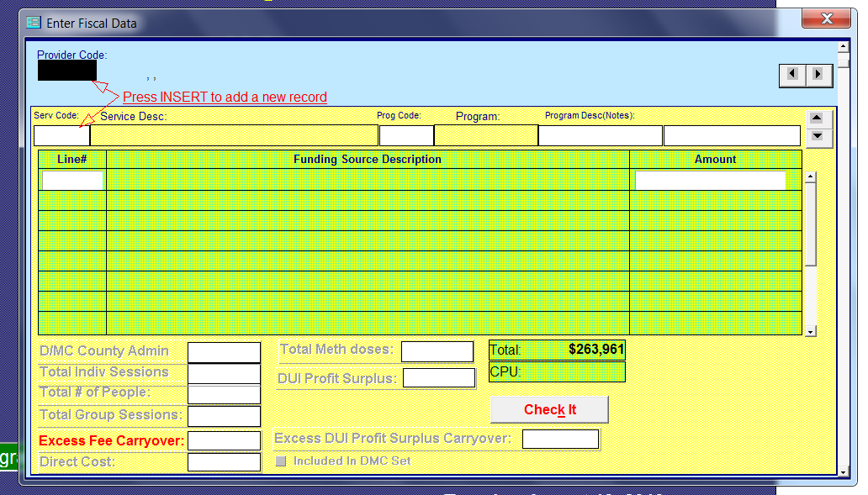
Using the control space bar
Highlight provider code box, use INSERT key to clear
Following on screen instructions, in the black highlighted box, press the insert key and control space bar for a drop down list of providers

Slide 49
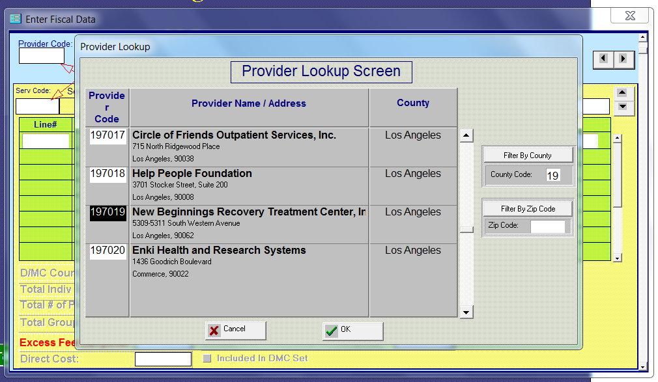
Using the control space bar2
Provider Code box will show Provider Lookup Screen

Slide 50
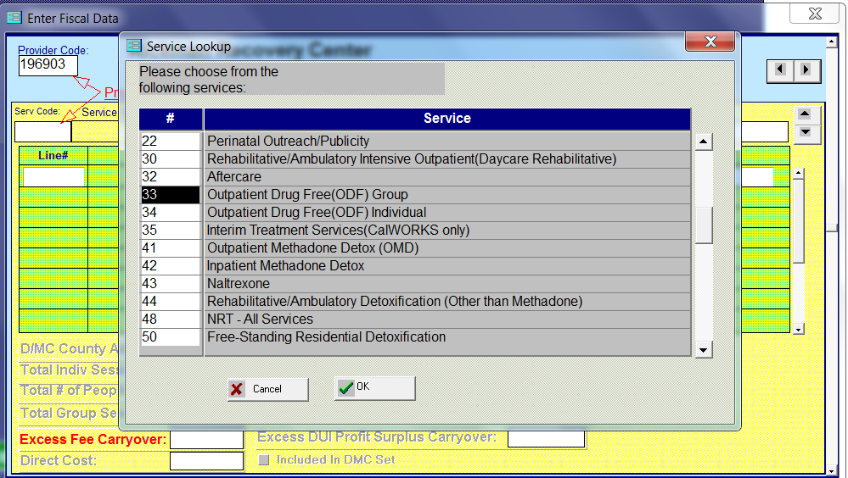
Using the control space bar3
Service Code box will display a list of service codes

Slide 51
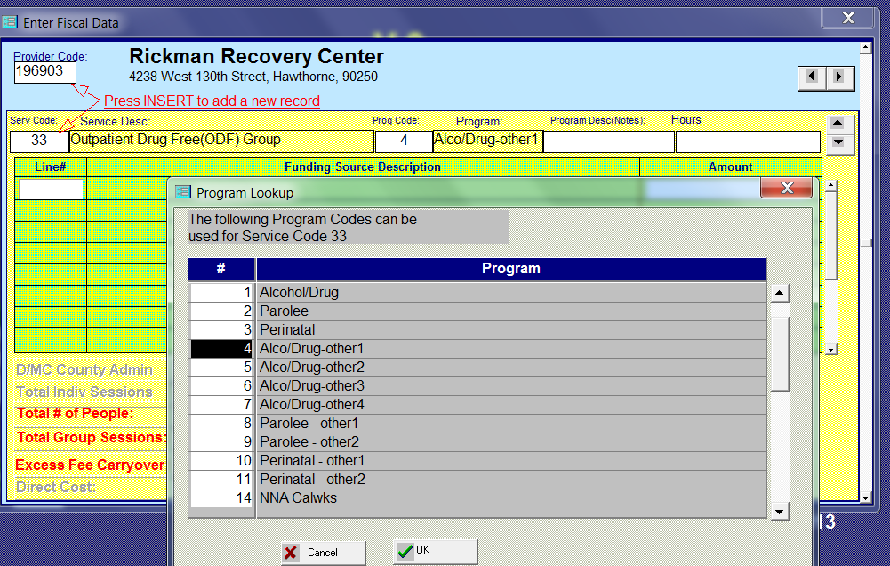
Using the control space bar for Program Code look up

Slide 52
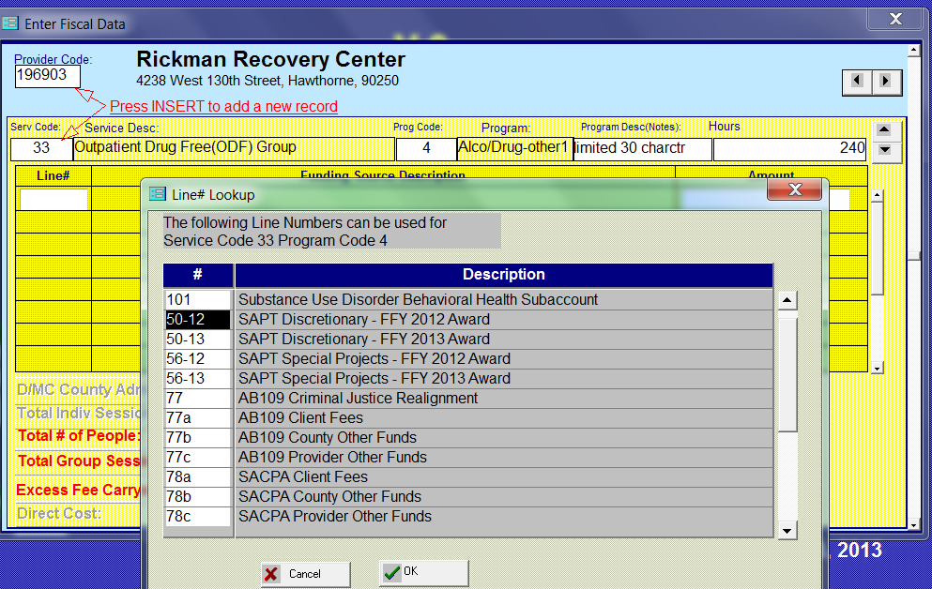
Using the control space bar for funding line information

Slide 53

Using the control space bar for Funding Line information

Slide 54
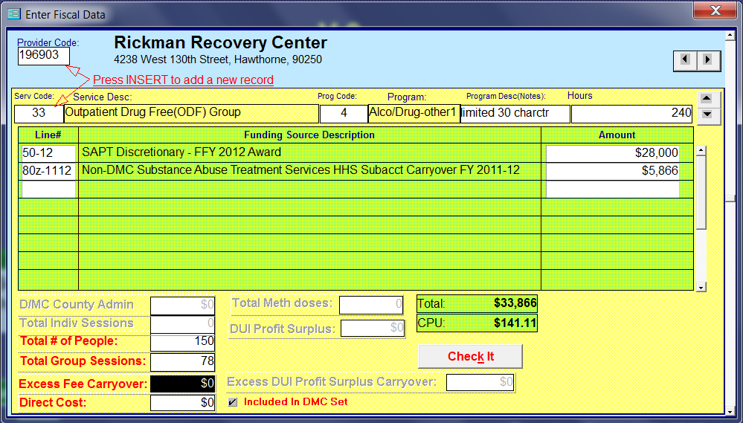
Tying the Non DMC to DMC record - check box

Slide 55
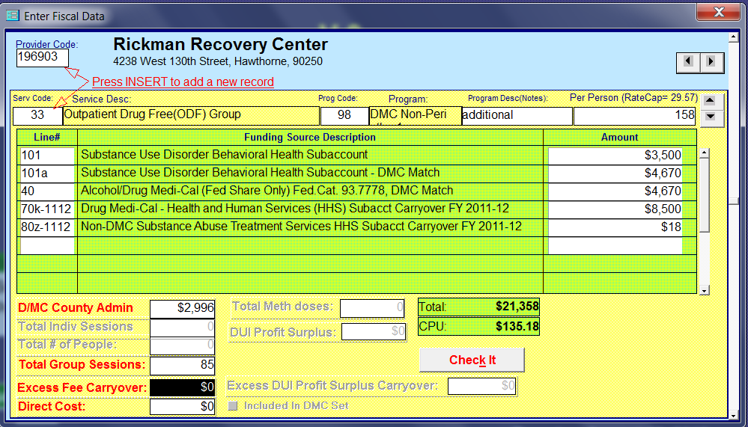
A completed DMC record

Slide 56
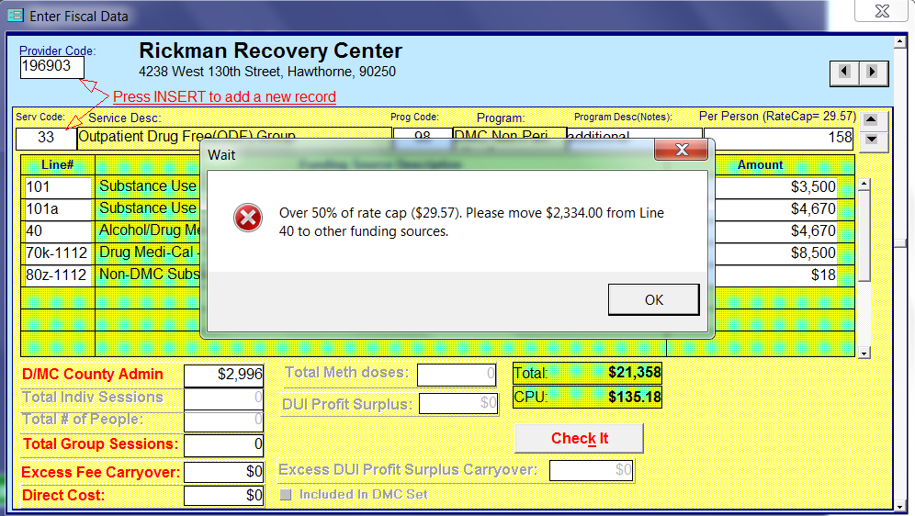
Paradox Business Edits

Slide 57
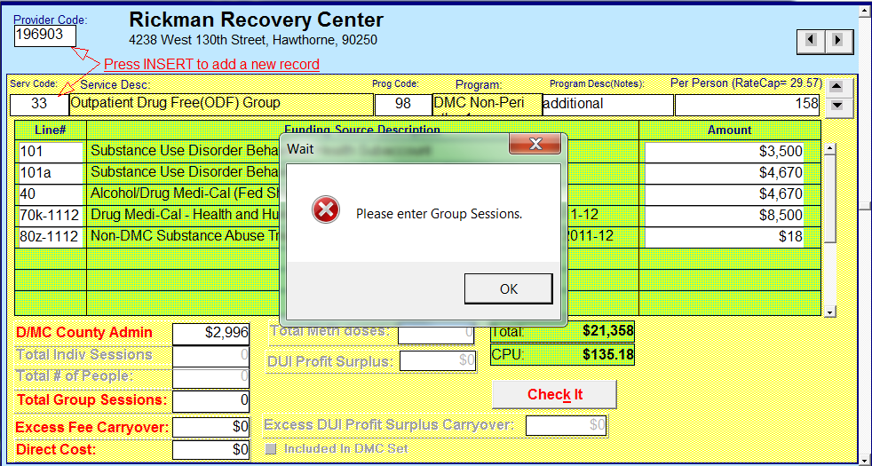
Paradox Business Edits2

Slide 58
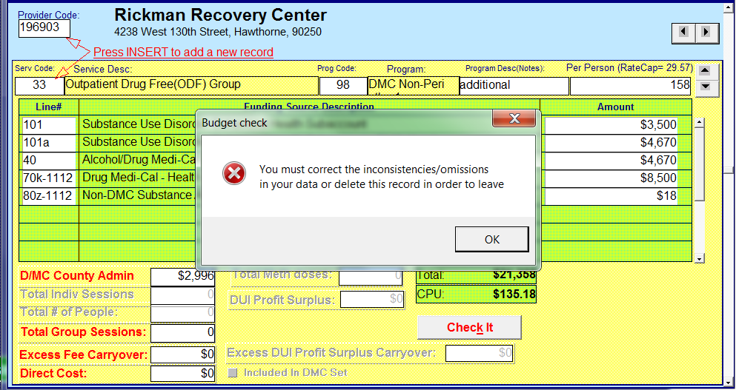
Paradox Business Edits3

Slide 59
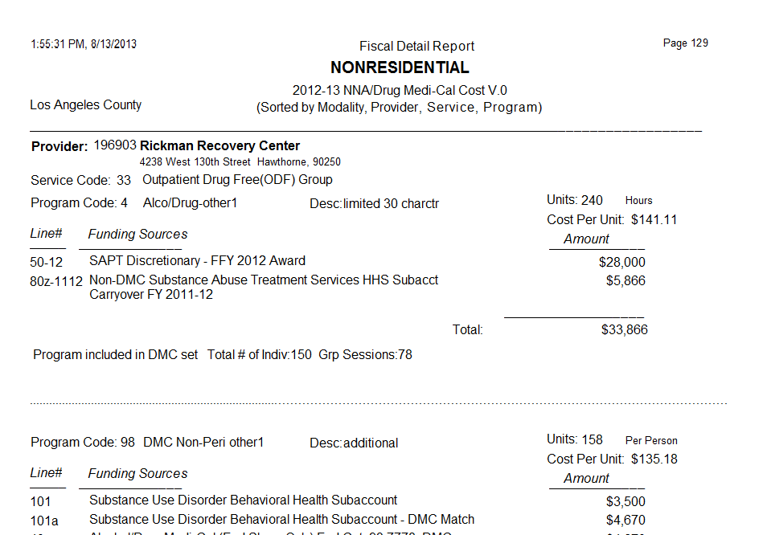
Fiscal Detail Report

Slide 60
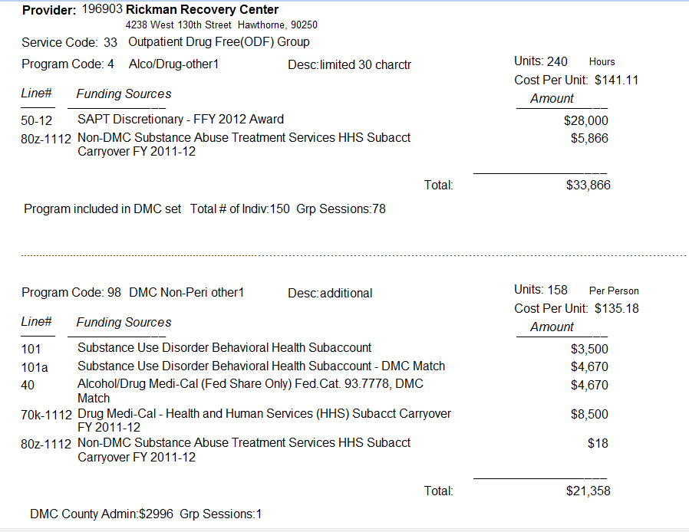
Fiscal Detail Report2

Slide 61
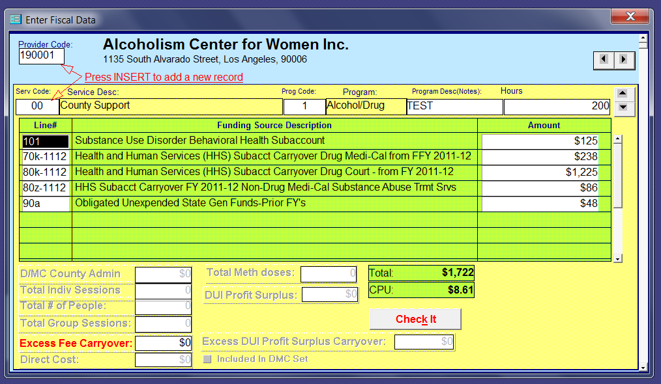
Funding Line usage

Slide 62
Paradox Tools
Summary Report Information
Error Reports
Limitations

Slide 63
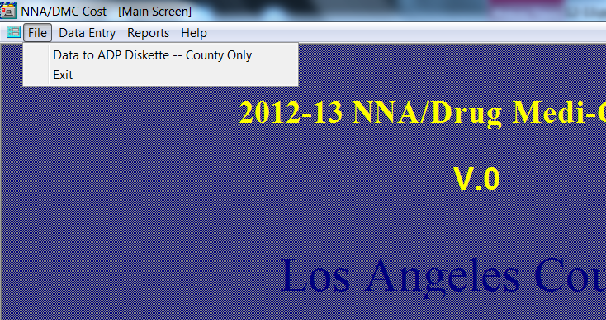
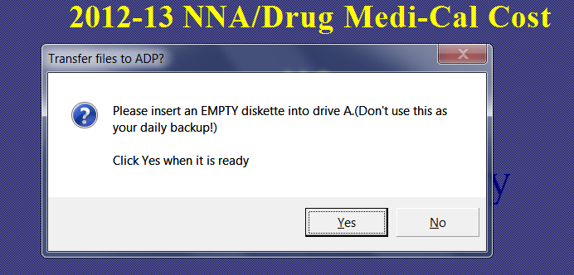
Submitting PDX Files to DHCS

Slide 64
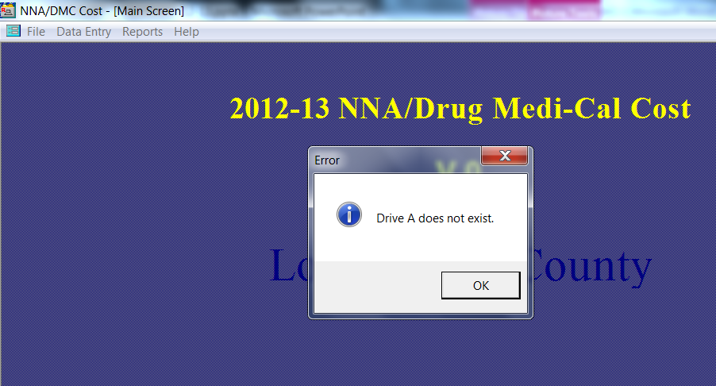
And technology ran away!

Slide 65
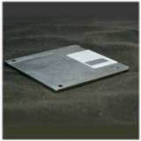
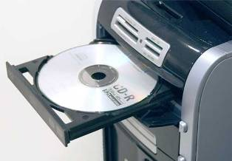

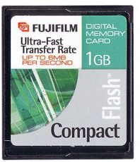

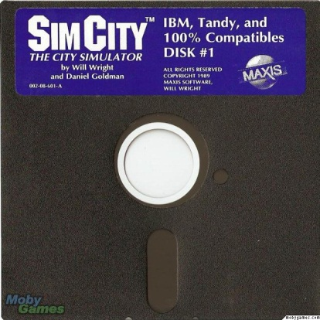
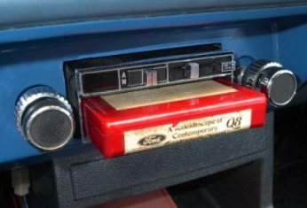
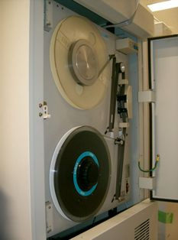
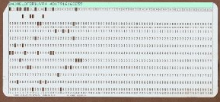
Not all electronic media accepted
Acceptable
Email
Not all electronic media accepted

Slide 66
Paradox Submission / 6 Critical Files
Budget.db
CURCNTY.DB
CurrProv.db
Provider.DB
rptTitle.DB
ServUnit.db
Local drive - C:\C1213_0\Data
Network drive - N*:\C1213_0\Data

Slide 67
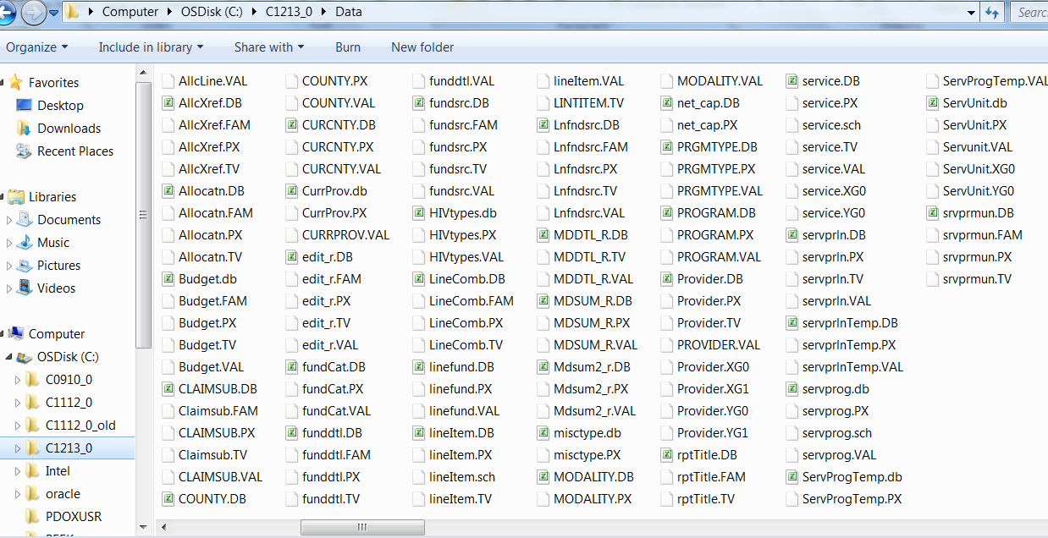
C1213_0 Data Sub-Directory

Slide 68
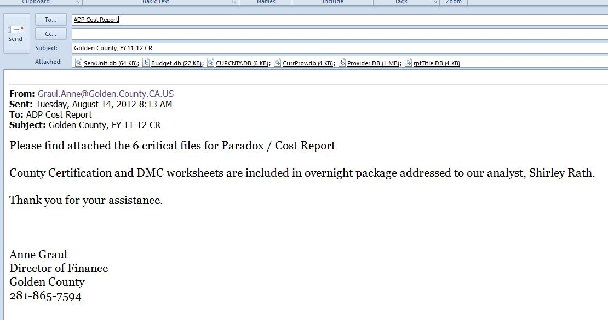

Sending in your Paradox files
AODCOSTREPORT@dhcs.ca.gov
Golden County FY 2012-13 Cost Report
to Irma Nieves

Slide 69
Yes we have a new mailbox
aodcostreport@dhcs.ca.gov
  It is easy to remember
    AOD
    CostReport
    @dhcs.ca.gov

Slide 70

Heave up… a big sigh of relief
get it; it’s a Paradox

