Slide 1

MHSA Reversion Notices
Funds subject to reversion as of July 1, 2020
Mental Health Services Act
Notes:
The purpose of this PowerPoint presentation is to provide a guide to county behavioral health staff who are responsible for reviewing the annual MHSA reversion notices. This training covers the MHSA Reversion notice that determines funds subject to reversion as of July 1, 2020.

Slide 2
Purpose of Demonstration
Overview of updates to reversion workbook
Review the reversion date extensions
Walk-through of the unspent funds calculation
Provide new guidance for:
  Adjustments to unapplied expenditures
  Reconciliation of Prudent Reserve Balances
Notes:
DHCS has updated the reversion workbook with the data from the county’s 19/20 revenue and expenditure report (RER). I will also go over additional updates that DHCS made to the reversion workbook, based on county feedback to last year’s reversion notices. I will clarify the new reversion dates, based on the extension granted by AB 81 in response to the COVID-19 Public health emergency. I will also provide a walkthrough demonstration of the unspent funds calculations. For this year’s notice, DHCS will provide new guidance regarding adjustments to unapplied expenditures and reconciliation of prudent reserve balances

Slide 3
Official Notice of Reversion
After 19/20 MHSA RERs are finalized, DHCS emails reversion notices
Package Includes:
  DHCS letter which requests payment for reverted funds
  Reversion workbook
    Enclosure 1: MHSA Funds Subject to Reversion
    Enclosure 2: Reversion Schedule
  Appeal documents
Notes:
Each year, DHCS sends a notice to each county regarding the status of MHSA unspent funds. Attached to the notice is the reversion schedule that shows how DHCS calculates the unspent amounts.
Upon completion of the 19/20 RER, DHCS calculates reversion and emails the county behavioral health director with a copy to their MHSA coordinators and fiscal staff. The email will include the official notice, the reversion workbook, and appeal documents. Counties that have not finalized the 19/20 RER will still receive a reversion notice, but the unspent amounts will be incomplete and only include data as of the 18/19 RER.
Regarding point #1, it’s important to note that the reversion date is extended to July 1, 2021 and no funds are actually due at this time. DHCS still encourage the county to review the notice and submit any appeals to DHCS.

Slide 4
MHSA Reversion Workbook
Reversion Enclosure (Excel workbook)
Unspent Funds
Revenue and Expenditure Data
Replaces prior reversion notices
Allows a county to plan for unspent funds at risk of reversion
Allows a county to review data DHCS used to calculate reversion
Updated as of the 2019-20 RER
Shows previously reverted funds for historical purposes
Opportunity to make adjustments to data to ensure DHCS records matches the county
Notes:
DHCS has updated the workbook to included data from the FY 19/20 RER that was due January 31, 2021. We cannot complete reversion calculations for funds subject to reversion as of July 1, 2020, until the 19/20 RER has been finalized. The unspent amounts in this workbook replaces prior year. This is the most up to date calculations that includes from the 19/20 RER, adjustments and appeal received since last year’s notice. We encourage the county to review this workbook to ensure DHCS’s records matches the counties.

Slide 5
Extended Reversion Dates
Per W&I Code section 5892(i), the reversion date for unspent funds originally subject to reversion on July 1, 2019 and July 1, 2020, including AB 114 reversion funds, and any interest accruing on those funds, is extended to July 1, 2021. All funds must be spent consistent with an approved Plan or Update.
Large Counties | Original Date | New Date
FY 16-17 (CSS, PEI, INN), FY 09-10 (WET/CFTN) | 7/1/2019 | 7/1/2021
Reallocated AB 114 | 7/1/2020 | 7/1/2021
FY 17-18 (CSS, PEI, INN), FY 10-11 (WET/CFTN) | 7/1/2020 | 7/1/2021
Small Counties | Original Date | New Date
FY 09-10 (WET/CFTN) | 7/1/2019 | 7/1/2021
Reallocated AB 114 | 7/1/2020 | 7/1/2021
FY 15-16 (CSS, PEI, INN), FY 10/11 (WET/CFTN) | 7/1/2020 | 7/1/2021
Notes:
Reversion notices sent last year, covered funds subject to reversion as of July 1, 2019, which we sent to counties upon the completion of the 18/19 RER. This year’s reversion notice will cover funds subject to reversion as of July 1, 2020, which uses the 19/20 RER. Both of these reversion dates have been extended due to the COVID 19 public health emergency.
This chart shows the components and funding years that will revert on July 1, 2021. In order for DHCS to determine unspent amounts, counties must submit their 20/21 RER by January 31, 2022.

Slide 6
New Changes
Enclosure 1: MHSA Funds Subject to Reversion
Ties unspent balances to reversion dates
Shows unspent funds that were reverted or will be reverted
Shows remaining balance of reallocated AB 114 funds
Notes:
DHCS made some changes to the layout of the workbook. We received very positive and valuable feedback from counties and we implemented all the suggestions possible. We thank the counties that helped us.
In the reversion workbook, there is a tab called Enclosure 1. DHCS changed the layout of this enclosure to be more informative and to tie unspent amounts with reversion dates. The previous version summarized unspent amounts by component and fiscal year, but it was not clear on when the unspent amounts were reverted or will revert.

Slide 7
New Changes 2
MHSA Over Expenditures
If expenditures exceed the amount of available MHSA funds, then the county must use other local resources to cover additional program expenditures
Reversion calculations revealed that some counties may have overspent available MHSA funds
County should verify expenditures from RERs and adjust accordingly
Notes:
This year’s workbook will emphasize the over expenditure of MHSA funds. This information has been on prior notices, but we want to make sure that counties take a closer look. This does not impact all counties. We believe that some counties may have accidentally overestimated the amount of MHSA funds used to pay for program costs. We encourage the counties to review RER records against the workbook and utilize the adjustment process to address it.

Slide 8
New Changes 3
Prudent Reserve transfers impact CSS and PEI reversion calculations
Prudent Reserve Balance Reconciliation
Reversion data and RER’s PR data are currently not aligned
DHCS disallowed some PR transactions from reversion, even though the county reported it on the RER.
County should verify and then adjust disallowed PR transactions
The adjustment is required to accurately calculate reversion and PR balances
Notes:
Completely new this this year’s notice, is a process to reconcile the county’s prudent reserve balance. DHCS calculated the county’s PR balance by adding up the PR transfers and PR interest from RERs. The ending PR balance that DHCS calculated should match the county's ending PR balance from the 19/20 RER. If it doesn’t match, then DHCS is missing a PR transaction that the county did not report on the RERs. Another reason for a mismatch is that DHCS disallowed a PR transaction that the county is not aware of. DHCS disallowed some PR transactions from reversion, even though the county reported it on the RER. This reconciliation is required to accurately calculate unspent balances for CSS and PEI.

Slide 9
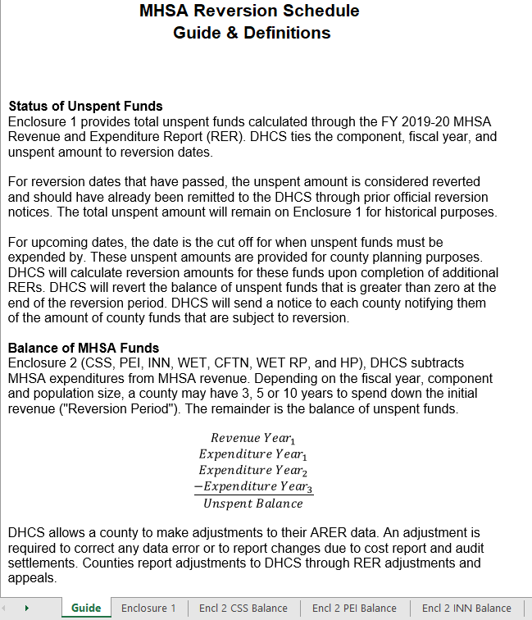
MHSA Reversion Workbook Guide
Notes:
This slide is the beginning of the excel workbook walk through. I have taken several screen shots of the workbook to help our discussion. I will circle parts of the screenshots and discuss some tips that will help counties understand the information better.
The first tab in the excel workbook is called “Guide.” This is an information tab that provides details on the rest of the work book. This screen shot is just one page, but the guide tab will have other definitions and resources.

Slide 10
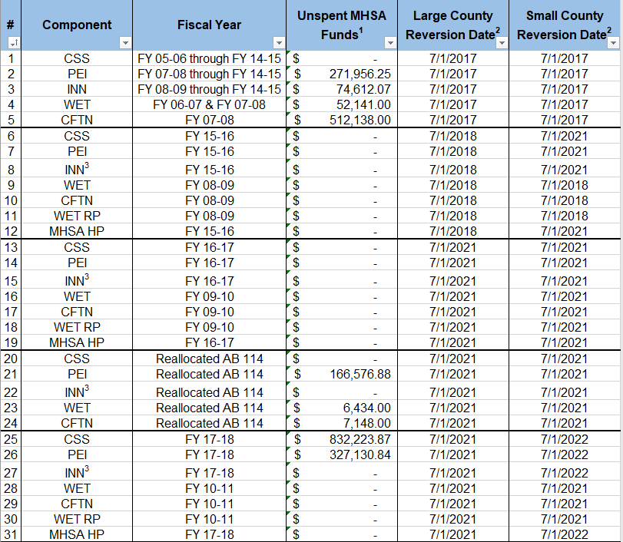
Enclosure 1
Notes:
To provide clarity with reversion dates, DHCS ties the component, fiscal year, and unspent amount to dates. For reversion dates that have passed, the unspent amount is considered reverted. For upcoming dates, that is the cut off for when unspent funds must be expended by. It’s important to note that these amounts are dynamic and will change based on additional RER data or adjustments. The goal here is to reduce these unspent amount to $0, which means there were no funds subject to reversion. We hope this gives a clearer timeline of when funds must be spent and helps gives counties a general idea of what their fund balances are.
For example, unspent funds reverted on 7/1/2017 are the AB 114 funds. Those unspent funds were the only time DHCS reallocated unspent funds back to the county. To determine the current balance of those funds, the county should refer to the section called “reallocated AB 114 funds.” This is the current unspent balance for AB 114 funds as of the FY 19/20 RER. Based on the reversion date, the county must submit the 20/21 RER in order for DHCS to determine final unspent amounts.
Another example, is that the reversion date for small and large counties are different. CSS funds from FY 17/18 will be reverted on 7/1/2021 for large counties and 7/1/2022 for small counties. As a result, the county can project to spend the unspent balance shown on this chart by the reversion “cut-off” date. DHCS will determine final reversion amounts when the county submits the 20/21 or 21/22 RER, based on county size.

Slide 11
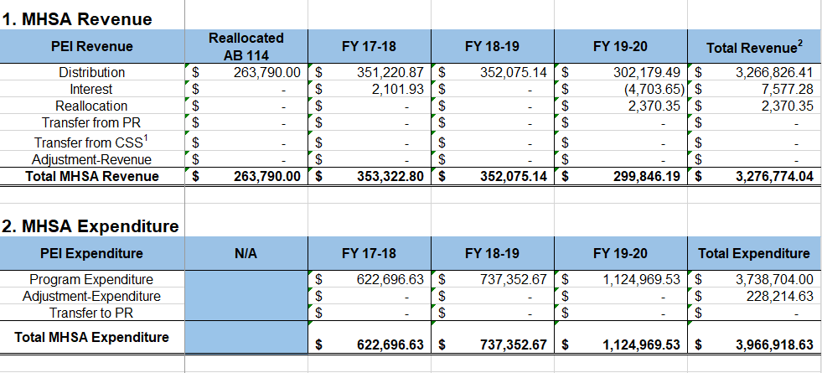
Revenue and Expenditures
Notes:
On each component tab, there is a section that covers the sources for MHSA revenue and expenditure. The screen shot here is an example of the PEI tab.
The sources that makes up PEI revenue are: Distributions, interest, reallocation, transfers from PR, transfers from CSS and revenue adjustments. The total of these revenue sources is called “Total MHSA Revenue” for the indicated fiscal year.
The sources that make up PEI expenditure are: Program expenditure, adjustments, and transfers to PR. The total of these expenditure sources is called “Total MHSA Expenditure” which DHCS will use to subtract from revenue to determine unspent amounts.
The types of sources will vary on each excel tab on CSS, PEI, INN, WET and CFTN. But the format to determine total revenue and expenditure is the same.
One tip here, is that you can see that Total expenditure exceeds Total Revenue. That means the county may have spent more MHSA funds than they received.

Slide 12
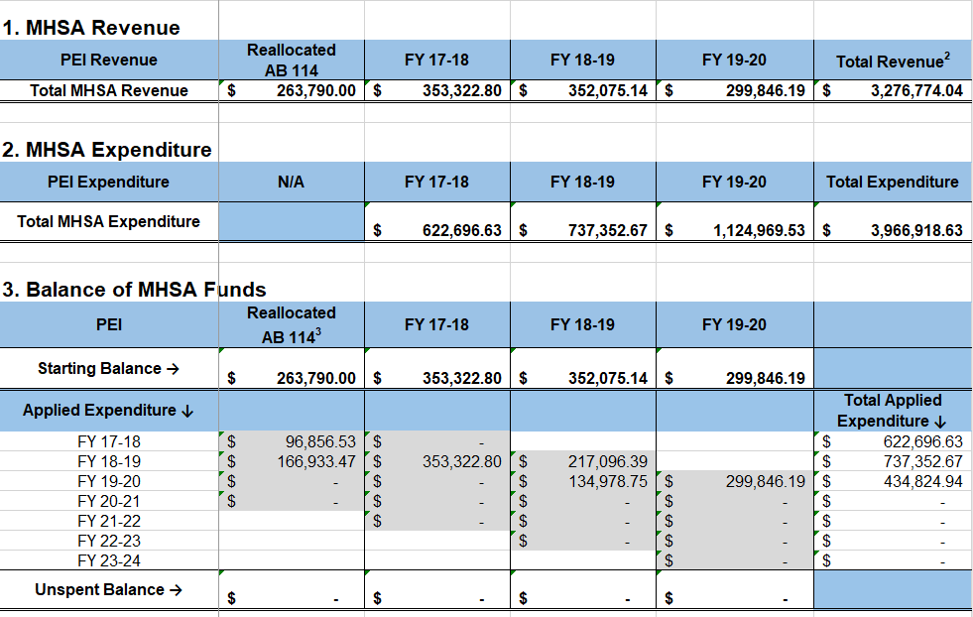
Unspent Balance
Notes:
Each component tab will have a section called, “Balance of MHSA funds.” This section will show how DHCS subtracts expenditures from the starting balance to determine the unspent balance that may be subject to reversion. This screen shot continues the example of the PEI component. In section 3 “Balance of MHSA Funds,” the fiscal years for the revenue goes horizontally while the fiscal years for expenditure goes vertically.
Focusing on 18/19 expenditures, this example illustrates how DHCS applied total 18/19 MHSA expenditures against the oldest available funds. In other words, what source funds did the county use to pay for 18/19 expenditures? DHCS determined that 18/19 expenditures were paid for with funds from AB 114, 17/18, and then 18/19. This is a representation of what we mean by applying expenditures against funds on a “first-in, first-out” basis. One tip here is that, is that 18/19 total applied expenditures should match 18/19 total expenditures from section 2. If it doesn’t it a sign that 18/19 expenditures exceeded available revenue. In this case, the totals matched. DHCS will continue to subtract MHSA expenditures from the remaining balance of funding in the oldest fiscal year. If expenditures less the balance of funding is greater than zero, DHCS will subtract the balance of expenditures from the remaining balance of funding in the next fiscal year. DHCS will repeat this process until the balance of expenditures minus the remaining balance of funding is zero. DHCS will revert the balance of funding that is greater than zero at the end of the reversion period.

Slide 13
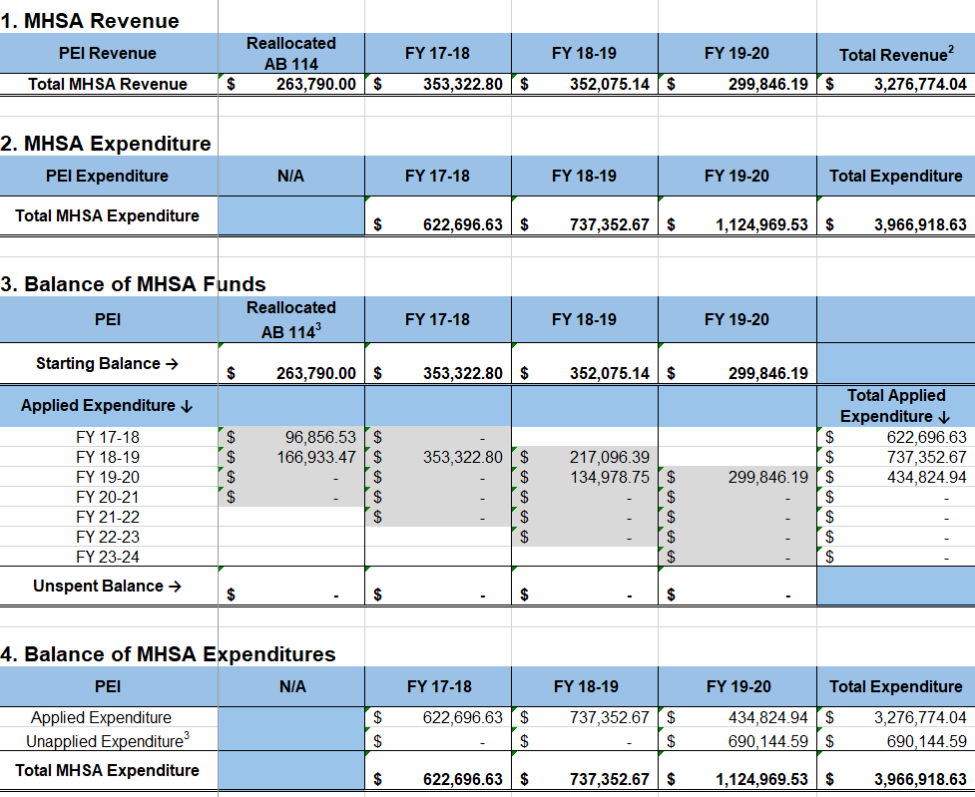
Over Expenditure
Notes:
Each component tab will have a section called, “Balance of MHSA Expenditures.” This section will show the amount of unapplied expenditure. DHCS applies MHSA expenditures up to the amount of available MHSA funds. If expenditures exceed the amount of available MHSA funds, then there is an “over-expenditure.” We categorize this as “unapplied expenditure.”
This is an example of a county that “over spent” MHSA funds. On this county’s FY 19/20 RER, they reported $1.1M in MHSA program expenditures. But only less than half of the expenditures were covered by MHSA funds. What is the reason for this? One possible reason is that DHCS believes the county may have reported 100% MHSA when other non-MHSA funds were actually used when paying for program costs.
To correct this issue, we recommend the county to submit an adjustment in the amount of the “unapplied expenditure.” The adjustment should include a reason, such as, “The County over-estimated MHSA expenditures and did not include the FFP share of program costs.”
One quick tip to confirm if over spending happened is to review section 1 and compare total expenditure and total revenue. If total expenditure is greater than revenue, then the county should explore which RER year they may have over estimated MHSA expenditures.

Slide 14
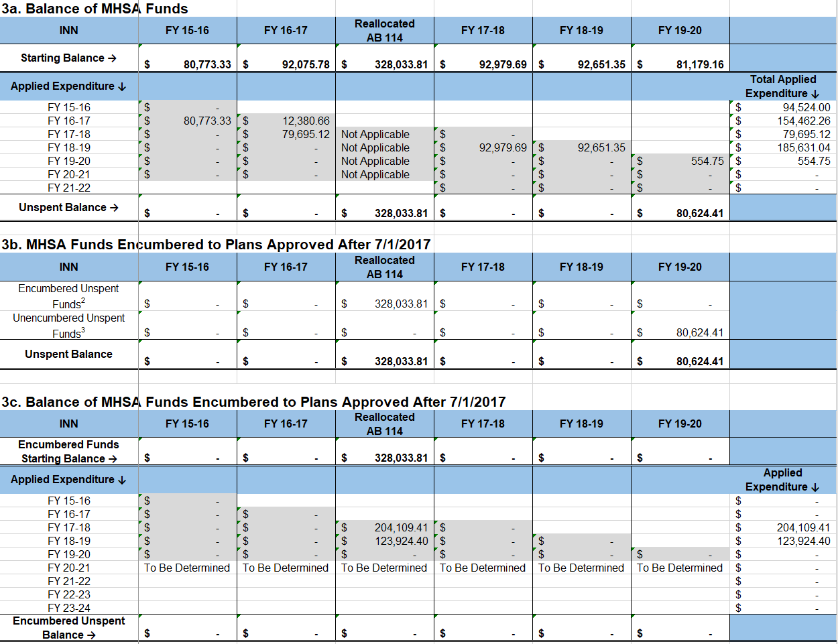
INN: Encumbered Funds
Notes:
The INN component has different reversion rules compared to the other components. These unique rules start with INN funds received in FY 15/16. If funds are encumbered to an INN project plan, then the INN funds are safe from reversion for an additional period of time. The INN tab has three parts to section 3: Balance of funds.
Section 3a: Is just like the other components. Initially, counties have 3 or 5 years to spend down the starting balance.
Section 3b: Per SB 79, DHCS will encumber unspent balances to INN plans (approved in FY 17/18 or later). Encumbered INN funds are protected from reversion.
Unspent funds from section 3a that are labeled “encumbered”, moves to section 3c for additional reversion calculations.
Unspent funds from section 3a that are labeled “unencumbered” will not move to section 3c. If a county does not have an INN plan or did not obtain approval from the OAC within three or five years of receiving the funds, those funds shall revert.
Section 3c: Once encumbered, counties have additional time to spend down INN funds. DHCS will apply expenditures first in, first out.

Slide 15
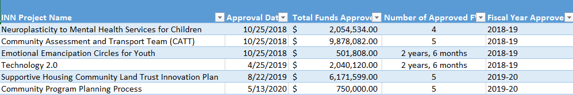
INN: Approved Plans
The Approved INN Plan Tab list county plans with approval date, budget and terms.
For reversion, DHCS uses plans approved in FY 2017-18 or later
If a plan is not listed, the county may send DHCS a copy of the MHSOAC approval letter
Notes:
As previously mentioned, encumbered funds have an extended reversion date. INN funds are encumbered up to the budget amount and the reversion period ends according to the terms of the approved INN Plan. The OAC provides DHCS a copy of the INN approval letter that the county receives. On the approval letter, there is the OAC’s approval date, projected budget and terms. DHCS provides a list of plans on the excel tab called "Approved INN Plans." For reversion purposes, DHCS uses plans approved in FY 17/18 or later.

Slide 16
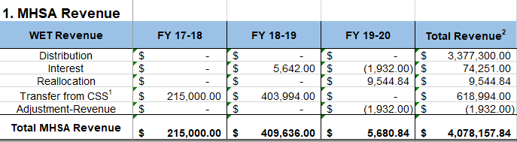
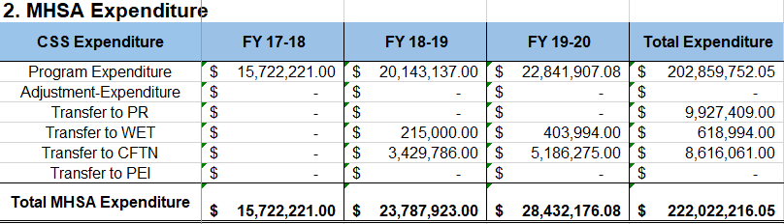
WET and CFTN Transfer Revenue
Notes:
Counties have 10 years to spend WET and CFTN funds. One of the revenue sources for WET and CFTN are transfers from CSS. The reversion period begins when the funds are received or when the funds were transferred from CSS. However, to pay for the transfer, DHCS uses the oldest available CSS fund. As a result, the source year funds may not match fiscal year that the county reported on the RERs.
In this example, the county reported CSS transfers to WET on the 18/19 and 19/20 RERs. However, DHCS determined that 17/18 and 18/19 CSS funds were used to pay for those transfers. So the WET revenue is recognized in 17/18 and 18/19 and the 10 year countdown begins.
One tip here is that the totals on the WET tab, “Transfers from CSS” should match the totals on the CSS tab, “Transfers to WET.”

Slide 17
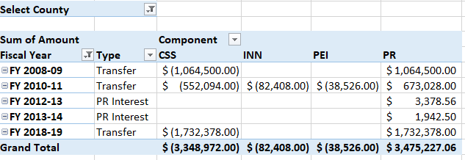
Prudent Reserve Reconciliation
Notes:
DHCS provides a list of Prudent Reserve (PR) transactions from all RERs for county review. The PR grand total should match the county's ending PR balance from the 19/20 RER. This list of transactions also includes PR transactions that were not allowable, but is ultimately part of the county's ending PR balance.
The PR account is not subject to reversion. However, PR transactions that involve the CSS and PEI account are part of reversion calculations. In order to calculate accurate unspent amounts for CSS and PEI, DHCS disallowed some PR transactions that the county may have reported on the RER.
This is an example of where a county reported on its 10/11 RER a transfer of INN funds to their PR. Statute does not allow a county to transfer INN funds to the PR. Also, this county reported on its 10/11 RER a transfer of PEI funds to their PR, which is not allowable for this year.
We recommend that the county verify these transactions from their 10/11 RER and then submit an adjustment to remove it. Right now, DHCS did not include these INN and PEI transfer as part of reversion. If we did, it would inflate the expenditure used for INN and PEI calculations.

Slide 18
Prudent Reserve Reconciliation 2
Allowable Transfers
  PR → CSS or PEI
    FY 2011-12 (DMH 10-21)
    FY 2018-19 (BHIN 19-017, PR maximum)
    FY 2019-20 (BHIN 20-040, COVID-19 flexibilities)
  CSS or PEI → PR
    CSS: Any fiscal year
    PEI: Only FY 2007-08 (DMH 09-16)
Notes:
Statue provides guidance for allowable PR transfers. For example, strict conditions must be met for a county to access its PR. This slide is an example of the only three fiscal years that statue allowed counties to access their PR. Any transfers from the PR in other years should be reversed from the county’s RERs.
Statue allows a county to transfer PEI funds to its prudent reserve using 07/08 funds. Many counties reported a PEI to PR transfers on their 09/10, 10/11, and 11/12 RERs. For reversion purposes and based on statute guidance, DHCS recognized the PEI transfer in 07/08. We recommend counties to adjust the RERs and recognize PEI transfers in 07/08 as well.

Slide 19
Prudent Reserve Reconciliation 3
Prudent Reserve Interest Revenue
  FY 2016-17 and prior: Part of PR ending balance
  FY 2017-18 and later: Report PR interest with CSS account
Notes:
On past RERs, the county may report PR interest with their PR account. Per statute, and beginning with the FY 17/18 RER, PR interest must be reported only with the CSS account. This is because the PR is funded with CSS funds. The county can feel free to submit adjustments to update any of the PR interest data based on these rules.

Slide 20
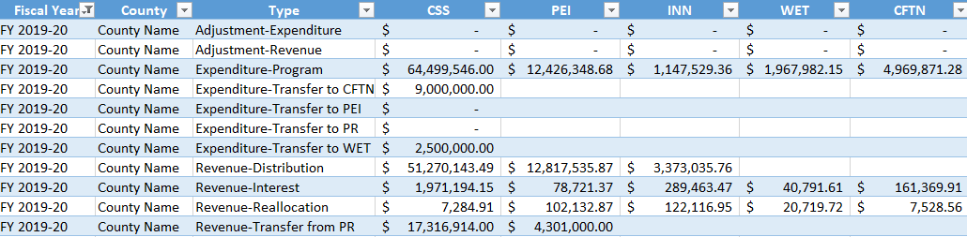
Data Tab
Copy of Reversion Data used to calculate reversion
Grouped by:
  Revenue, Expenditure and Adjustments
Notes:
Similar to last year, DHCS provided a data tab that centralized all the revenue and expenditure data used to calculate reversion. Based on county suggestion, we grouped the sources to identify what is considered Revenue, Expenditure, and Adjustment types.

Slide 21
Key Takeaway #1
County must remit payment based on the official reversion letter that identifies the actual amount due to DHCS
  Currently $0 because next reversion date is 7/1/2021
  Will be determined upon completion of FY 2020-21 RER (Due 1/31/2022)
Notes:
Typically, the county would remit payment to DHCS for unspent funds based on the letter that is included with the reversion package. However, there are no funds subject to reversion at this time. The county can use the unspent amounts from the workbook to help plan for upcoming reversion or to estimate current MHSA balances as of the 19/20 RER.

Slide 22
Key Takeaway #2
Review unapplied expenditures and prudent reserve transfers
  County may submit adjustments through an appeal or with the FY 2020-21 RER
  DHCS will recalculate reversion amounts and send revised enclosures
Notes:
While there are no funds subject to reversion, DHCS requests that the county take action to fix MHSA over-expenditures and reconcile Prudent Reserve balances. The county can also submit adjustment for any other inconsistencies between DHCS and county reversion data.

Slide 23
Key Takeaway #3
Encumbered funds extends the INN reversion date
  Unspent INN funds can be encumbered to plans approved in FY 2017-18 or later
  If a county does not have an INN plan or did not obtain approval from the MHSOAC within three or five years of receiving the funds, those funds shall revert
  Send DHCS any MHSOAC approval letters for INN projects that are not included in the Approved INN tab
Notes:
INN reversion rules are different because the county can extend the reversion period by encumbering INN funds based on the OAC-approved plans. The county should review the approved INN tab and send DHCS any plans approved from FY 17/18 or later.

Slide 24
Key Takeaway #4
DHCS applies CSS transfers to PR, WET, CFTN and PEI using the oldest available CSS fund.
  The reversion period for WET/CFTN begins with the FY of the funds used to cover the transfer
  As a result, the source year funds may not match fiscal that the county reported on the ARERs.
Notes:
To emphasize, the 10 year reversion period for WET and CFTN is based on the source fiscal year used to pay for the CSS transfer. The county should verify that total CSS transfers match the Total WET and CFTN revenue transfers.

Slide 25
Appeal process
The county must submit an appeal within 30 calendar days of receiving the notice
To appeal, the county shall submit the following documents by email to MHSA@dhcs.ca.gov:
  An executed MHSA Fiscal Accountability Certification form (DHCS 1820)
  A completed Adjustments to Revenue or Expenditure Summary form (DHCS 1821)
DHCS will review the appeal documents and email a written decision to the county within 45 days of receiving the appeal
Notes:
The appeal process is the same as prior years. The appeal process allows a county to submit an adjustment sheet to DHCS. The adjustment sheet is very similar to the adjustment tab located on the annual RERs.

Slide 26
Resources
For more MHSA reversion information, visit the MHSA Fiscal Website
Email: MHSA@dhcs.ca.gov
MHSA forms are available at DHCS Forms website
For reversion extension information, see BHIN-20-040
Notes:
Counties can contact the MHSA team or visit the MHSA Fiscal website for questions and additional information. Thank you for your time.

