Slide 1
Drug Medi-Cal Organized Delivery System and Peer Support Services
Tuesday, March 22, 2022
3:00 p.m. – 4:00 p.m.

Slide 2
Featured Presenters
Khatera Aslami Tamplen, Office of Peer Support Services Manager, Alameda County Behavioral Health
Kristen Duffy, Peer Support Services Program Manager, Riverside University Health System-Behavioral Health
Ali Marzolf, Senior Policy Consultant, Integrated Care, Aurrera Health Group
Shannon McCleerey-Hooper, Peer Support Oversight Administrator, Riverside University Health System-Behavioral Health
Kenneth Rhodes, Operations Manager, Local Governmental Financing Division, Department of Health Care Services
Anne Vierra, Unit Chief, Support Unit, Local Governmental Financing Division, Department of Health Care Services

Slide 3
Agenda
Introduction
Submitting a Fiscal Plan
Billing
Intergovernmental Agreements (IGAs) and Reporting
Questions

Slide 4
Introduction
Ali Marzolf, Senior Policy Consultant
Integrated Care, Aurrera Health Group

Slide 5
Who are peers?
Peer support specialists are people who have been successful in the recovery process who help others experiencing similar situations.
Through shared understanding, respect, and mutual empowerment, peer support specialists help people become and stay engaged in the recovery process and reduce the likelihood of relapse.

Slide 6
Senate Bill 803
Senate Bill 803 (SB 803) (Beall, Chapter 150, Statutes of 2020) authorized DHCS to add peer support specialists as a Medi-Cal provider type and peer support services as a Medi-Cal benefit.
Effective July 1, 2022, peer support specialist services will be an optional behavioral health Medi-Cal benefit in California.

Slide 7
Peer Support Specialists Outside of Medi-Cal
SB 803 does not impact peer programs under other funding sources.
Counties may continue to provide peer services through other funding streams.
BHIN 20-056 identifies the range of funding sources for peer support specialists that are available outside of the Medi-Cal program.
Examples of other funding streams:
  Private health insurance
  Grants
  Self-pay

Slide 8
Roles in the Medi-Cal Peer Support Specialist Services Benefit
Department of Health Care Services: Establish statewide standards for peer certification and monitor certifying organizations and counties.
County: Implement the Medi-Cal benefit, and either develop or choose a certification program.
Certification program: Certify peer support specialists for Medi-Cal reimbursement.
Peers: Provide peer support services to Medi-Cal beneficiaries.

Slide 9
County Role in Medi-Cal Peer Support Specialist Services
Each county may decide whether to opt into this benefit.
Counties are responsible for implementing the Medi-Cal peer support specialist services benefit.
Interested peers and peer-run organizations should work with their county Behavioral Health Department to bill Medi-Cal for peer support specialist services.

Slide 10
Certification Programs for Medi-Cal Peer Support Specialists
To receive Medi-Cal reimbursement, peer support specialists must become certified as a Medi-Cal Peer Support Specialist in California.
Counties are responsible for implementing certification programs.
Counties may implement their own certification program or select an entity to provide a certification program for their county.

Slide 11
Certification Program (continued)
A county may only elect one certification entity at a time.¹
Many counties have chosen CalMHSA as their certification entity for FY 2022-2023.
  More information about the CalMHSA Medi-Cal Peer Support Specialist Certification Program can be found online: https://www.calmhsa.org/peer-certification
DHCS will host a separate Technical Assistance webinar on developing certification programs in Fall 2022.
¹ Behavioral Health Information Notice 22-006

Slide 12
Benefit Description
Peer Support Services:
Are culturally competent individual and group services that promote recovery, resiliency, engagement, socialization, self-sufficiency, self-advocacy, development of natural supports, and identification of strengths through structured activities such as group and individual coaching to set recovery goals and identify steps to reach the goals.
Services aim to prevent relapse, empower beneficiaries through strength-based coaching, support linkages to community resources, and to educate beneficiaries and their families about their conditions and the process of recovery.
May be provided with the beneficiary or significant support person(s) and may be provided in a clinical or non-clinical setting.
Can include contact with family members or other collaterals if the purpose of the collateral’s participation is to focus on the treatment needs of the beneficiary by supporting the achievement of the beneficiary's treatment goals.
Source: California State Plan Amendment 21-0058

Slide 13
Benefit Description
Peer support services are based on an approved plan of care and can be delivered as a standalone service. Peer support services include the following service components:
  Educational Skill Building Groups
  Engagement
  Therapeutic Activity
Source: California State Plan Amendment 21-0058

Slide 14
Submitting a Fiscal Plan
Anne Vierra, Unit Chief, Support Unit
Medi-Cal County Customer Services - MEDCCC
Kenneth Rhodes, Operations Manager
Behavioral Health Financing Section
Local Governmental Financing Division
Department of Health Care Services

Slide 15
Fiscal Plan
Information Notice 21-045 and the attachment provide reference material for developing and submitting the fiscal plan and rates for Peer services.
To be implemented for a July 1, 2022 services start date, fiscal plans that include Peers will need to be updated and submitted by April 30, 2022 to be implemented in Short-Doyle Medi-Cal on time.

Slide 16
Fiscal Plan (continued)
Proposed rates must be developed for each service modality.
Counties must provide supporting information consistent with state and federal guidance for each proposed rate.
Appropriate sources of information include filed cost reports, approved medical inflation factors, detailed provider direct and indirect service estimates, verified charges made to other third-party payers for similar programs.
If counties choose to incorporate peer support specialist services into withdrawal management and/or residential treatment services, counties must fill out the relevant sections of the chart in the attachment and develop new interim rates for these modalities that reflect the additional costs of peer support specialist services. These interim rates should only include treatment costs and not room and board expenses.

Slide 17
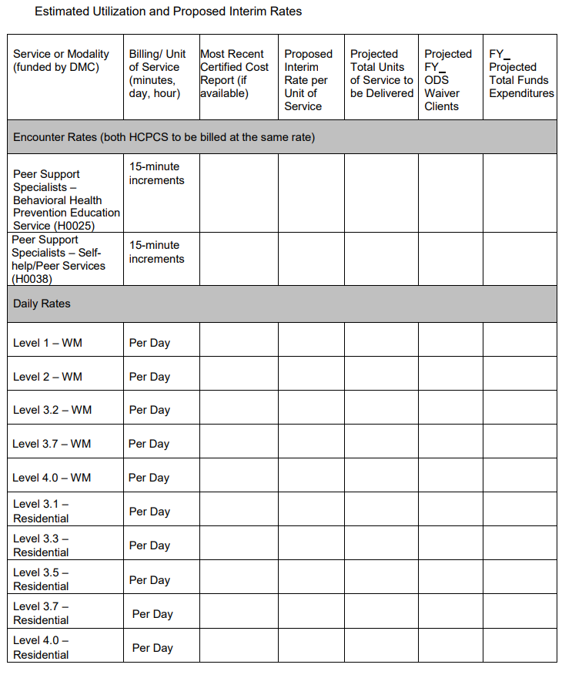
Extended Utilization Picture

Slide 18
Peer Support Services:
Short Doyle Medi-Cal Claiming
Service will be billable to Short Doyle Medi-Cal for dates of service July 1, 2022 and after.
Two new procedure codes will be added to Short Doyle Medi-cal for Peer Support Services Claiming:
  H0025 - Behavioral Health Prevention Education Service
  H0038 - Self-Help/Peer Services
    These codes will be used for Drug Medi-Cal, Drug Medi-Cal ODS and Specialty Mental Health.

Slide 19
837P Claiming Requirements July 1, 2022 through July 1, 2023
All claims must include rendering provider’s taxonomy code “175T00000X” Peer Specialist for reimbursement.
All claims will be billed in 15-minute increments.
SMHS will require “HE” modifier.
Level of Care Modifiers are required for DMC-ODS claims.
  The level of care modifier should correspond to the DMC service group the Service Facility is certified for.
For DMC claims use Youth modifier “HA” and/or Pregnancy modifier “HD” when applicable.

Slide 20
Billing and Reporting
Shannon McCleerey-Hooper, Peer Support Oversight Administrator
Kristen Duffy, Peer Support Services Program Manager
Riverside University Health System-Behavioral Health
Khatera Aslami Tamplen, Office of Peer Support Services Manager
Alameda County Behavioral Health

Slide 21
Billing under DMC-ODS
Separate Mode of Service
Three Areas of Focus
  Therapeutic Activity
  Engagement
  Educational Groups
SUD Peer Services Expansion – Not Isolated to Recovery Services
MH Peer Services Ability to Bill for More of What We Do
  Contracted providers (Alameda)
  County-employed providers will be given a specific set of Peer Only codes through which to bill for services.
Plan for success - hire for specific lived experience

Slide 22
Intergovernmental Agreements & Reporting
Currently no PSS-specific data collection or reporting
BHIN 21-041 gives detailed instructions regarding the reporting of Peer-specific services
Data collection (equity, methods, etc.)

Slide 23
Questions
Please submit your questions through the GoToWebinar portal.
Questions after the presentation regarding the peers benefit may be submitted to your County Support Liaison.

Slide 24
Public Health Emergency (PHE) Unwinding
The COVID-19 PHE will end soon and millions of
Medi-Cal beneficiaries may lose their coverage.
Top Goal of DHCS: Minimize beneficiary burden and promote continuity of coverage for our beneficiaries.
How you can help:
  Become a DHCS Coverage Ambassador
  Download the Outreach Toolkit on the DHCS Coverage Ambassador webpage
  Join the DHCS Coverage Ambassador mailing list to receive updated toolkits as they become available
Notes:
The end of the COVID-19 PHE and the Medi-Cal continuous coverage requirements necessitates a coordinated, phased communication campaign to reach beneficiaries with messages across multiple channels using trusted partners called DHCS Coverage Ambassadors. As California plans to resume normal Medi-Cal eligibility operations, beneficiaries will need to know what to expect and what they need to do to keep their health coverage. Most beneficiaries will either remain eligible for Medi-Cal or qualify for tax subsidies that allow them to buy affordable Covered California coverage.
DHCS will engage community partners to serve as DHCS Coverage Ambassadors to deliver important messages to Medi-Cal beneficiaries about maintaining Medi-Cal coverage after the COVID-19 PHE ends. The DHCS Coverage Ambassadors! will be trusted messengers made up of diverse organizations that can reach beneficiaries in culturally and linguistically appropriate ways. Additionally, DHCS Coverage Ambassadors will connect Medi-Cal beneficiaries at the local level with targeted and impactful communication.
Ambassadors may include, but are not limited to:
Local County Offices
Health Navigators
Managed Care Plans
Community Organizations
Advocates
Stakeholders
Providers
Clinics/Healthcare Facilities
Legislative Offices/Other State Agencies

Slide 25
DHCS PHE Unwind Communications Strategy
Phase One: Encourage Beneficiaries to Update Contact Information
  Launch immediately
  Multi-channel communication campaign to encourage beneficiaries to update contact information with county offices.
  Flyers in provider/clinic offices, social media, call scripts, website banners
Phase Two: Watch for Renewal Packets in the mail. Remember to update your contact information!
  Launch 60 days prior to COVID-19 PHE termination.
  Remind beneficiaries to watch for renewal packets in the mail and update contact information with county office if they have not done so yet.
Notes:
Two-Phased Approach. A PHE Unwind Communication and Outreach Campaign is currently rolling out in two phases to prioritize and sequence strategies, tactics, and messages across the state to prepare for the resumption of normal eligibility operations.
Phase 1.0 – This phase is designed to encourage beneficiaries to provide updated contact information such as: name, address, phone number, and email in order to be able to contact beneficiaries with important information about keeping their Medi-Cal. This phase is underway.
Phase 2.0 – This phase is designed to encourage beneficiaries to continue to update contact information, report any change in circumstances, as well as check for upcoming renewal packets. Phase 2.0 will begin 60 days prior to the end of the PHE. A Phase 2.0 Outreach Toolkit will be released in the future.

