Slide 1
How to Become a Medi-Cal Peer Support Specialist
Tuesday, May 10, 2022
3:00 p.m. – 4:00 p.m.

Slide 2
Public Health Emergency (PHE) Unwinding
The COVID-19 PHE will end soon and millions of
Medi-Cal beneficiaries may lose their coverage.
Top Goal of DHCS: Minimize beneficiary burden and promote continuity of coverage for our beneficiaries.
How you can help:
  Become a DHCS Coverage Ambassador
  Download the Outreach Toolkit on the DHCS Coverage Ambassador webpage
  Join the DHCS Coverage Ambassador mailing list to receive updated toolkits as they become available
Notes:
The end of the COVID-19 PHE and the Medi-Cal continuous coverage requirements necessitates a coordinated, phased communication campaign to reach beneficiaries with messages across multiple channels using trusted partners called DHCS Coverage Ambassadors. As California plans to resume normal Medi-Cal eligibility operations, beneficiaries will need to know what to expect and what they need to do to keep their health coverage. Most beneficiaries will either remain eligible for Medi-Cal or qualify for tax subsidies that allow them to buy affordable Covered California coverage.
DHCS will engage community partners to serve as DHCS Coverage Ambassadors to deliver important messages to Medi-Cal beneficiaries about maintaining Medi-Cal coverage after the COVID-19 PHE ends. The DHCS Coverage Ambassadors! will be trusted messengers made up of diverse organizations that can reach beneficiaries in culturally and linguistically appropriate ways. Additionally, DHCS Coverage Ambassadors will connect Medi-Cal beneficiaries at the local level with targeted and impactful communication.
Ambassadors may include, but are not limited to:
Local County Offices
Health Navigators
Managed Care Plans
Community Organizations
Advocates
Stakeholders
Providers
Clinics/Healthcare Facilities
Legislative Offices/Other State Agencies

Slide 3
DHCS PHE Unwind Communications Strategy
Phase One: Encourage Beneficiaries to Update Contact Information
  Launch immediately
  Multi-channel communication campaign to encourage beneficiaries to update contact information with county offices.
  Flyers in provider/clinic offices, social media, call scripts, website banners
Phase Two: Watch for Renewal Packets in the mail. Remember to update your contact information!
  Launch 60 days prior to COVID-19 PHE termination.
  Remind beneficiaries to watch for renewal packets in the mail and update contact information with county office if they have not done so yet.
Notes:
Two-Phased Approach. A PHE Unwind Communication and Outreach Campaign is currently rolling out in two phases to prioritize and sequence strategies, tactics, and messages across the state to prepare for the resumption of normal eligibility operations.
Phase 1.0 – This phase is designed to encourage beneficiaries to provide updated contact information such as: name, address, phone number, and email in order to be able to contact beneficiaries with important information about keeping their Medi-Cal. This phase is underway.
Phase 2.0 – This phase is designed to encourage beneficiaries to continue to update contact information, report any change in circumstances, as well as check for upcoming renewal packets. Phase 2.0 will begin 60 days prior to the end of the PHE. A Phase 2.0 Outreach Toolkit will be released in the future.

Slide 4
Featured Presenters
Lucero Robles, LCSW, Quality Assurance Director, California Mental Health Services Authority (CalMHSA)
Andrea Wagner, Interim Executive Director, California Association of Mental Health Peer-Run Organizations (CAMHPRO)

Slide 5
Agenda
Timeline of SB803
What is Peer Empowerment Partnership?
County Behavioral Health Plan Guidelines in BHIN 22-041
Requirements for certification for Medi-Cal Peer Support Specialist Certification in California
How to apply for Certification
Q & A

Slide 6
Recent Timeline for Senate Bill 803 (SB803)
SB803
Signed Sept. 2020
CalMHSA elected by counties as the Agency Representing Counties and as Certifying Entity
CalMHSA Stakeholder Advisory Council
RFPs (CalMHSA certification program) and BHINs (DHCS guidance)
Recommendations from CAMHPRO, CBHDA, CalBHB/C, Stakeholder Meetings
DHCS Created Guidelines for Counties BH Plans
(BHIN 21-041)

Slide 7


Peer Empowerment Partnership
Created by a DHCS grant to CAMHPRO as a 17-month program to assist in the implementation of SB803: Peer Support Specialist Certification Act
Providing training and assistance with the peer perspective with Department of Health Care Services (DHCS), CalMHSA, county-level administration, peer organizations, and individuals
Includes Parent/Caregiver and Substance Use peer supporters, along with mental health peer supporters

Slide 8
Guidelines for Medi-Cal Peer Support Specialist Certification Program
BHIN 21-041 – Established guidelines for county Behavioral Health Departments for the development of Medi-Cal Peer Support Specialist (PSS) certification. County Behavioral Health Departments who elect to implement the PSS benefit must follow standards established in the information notice.
  Provided option for self-representation by counties
  Attached five enclosures:
    Standards for initial certification, renewal, lapsed certification, areas of specialization, grandparenting, reciprocity, and complaints/corrective actions
    Plan submission requirements
    Code of Ethics
    Practice Guidelines and Supervision Standards
    Reporting Requirements

Slide 9

Three Basic Elements
    Established a Code of Ethics
    Training Requirements
    Certification Exam
Enclosure 1 – Part 1 – BHIN-22-041

Slide 10
Code of Ethics
Derived from extensive peer stakeholder development
Hope Person-driven Family Driven and Child-Centered Holistic Wellness Authenticity Cultural Responsiveness & Humility Respect Integrity | Advocacy Confidentiality Safety & Protection Education Mutuality Reciprocity Strengths-Based Wellness, Recovery, and Resiliency
Peer Support Specialists agree to uphold the Code of Ethics for
Medi-Cal Peer Support Specialists.
Enclosure 3 – BHIN-22-041

Slide 11

Training
Core Competencies:
  17 areas of focus for training Medi-Cal Peer Support Specialists
Four areas of specializations:
  Parent, Caregiver, Family Member Peer
  Peers working with persons in crisis
  Peers working with persons who are experiencing homelessness
  Peers working with person with justice involvement
Supervisors
  Supervisors required to complete training
  CalMHSA will make standardized training available
  Counties not using CalMHSA supervisor training must submit supervisor training course for approval by DHCS.
Enclosure 1 – Part 1(B) & Enclosure 2 – BHIN-22-041

Slide 12

Certification Exam
DHCS approved exam
Must successfully pass exam to receive certification
Must include reasonable accommodations, as needed, including verbal testing and testing in prevalent languages.
Enclosure 1 – Part 1 (C) & Enclosure 2– BHIN-22-041

Slide 13
Other Guidelines
Certification renewals- every two years; 20 hours of continuing education and re-affirm the most recent Code of Ethics
Recertification for lapsed certifications- may request renewal within 4 years of when renewal was due; requires 40 hours of refresher training,
  Recertification for lapsed certification beyond 4 years of when renewal was due require person to apply through the initial certification process (80-hour training & pass the exam)
Availability of specializations
  First year – Parent, Caregiver and Family Member Peer
  By Jan. 1, 2023 – Crisis Services, Justice Involved, and Persons Experiencing Homelessness
Other areas of specialization may be added later if approved by DHCS
Enclosure 1 – Parts 2, 3, 4 – BHIN-22-041

Slide 14
County Reciprocity
Medi-Cal Peer Support Specialist certification is recognized and accepted by all California counties
Medi-Cal Peer Support Specialists become part of a certified workforce
Certification affirms an individual has met the minimum training requirements
Enclosure 1 – Part 6 – BHIN-22-041

Slide 15
Medi-Cal Peer Support Specialist Implementation
SB803
DHCS
Counties Opt-In to this work
CalMHSA Certifying Entity
Peers – People with a certification
Law that makes allows DHCS to apply to CMS for a new Peer Support Specialist Med-Cal provider type and Peer Support Services Medi-Cal benefit
Oversees benefit
Updates the federal waiver
Work with counties to set reimbursement rates
Select Certifying Entity
Update contracts/billing system
Has employer/contract oversight role
Certifies Training Entities
Develops all “Board” functions: exam, registration lookup, investigations, etc.
Evaluates outcomes
Once certified, Peers can move across counites as part of certified workforce

Slide 16
Certification Requirements

Slide 17
Requirements for Certification
Submit application on the CalMHSA Certification website.
Must be at least 18 years of age or older.
Possess a high school diploma or equivalent degree.
Self-identify as an individual with lived experience, Peer.
Be willing to share own experience of recovery to help others.
Have a strong dedication to recovery.
Agree to adhere to the Medi-Cal Code of Ethics for Peer Support Specialists in California.
Meet training requirement.
Successfully pass the exam.

Slide 18
Grandparenting/Legacy
The first wave of certification

Slide 19
Grandparenting/Legacy Process
For grandparenting/legacy process, must also:
Employed in a Peer role as of January 1, 2022, AND
Meet at least ONE of the following:
Option 1: One (1) year paid or unpaid work experience with a minimum accumulation of 1550 hours of experience in a peer role.
Option 2: Minimum of 1550 hours in 3-years with 500 hours completed within the last 12-months, working in a peer role.
And ALL the following:
1. Complete 20 hours of continuing education (CEs), including 6 hours of law and ethics. CE course training shall have been taken in the last 2 years.
2. Completion of a Peer training. Peer training is defined as training focused on concepts of peer recovery and resiliency. Proof of completion is required.
3. Three (3) letters of recommendation (supervisor, colleague or professional, & Self).

Slide 20
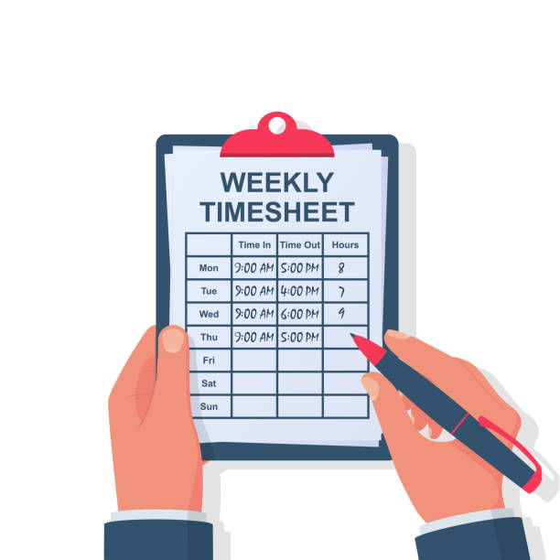
Work Experience
Meet at least ONE of the following:
Option 1: One (1) year paid or unpaid work experience with a minimum accumulation of 1550 hours of experience in a peer role.
Option 2: Minimum of 1550 hours in 3-years with 500 hours completed within the last 12-months, working in a peer role.

Slide 21
Training Requirements
Meet ALL the following:
1. Complete 20 hours of continuing education (CEs), including 6 hours of law and ethics. CE course training shall have been taken in the last 2 years.
2. Completion of a Peer training. Peer training is defined as training focused on concepts of peer recovery and resiliency. Proof of completion is required.
3. Three (3) letters of recommendation
Supervisor
Colleague or professional
Self
A list of acceptable trainings and documentation is available on the CalMHSA website.
Notes:
CEs can be in relevant professional competencies obtained via relevant in-state, out of state or national educational forums.

Slide 22
Three Letters of Recommendation
Supervisor
Colleague or Professional
Self
Describing your role and responsibilities as a Peer Support Specialist

Slide 23
Initial Certification
The second wave of certification

Slide 24
Initial Certification
Certification Requirements
Submit application on the CalMHSA Certification website.
Must be at least 18 years age or older.
Possess a high school diploma, General Education Development (GED) or equivalent, or college degree.
Self-identify as an individual with lived experience, Peer.
Be willing to share own experience as a person with lived experience.
Have a strong dedication to recovery.
Agree, in writing, to adhere to the California Department of Health Care Services Medi-Cal Code of Ethics for Peer Support Specialists in California.
Meet training requirement.
Successfully pass the exam.

Slide 25
Initial Certification Continued
Training Requirements
CalMHSA approves all training entities
Requires evidence of completing an 80-hour Peer Support Specialist training from an approved training entity
Training entities approved to begin training on July 1, 2022

Slide 26
Approved Training Entities with Intended Contracts
Alameda County Network of Mental Health Clients
Cal Voices
City College of San Francisco
Community Action Marin
Copeland Center for Wellness and Recovery Inc.
Crestwood Behavioral Health, Inc.
Depression and Bipolar Support Alliance (DBSA)
Emotional Health Association/SHARE!
Futuro Health
Integrated Community Services
Los Angeles Centers for Alcohol and Drug Abuse (L.A. CADA)
Loyola Marymount University
Mental Health Client Network
Mental Health Association of San Francisco
NAMI California
Pacific Clinics
Painted Brain
Parents Anonymous Inc.
RI International a DBA for Recovery Innovations
Richmond Area Multi-Services, Inc.
RUHS – Behavioral Health
San Jose City College
Tarzana Treatment Centers, Inc.
The Wildflower Collective
Worker Education and Resource Center

Slide 27
Exam
All persons must successfully pass the exam to receive certification for Medi-Cal Peer Support Specialist
Presently under development by the Human Resource Research Organization (HumRRO)
Use of Subject Matter Experts identified by CalMHSA (local and national SMEs)
Exam expected to be available in October 2022
Available in English, followed by 16 other languages
Exam administered on-line
Number of questions and format under development

Slide 28

How to Apply
Watch the Medi-Cal Peer Support Specialist Orientation and Self-Assessment Video (30 minutes)
Submit application on the CalMHSA Certification website
Upload documents for evidence is required
Sign the Code of Ethics
Take the exam

Slide 29
A Last Few Words
Continue to check the CalMHSA Certification website for updates: https://www.calmhsa.org/peer-certification/
Resources also available on the DHCS website: Peer Support Services (ca.gov)
Attend a Peer Support Specialist Stakeholder Advisory Council Meeting hosted by CalMHSA and CAMPRO (information on the CalMHSA website)

Slide 30
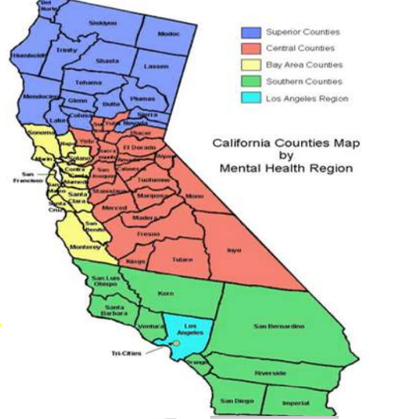
Peer Empowerment Partnership Regional Trainers
Mary McQueen
Southern & Los Angeles Regions
Mary.camhpro@gmail.com
Corinita Reyes
Bay Area Region
Corinita.camhpro@gmail.com
Daniel Medina
Superior & Central Regions
Daniel.camhpro@gmail.com

Slide 31
CalMHSA
Email: PeerCertification@calmhsa.org

Slide 32
Questions
Please submit your questions through the GoToWebinar portal.
Questions after the presentation regarding the peers benefit may be submitted to your County Support Liaison.

