Slide 1
Defining Housing and Housing-Based Services
Sharon Rapport,
Associate Director, California Policy, CSH
November 4, 2014

Slide 2
Our Mission
Advancing housing solutions that:
Improve lives of vulnerable people
Maximize public resources
Build strong, healthy communities

Slide 3
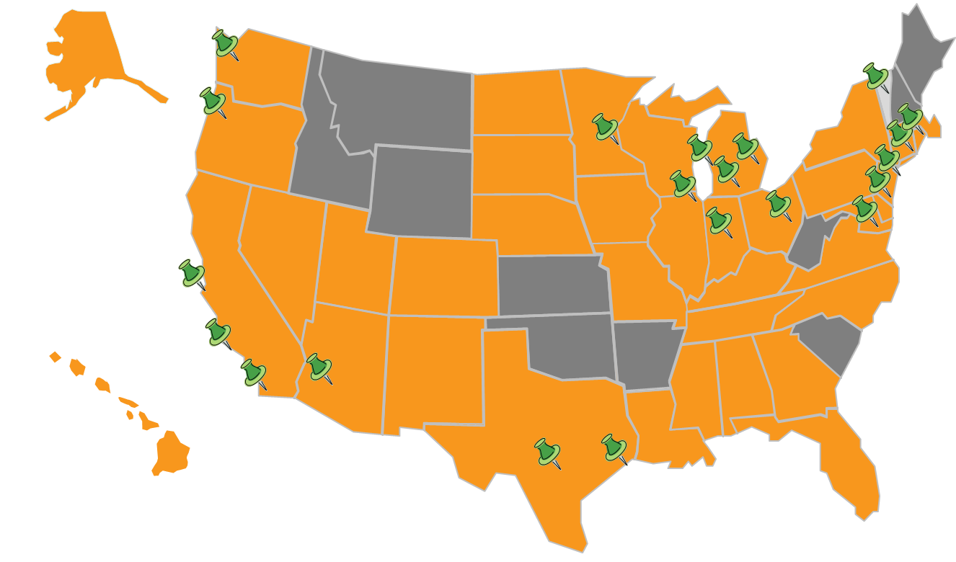
Building Strong, Healthy Communities

Slide 4
Maximizing Public Resources
CSH collaborates with communities to introduce housing solutions that promote integration among public service systems, leading to strengthened partnerships and maximized resources.
Public Systems (Housing, Health Care, Criminal Justice, Welfare) → CSH → Maximized Resources

Slide 5
Housing is Health Care
Randomized trial showed people remaining homeless had 1/3 higher hospitalizations & hospital days, 1/4 higher ED visits than formerly chronically homeless, chronically ill housing tenants. Journal of American Medical Association.
Premature death rates for people experiencing homelessness are 3.5-5 times higher than general population. New England Journal of Medicine, Annals of Internal Medicine.
Survival rates among HIV patients still homeless are 62% higher than people living in supportive housing, despite receiving same care. Tenants showed intact immunity, decreased viral load. American Journal of Public Health.
After 2 years in supportive housing, 100% reduction in hypertension crises, 30% decrease in rates of obesity, over 19% decrease in alcohol consumption.

Slide 6
Housing Models: 1980’s-’90’s (not subject to licensure)
Model | Emergency Shelter | Transitional Housing | Affordable Housing
Cost | $$$$ | $$$ | $$
Duration | Short-Term (1-180 Days) | Medium-Term Subsidy, Length of Stay in Housing Limited to 6-24 Months | Long-Term Subsidy, No Limit on Length of Stay in Housing
Features | Site-Based Immediate Access High-Barriers, Particularly for People with SUD Services Vary Greatly | Site-Based Must be “Ready” No High-Need Populations No Lease Housing Contingent on Participation in Services Services: Job Training, Abstinence-Based SUD Treatment | Site-Based (i.e., tax credits) & Scattered Site (HUD §§ 8, 811, 202) Lease Apply, Meet Background Check, Waiting List Services: Site Amenities Income Targeting for Site Based Often Above Poverty

Slide 7
Housing Models: 1990’s-Present (evolving)
Model | Rapid Re-Housing | Permanent Supportive Housing | Affordable Housing
Cost | $ | $$$ | $$
Duration | Short- & Medium-Term Subsidy, No Limit on Length of Stay in Housing | Long-Term Subsidy, No Limit on Length of Stay (focused on permanency) | Long-Term Subsidy, No Limit on Length of Stay in Housing
Features | Scattered Site Lease Services: Housing Location, Some Short-Term Case Management | Site-Based & Scattered Site Lease Low-Barrier (Harm Reduction, Criminal Record, Ltd. Background Check) Services: Housing & Health Stability (Case Management, Money & Med. Management, Benefits Advocacy, etc.) | Site-Based & Scattered Site Lease Apply, Meet Background Check, Waiting List Services: Site Amenities Income Targeting for Site Based Often Above Poverty

Slide 8
What is Supportive Housing?
Supportive housing is an evidence-based model that combines affordable housing with services that help tenants retain housing stability.
Housing: Affordable
  No limits on stay
  Independent
  Lease w/tenant protections
  Not subject to licensure
  Support
  Flexible
  Voluntary
  Tenant-centered
  Face-to-Face
  Affordable Housing
  SUD Tx
  Primacry Care
  Case Management
  Life Skills
  Employment Services
  Mental Health Services

Slide 9
Why Housing Stability is Important
Highly-vulnerable populations must move into housing before services can be effective.
Housing is independent, integrated, & not conditioned on participation in services.
Housing is necessary for recovery.
Anyone is ready for housing.
Housing is a basic human need, not a reward for clinical success or a contingency for compliance.
Engagement is key.
Once stable in housing, clinical & social stabilization occur faster, & are more enduring.

Slide 10
Housing Continuum for Vulnerable / Expensive Medicaid Populations
No Wrong Door
Assessment
Rapid Re-Housing: Housing Location
  Need Affordable Place to Live
  Need SH
  Bridge Housing/Respite Until Locate Available Supportive Housing
  Moving toward until recently

Slide 11
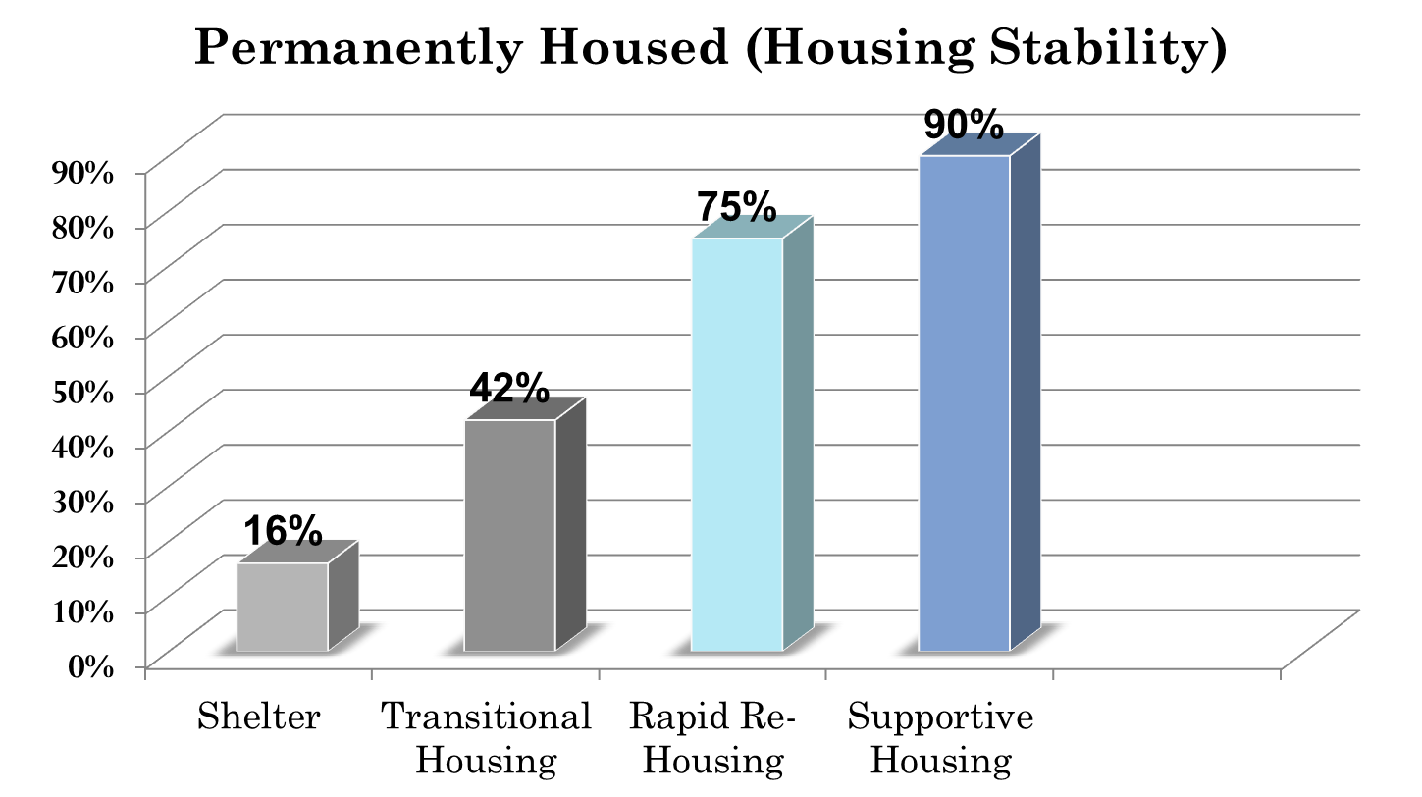
Percent of People Achieving Housing Stability After Moving Into . . .

Slide 12
Supportive Housing Reduces Health Care Costs
California: 40% decrease in public costs among homeless GR recipients after moving into supportive housing (taking into consideration costs of housing).
Chicago: $6,307 reduction in costs per year, compared to control group.
Seattle: $2,449 less in Medicaid costs per month among formerly chronically homeless alcoholics, compared to control group.
Los Angeles: 81% decrease in inpatient days and total hospital costs among 10% highest-cost homeless people.

Slide 13

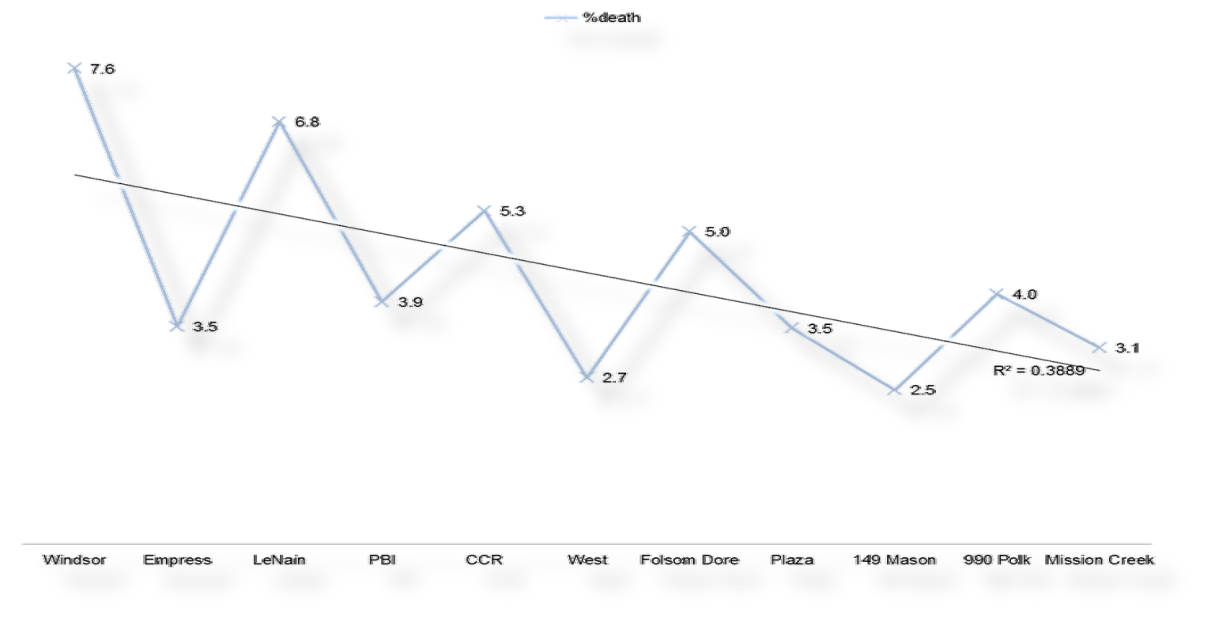
Housing Quality Matters

Slide 14
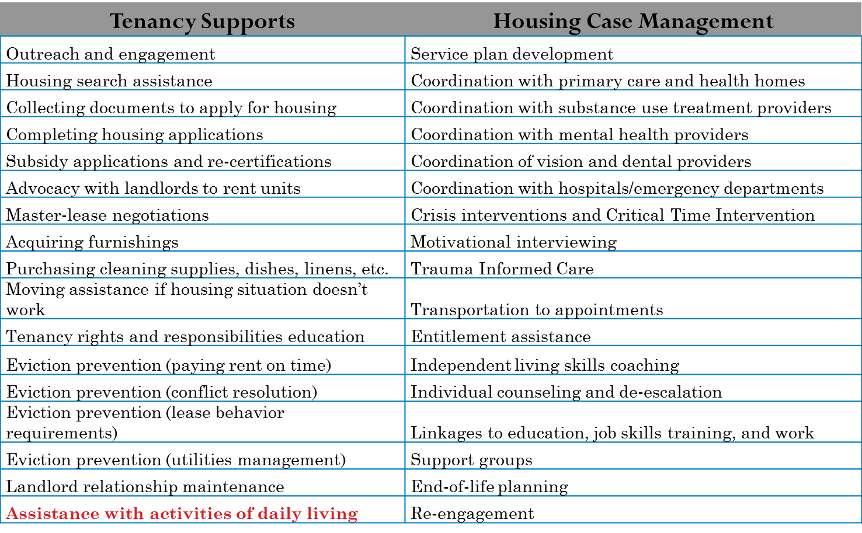
Housing-Based Services

Slide 15
Recuperative Care & Medical Respite
Specialized shelter for people not sick enough to be in the hospital, too sick to be on the streets or in shelter:
Discharged or diverted from hospital.
On-site or visiting nurse services.
Designated facilities or beds within a shelter or transitional housing (not licensed).
Short-term stays or stabilization until case manager connects to permanent housing.

Slide 16
Role of Housing & Housing-Based Services in Other States’ Medicaid Programs
Sharon Rapport,
Associate Director, California Policy, CSH
November 4, 2014

Slide 17
Types of Funding for Housing
Capital
Operating/Rental Subsidies
Services

Slide 18
Other States’ Approach to Funding Housing: New York
1115 Waiver
$750 million: reinvestment of projected Medicaid cost savings from creating supportive housing for chronically homeless beneficiaries. Reinvestment in—
Capital to build new apartments
Operating to fund operations of buildings
Services offered to tenants
CMS:
Denied use of federal dollars for capital & operating
Approved use of federal & state Medicaid money for housing-based services
Approved use of state Medicaid savings for capital & operating

Slide 19
Other States’ Approach to Funding Housing: New York (cont.)
CMS also approved—
Reinvestment of overall savings from waiver ($8 billion) into new payment models, including Delivery System Reform Incentive Payments (DSRIP):
Grants, workforce programs, & incentive payments to reduce avoidable hospital use by 25% over 5 years
Available to public hospitals, Federally-Qualified Health Centers, nursing homes
Partnerships with housing providers for respite care:
Rehabilitation. stabilization, case management
Link to permanent housing
State Medicaid Savings Investment: $256 million in capital & operating support for supportive housing FY2012/13 to 2014/15

Slide 20
Other States’ Approach to Funding Housing: Illinois
1115 Waiver
Made IL a mandatory managed care state
Improvements in targeting highly vulnerable, high-cost populations
Incentive payments based on performance measures
Allow managed care organizations to re-invest incentive payments into—
Rental assistance
Capital investment
Supportive housing services
Submitted in June 2014, in negotiations with CMS on budget neutrality

Slide 21
Other States’ Approach to Funding Housing-Based Services: Texas
1115 Waiver
Delivery System Reform Incentive Payments (DSRIP):
Enhanced access in 20 Regional Health Plan areas
Two regions (Travis County & Harris County) fund comprehensive services in supportive housing
Coupled with locally-committed housing vouchers

Slide 22
Other States’ Approach to Funding Housing-Based Services: Rhode Island
1115 Waiver
Estimated savings of over $2 million by investing in supportive housing services
Benefits package included bundled/case rate payment to supportive housing service providers who offer services in housing to high-acuity beneficiaries
Outreach & engagement
Tenancy supports
Case management
Behavioral health counseling
Transportation
State withdrew this part of their waiver

Slide 23
Other States’ Approach to Funding Housing-Based Services: Illinois
Accountable Care Organizations
Payment & delivery reform model for assigned patient population
Coordinated health care providers offer care coordination
Chicago Together for Health ACO manages Coordinated Care Entity (CCE)
Targets beneficiaries with chronic conditions
Provider network includes supportive housing programs
Funds services in housing
Tracks costs among beneficiaries

Slide 24
Other States’ Approach to Funding Housing-Based Services: Oregon
Accountable Care Organizations
CMS-approved Medicaid funding for Coordinated Care Organizations in Oregon
Coordinated health care providers offer full-range of care, at risk for whole-person care
Tri-City Medicaid Collaborative (Portland/Multnomah County):
Provider network includes supportive housing programs
Use savings to fund services in housing

Slide 25
Other States’ Approach to Funding Housing-Based Services: Louisiana
Home & Community-Based Services Waivers
Managed through behavioral health managed care organization (MCO)
MCO tracks availability of housing units, & funds supportive housing service providers for services in housing
Goals
Reducing chronic homelessness
Reducing number of people residing in institutional care
Improving integration of care
Eligibility
Beneficiaries with significant long-term disability in need of housing and services

Slide 26
Other States’ Approach to Funding Housing-Based Services: Washington
Work in Progress
Developing plans to seek approval for a “supportive housing benefit”
Services in supportive housing
For people who are chronically homeless or people in long-term institutional care

Slide 27
Managed Care Specific Initiatives
Massachusetts Behavioral Health Partnership
  Chronically Homeless Beneficiaries
  Uses behavioral health benefit
  Pays $17 per day, per member
  Supportive housing providers must place beneficiary in housing w/in 60 days
Medica in Minnesota
  Demonstration Project: 85 high-cost users
  MCO funds services and operating costs of supportive housing (i.e., rental assistance)
  Coordinated by Hearth Connection, Inc
Others
  Philadelphia: City-Run MCO funds operating through projected savings & uses Medicaid for services
  LA Care, Anthem in LA investing in pilots
  UnitedHealth Care/OptumHealth & WellPoint/ Amerigroup exploring

Slide 28
Issues & Ideas for Housing Component in 1115 Waiver
Sharon Rapport,
Associate Director, California Policy, CSH
November 4, 2014

Slide 29
Issues to be Decided
Who to Serve
  Identifying populations to be targeted.
  Defining eligibility criteria.
What to Fund
  Identifying appropriate housing options.
  Establishing categories of services.
  Enumerating & defining services models for each population.
  Defining services not otherwise covered.
How to Fund
  Identifying viable options for CMS approval.
  Assessing options for oversight & payment.
  Determining costs to set rate.
  Identifying mechanisms for administering housing vouchers.

Slide 30
Issues to be Decided (cont.)
How to Achieve Budget Neutrality
  Identifying Medicaid costs saved.
  Comparing Medicaid costs populations currently incur to costs saved.
  Determining a threshold of potential savings to establish federal budget neutrality.
Others
  ???

Slide 31
Identifying & Targeting Eligible Populations
Overlap between:
  39,250 chronically homeless people live on the streets or in shelters on any given night in California.
    Average Health Care Costs: >$1,854/month
  11.4% (10,727) of nursing home residents have “low care needs.”
    Seniors & adults with disabilities
    Average Health Care Costs: >$4,580/month

Slide 32
Overlap: Homeless People are Aging & Have Greater Risk of Nursing Home Placement
32% increase in number of homeless persons 51-61 between 2007 and 2013.
People experiencing homelessness use 9.8 more nursing home days on average per year than formerly homeless people living in supportive housing
Homeless people over 50 disproportionately exit homelessness to SNFs & board & care.
Growing number of older homeless adults.

Slide 33
Overlap in Populations: Poverty & Housing Unaffordability Cause Homelessness
Admitting beneficiaries, already in poverty, to nursing homes often leads to loss of their affordable place to live.
Institutionalization and homelessness among people in deep poverty who cannot a afford an apartment.
Poverty rates still on the rise in California

Slide 34
What to Fund
Capital
  Medicaid
Operating/Rental Subsidies
Services

Slide 35
Bridge Housing/Respite Care
Bridge Subsidies: short to medium term rental payments
Bridge Subsidy → Long-term subsidy
Respite/Recuperative Care

Slide 36
Permanent Housing
Operating/Rental Subsidies
  Tenant Choice
  Nature of Benefits
  Qualified Housing Providers
  Use for:
    Single Site
    Master Leased
    Scattered Site

Slide 37
Medicaid-Funded Housing
HUD: Housing
HHS: Services
“How can Medicaid support people connecting to housing without becoming a permanent affordable housing subsidizer?”

Slide 38
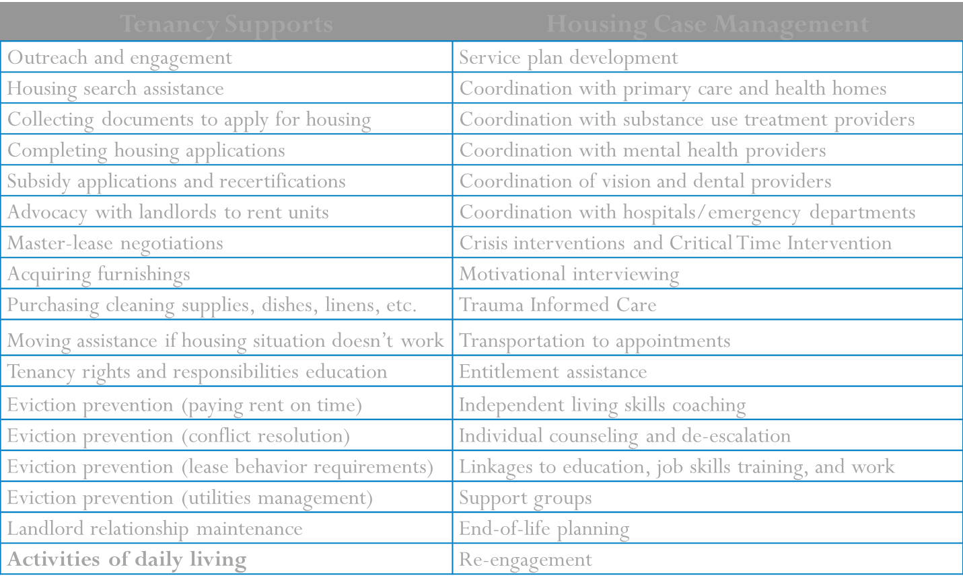
Housing Based Services

Slide 39
Medicaid-Funded Housing-Based Services
CMS & HHS have recognized services in supportive housing as Medicaid reimbursable
Comprehensive range of flexible services already covered in many state Medicaid programs
Pre-tenancy services
Move-in services
Tenancy services

Slide 40
How to Fund
Medi-Cal Managed Care
  MCO rates include housing & services for defined populations.
  Incentive payments.
  Case rate for “housing-based services,” including rental payments, nurse care in housing/respite.
DSRIP
  Pool of funds to offer incentives for reducing high-cost care (hospitalizations, nursing home stays, etc.).
  Hospitals, nursing homes, clinics, MCOs.
Separate Benefit
  Case rate for “housing-based services,” incl. rental payment.
  MCOs, counties, or State administer.
  Network of providers.

Slide 41
Budget Neutrality
Cost data for low-care need populations: housing & services in community vs. skilled nursing facilities
Targeting of high-cost populations:
Monthly costs of $6,529, Annual cost: $78,348
Hospitals: $3,452 per month annual cost: $41,424
More with jail medical & mental health.

Slide 42

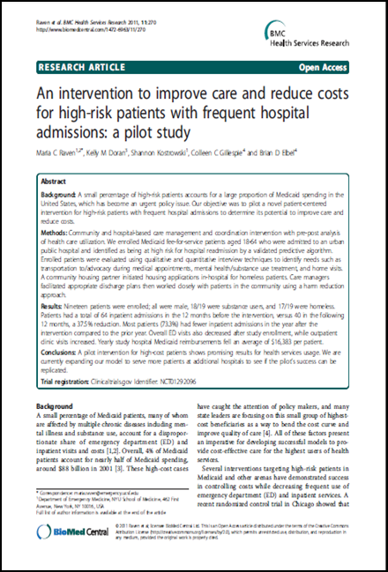
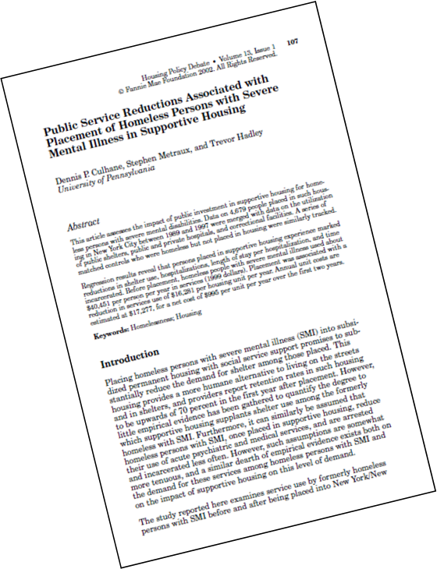
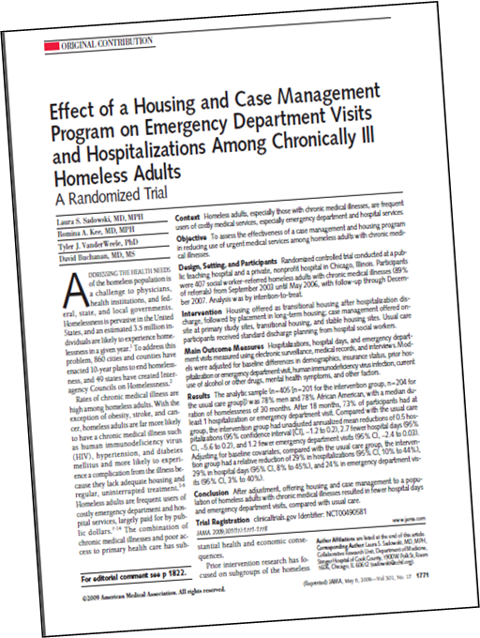
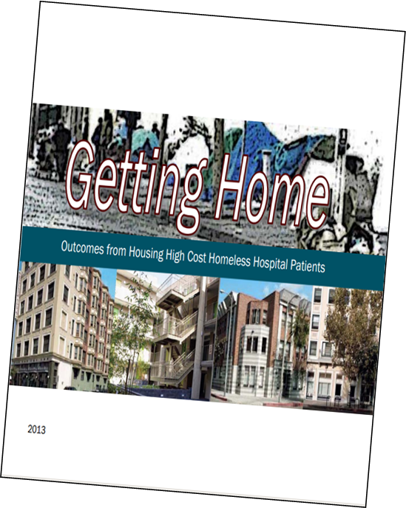
Research Data: Affordable Housing & Housing-Based Services Reduces Medicaid Costs

Slide 43
Gathering Data
Other States

Slide 44
Sharon.Rapport@csh.org
(323) 243-7424 (c)
(213) 623-4342, x18 (o)

