Slide 1
Defining Housing and Housing-Based Services
Sharon Rapport,
Associate Director, California Policy, CSH
November 4, 2014

Slide 2
Our Mission
Advancing housing solutions that:
Improve lives of vulnerable people
Maximize public resources
Build strong, healthy communities

Slide 3
Building Strong, Healthy Communities
Locations where CSH has staff stationed
Locations where CSH has helped build strong communities

Slide 4



Maximizing Public Resources
CSH collaborates with communities to introduce housing solutions that promote integration among public service systems, leading to strengthened partnerships and maximized resources.
Public Systems
Housing
Health Care
Criminal Justice
Child Welfare
Maximized Resources

Slide 5
Housing is Health Care
Randomized trial showed people remaining homeless had 1/3 higher hospitalizations & hospital days, 1/4 higher ED visits than formerly chronically homeless, chronically ill housing tenants. Journal of American Medical Association.
Premature death rates for people experiencing homelessness are 3.5-5 times higher than general population. New England Journal of Medicine, Annals of Internal Medicine.
Survival rates among HIV patients still homeless are 62% higher than people living in supportive housing, despite receiving same care. Tenants showed intact immunity, decreased viral load. American Journal of Public Health.
After 2 years in supportive housing, 100% reduction in hypertension crises, 30% decrease in rates of obesity, over 19% decrease in alcohol consumption.

Slide 6


Housing Models: 1980’s-’90’s (not subject to licensure)
Model | Emergency Shelter | Transitional Housing | Affordable Housing
Cost | $$$$ | $$$ | $$
Duration | Short-Term (1-180 Days) | Medium-Term Subsidy, Length of Stay in Housing Limited to 6-24 Months | Long-Term Subsidy, No Limit on Length of Stay in Housing
Features | Site-Based Immediate Access High-Barriers, Particularly for People with SUD Services Vary Greatly | Site-Based Must be “Ready” No High-Need Populations No Lease Housing Contingent on Participation in Services Services: Job Training, Abstinence-Based SUD Treatment | Site-Based (i.e., tax credits) & Scattered Site (HUD §§ 8, 811, 202) Lease Apply, Meet Background Check, Waiting List Services: Site Amenities Income Targeting for Site Based Often Above Poverty

Slide 7


Housing Models: 1990’s-Present (evolving)
Model | Rapid Re-Housing | Permanent Supportive Housing | Affordable Housing
Cost | $ | $$$ | $$
Duration | Short- & Medium-Term Subsidy, No Limit on Length of Stay in Housing | Long-Term Subsidy, No Limit on Length of Stay (focused on permanency) | Long-Term Subsidy, No Limit on Length of Stay in Housing
Features | Scattered Site Lease Services: Housing Location, Some Short-Term Case Management | Site-Based & Scattered Site Lease Low-Barrier (Harm Reduction, Criminal Record, Ltd. Background Check) Services: Housing & Health Stability (Case Management, Money & Med. Management, Benefits Advocacy, etc.) | Site-Based & Scattered Site Lease Apply, Meet Background Check, Waiting List Services: Site Amenities Income Targeting for Site Based Often Above Poverty

Slide 8
What is Supportive Housing?
Supportive housing is an evidence-based model that combines affordable housing with services that help tenants retain housing stability.
Case Manage-ment
Primary Care
Housing: Affordable
No limits on stay
Independent
Lease w/tenant protections
Not subject to licensure
SUD Tx
Support:
Flexible
Voluntary
Tenant-centered
Face-to-Face
Affordable Housing
Life Skills
Mental Health Services
Employ-ment Services

Slide 9

Why Housing Stability is Important
Highly-vulnerable populations must move into housing before services can be effective.
Housing is independent, integrated, & not conditioned on participation in services.
Housing is necessary for recovery.
Anyone is ready for housing.
Housing is a basic human need, not a reward for clinical success or a contingency for compliance.
Engagement is key.
Once stable in housing, clinical & social stabilization occur faster, & are more enduring.

Slide 10
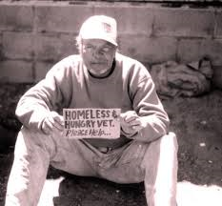
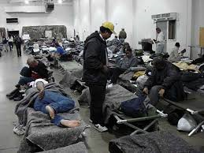



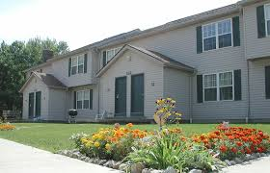




Housing Continuum for Vulnerable/Expensive Medicaid Populations
Rapid Re-Housing: Housing Location
No Wrong Door
Need Affordable Place to Live
Need SH
Bridge Housing/Respite Until Locate Available Supportive Housing
Assessment
Moving Toward
Until Recently

Slide 11
Percent of People Achieving Housing Stability After Moving Into . . .

Slide 12
Supportive Housing Reduces Health Care Costs
California
40% decrease in public costs among homeless GR recipients after moving into supportive housing (taking into consideration costs of housing).
Chicago
$6,307 reduction in costs per year, compared to control group.
Seattle
$2,449 less in Medicaid costs per month among formerly chronically homeless alcoholics, compared to control group.
Los Angeles
81% decrease in inpatient days and total hospital costs among 10% highest-cost homeless people.

Slide 13
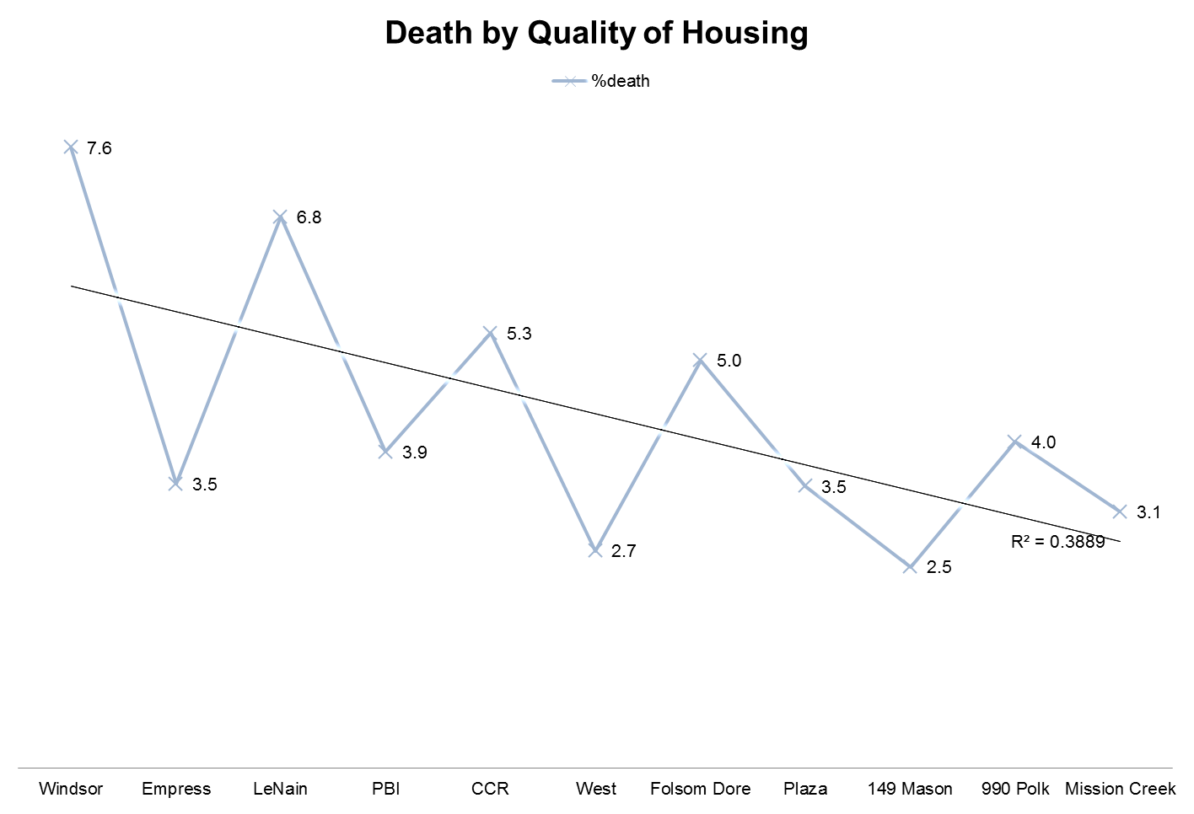
Housing Quality Matters
Death Rates Among SF Department of Public Health Projects

Slide 14
Housing-Based Services
Tenancy Supports | Housing Case Management
Outreach and engagement | Service plan development
Housing search assistance | Coordination with primary care and health homes
Collecting documents to apply for housing | Coordination with substance use treatment providers
Completing housing applications | Coordination with mental health providers
Subsidy applications and re-certifications | Coordination of vision and dental providers
Advocacy with landlords to rent units | Coordination with hospitals/emergency departments
Master-lease negotiations | Crisis interventions and Critical Time Intervention
Acquiring furnishings | Motivational interviewing
Purchasing cleaning supplies, dishes, linens, etc. | Trauma Informed Care
Moving assistance if housing situation doesn’t work | Transportation to appointments
Tenancy rights and responsibilities education | Entitlement assistance
Eviction prevention (paying rent on time) | Independent living skills coaching
Eviction prevention (conflict resolution) | Individual counseling and de-escalation
Eviction prevention (lease behavior requirements) | Linkages to education, job skills training, and work
Eviction prevention (utilities management) | Support groups
Landlord relationship maintenance | End-of-life planning
Assistance with activities of daily living | Re-engagement

Slide 15




Recuperative Care & Medical Respite
Specialized shelter for people not sick enough to be in the hospital, too sick to be on the streets or in shelter:
  Discharged or diverted from hospital.
  On-site or visiting nurse services.
  Designated facilities or beds within a shelter or transitional housing (not licensed).
  Short-term stays or stabilization until case manager connects to permanent housing.

Slide 16
Role of Housing & Housing-Based Services in Other States’ Medicaid Programs
Sharon Rapport,
Associate Director, California Policy, CSH
November 4, 2014

Slide 17



Types of Funding for Housing
Capital
Operating/
Rental Subsidies
Services

Slide 18

Other States’ Approach to Funding Housing: New York
1115 Waiver
$750 million: reinvestment of projected Medicaid cost savings from creating supportive housing for chronically homeless beneficiaries. Reinvestment in—
  Capital to build new apartments
  Operating to fund operations of buildings
  Services offered to tenants
CMS:
  Denied use of federal dollars for capital & operating
  Approved use of federal & state Medicaid money for housing-based services
  Approved use of state Medicaid savings for capital & operating

Slide 19
Other States’ Approach to Funding Housing: New York (cont.)
CMS also approved—
  Reinvestment of overall savings from waiver ($8 billion) into new payment models, including Delivery System Reform Incentive Payments (DSRIP):
    Grants, workforce programs, & incentive payments to reduce avoidable hospital use by 25% over 5 years
    Available to public hospitals, Federally-Qualified Health Centers, nursing homes
    Partnerships with housing providers for respite care:
        Rehabilitation. stabilization, case management
        Link to permanent housing
State Medicaid Savings Investment: $256 million in capital & operating support for supportive housing FY2012/13 to 2014/15

Slide 20

Other States’ Approach to Funding Housing: Illinois
1115 Waiver
Made IL a mandatory managed care state
Improvements in targeting highly vulnerable, high-cost populations
  Incentive payments based on performance measures
    Allow managed care organizations to re-invest incentive payments into—
      Rental assistance
      Capital investment
      Supportive housing services
Submitted in June 2014, in negotiations with CMS on budget neutrality

Slide 21

Other States’ Approach to Funding Housing-Based Services: Texas
1115 Waiver
Delivery System Reform Incentive Payments (DSRIP):
  Enhanced access in 20 Regional Health Plan areas
    Two regions (Travis County & Harris County) fund comprehensive services in supportive housing
    Coupled with locally-committed housing vouchers

Slide 22

Other States’ Approach to Funding Housing-Based Services: Rhode Island
1115 Waiver
Estimated savings of over $2 million by investing in supportive housing services
Benefits package included bundled/case rate payment to supportive housing service providers who offer services in housing to high-acuity beneficiaries
  Outreach & engagement
  Tenancy supports
  Case management
  Behavioral health counseling
  Transportation
State withdrew this part of their waiver

Slide 23
Other States’ Approach to Funding Housing-Based Services: Illinois
Accountable Care Organizations
Payment & delivery reform model for assigned patient population
Coordinated health care providers offer care coordination
Chicago Together for Health ACO manages Coordinated Care Entity (CCE)
  Targets beneficiaries with chronic conditions
  Provider network includes supportive housing programs
  Funds services in housing
  Tracks costs among beneficiaries

Slide 24

Other States’ Approach to Funding Housing-Based Services: Oregon
Accountable Care Organizations
CMS-approved Medicaid funding for Coordinated Care Organizations in Oregon
Coordinated health care providers offer full-range of care, at risk for whole-person care
Tri-City Medicaid Collaborative (Portland/Multnomah County):
  Provider network includes supportive housing programs
  Use savings to fund services in housing

Slide 25

Other States’ Approach to Funding Housing-Based Services: Louisiana
Home & Community-Based Services Waivers
Managed through behavioral health managed care organization (MCO)
MCO tracks availability of housing units, & funds supportive housing service providers for services in housing
Goals
  Reducing chronic homelessness
  Reducing number of people residing in institutional care
  Improving integration of care
Eligibility
  Beneficiaries with significant long-term disability in need of housing and services

Slide 26


Other States’ Approach to Funding Housing-Based Services: Washington
Work in Progress
Developing plans to seek approval for a “supportive housing benefit”
  Services in supportive housing
  For people who are chronically homeless or people in long-term institutional care

Slide 27
Managed Care Specific Initiatives
Massachusetts Behavioral Health Partnership
Chronically Homeless Beneficiaries
Uses behavioral health benefit
Medica in Minnesota
Demonstration Project: 85 high-cost users
Others
Pays $17 per day, per member
Supportive housing providers must place beneficiary in housing w/in 60 days
MCO funds services and operating costs of supportive housing (i.e., rental assistance)
Coordinated by Hearth Connection, Inc
LA Care, Anthem in LA investing in pilots
Philadelphia: City-Run MCO funds operating through projected savings & uses Medicaid for services
UnitedHealth Care/OptumHealth & WellPoint/ Amerigroup exploring

Slide 28
Issues & Ideas for Housing Component in 1115 Waiver
Sharon Rapport,
Associate Director, California Policy, CSH
November 4, 2014

Slide 29
Issues to be Decided
Who to Serve
Identifying populations to be targeted.
What to Fund
Identifying appropriate housing options.
How to Fund
Identifying viable options for CMS approval.
Defining eligibility criteria.
Assessing options for oversight & payment.
Determining costs to set rate.
Enumerating & defining services models for each population.
Establishing categories of services.
Defining services not otherwise covered.
Identifying mechanisms for administering housing vouchers.

Slide 30
Issues to be Decided (cont.)
How to Achieve Budget Neutrality
Identifying Medicaid costs saved.
Others
????
Comparing Medicaid costs populations currently incur to costs saved.
Determining a threshold of potential savings to establish federal budget neutrality.

Slide 31
Identifying & Targeting Eligible Populations
39,250 chronically homeless people live on the streets or in shelters on any given night in California.
Average Health Care Costs: >$1,854/month
11.4% (10,727) of nursing home residents have “low care needs.”
Seniors & adults with disabilities
Average Health Care Costs: >$4,580/month

Slide 32

Overlap: Homeless People are Aging & Have Greater Risk of Nursing Home Placement
32% increase in number of homeless persons 51-61 between 2007 and 2013.
People experiencing homelessness use 9.8 more nursing home days on average per year than formerly homeless people living in supportive housing
Homeless people over 50 disproportionately exit homelessness to SNFs & board & care.
Growing number of older homeless adults.

Slide 33
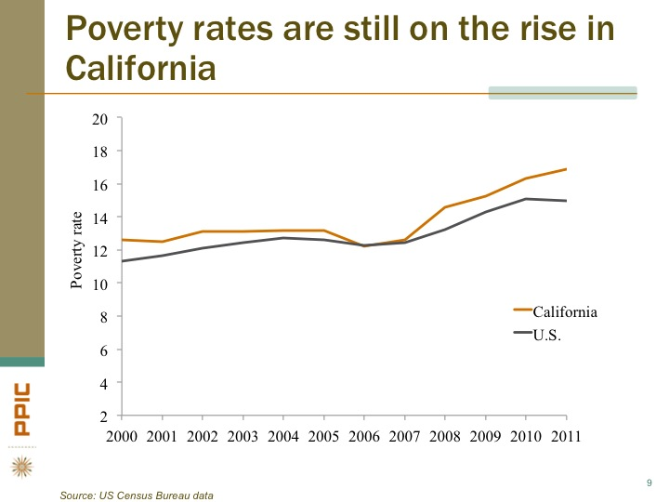
Overlap in Populations: Poverty & Housing Unaffordability Cause Homelessness
Admitting beneficiaries, already in poverty, to nursing homes often leads to loss of their affordable place to live.
      Institutionalization and homelessness among people in deep poverty who cannot a afford an apartment.

Slide 34
What to Fund
Medicaid
Capital
Operating/
Rental Subsidies
Services

Slide 35


Bridge Housing/Respite Care
Bridge Subsidies: short to medium term rental payments
Respite/Recuperative Care
Bridge Subsidy
Long-term subsidy

Slide 36
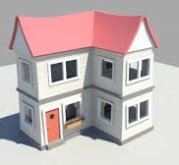


Permanent Housing
Single Site
Operating/
Rental Subsidies
Tenant Choice
Master Leased
Nature of Benefits
Qualified Housing Providers
Scattered Site

Slide 37


Medicaid-Funded Housing
HUD: Housing
HHS: Services
“How can Medicaid support people connecting to housing without becoming a permanent affordable housing subsidizer?”

Slide 38
Housing-Based Services2
Tenancy Supports | Housing Case Management
Outreach and engagement | Service plan development
Housing search assistance | Coordination with primary care and health homes
Collecting documents to apply for housing | Coordination with substance use treatment providers
Completing housing applications | Coordination with mental health providers
Subsidy applications and recertifications | Coordination of vision and dental providers
Advocacy with landlords to rent units | Coordination with hospitals/emergency departments
Master-lease negotiations | Crisis interventions and Critical Time Intervention
Acquiring furnishings | Motivational interviewing
Purchasing cleaning supplies, dishes, linens, etc. | Trauma Informed Care
Moving assistance if housing situation doesn’t work | Transportation to appointments
Tenancy rights and responsibilities education | Entitlement assistance
Eviction prevention (paying rent on time) | Independent living skills coaching
Eviction prevention (conflict resolution) | Individual counseling and de-escalation
Eviction prevention (lease behavior requirements) | Linkages to education, job skills training, and work
Eviction prevention (utilities management) | Support groups
Landlord relationship maintenance | End-of-life planning
Activities of daily living | Re-engagement
Services

Slide 39
Medicaid-Funded Housing-Based Services
CMS & HHS have recognized services in supportive housing as Medicaid reimbursable
Comprehensive range of flexible services already covered in many state Medicaid programs
  Pre-tenancy services
  Move-in services
  Tenancy services

Slide 40



How to Fund
Medi-Cal Managed Care
MCO rates include housing & services for defined populations.
Incentive payments.
Case rate for “housing-based services,” including rental payments, nurse care in housing/respite.
DSRIP
Pool of funds to offer incentives for reducing high-cost care (hospitalizations, nursing home stays, etc.).
Hospitals, nursing homes, clinics, MCOs.
Separate Benefit
Case rate for “housing-based services,” incl. rental payment.
MCOs, counties, or State administer.
Network of providers.

Slide 41

Budget Neutrality
Targeting of high-cost populations:
Monthly costs of $6,529 → Annual cost: $78,348
Hospitals: $3,452 per month annual cost: $41,424
More with jail medical & mental health.
Cost data for low-care need populations: housing & services in community vs. skilled nursing facilities

Slide 42
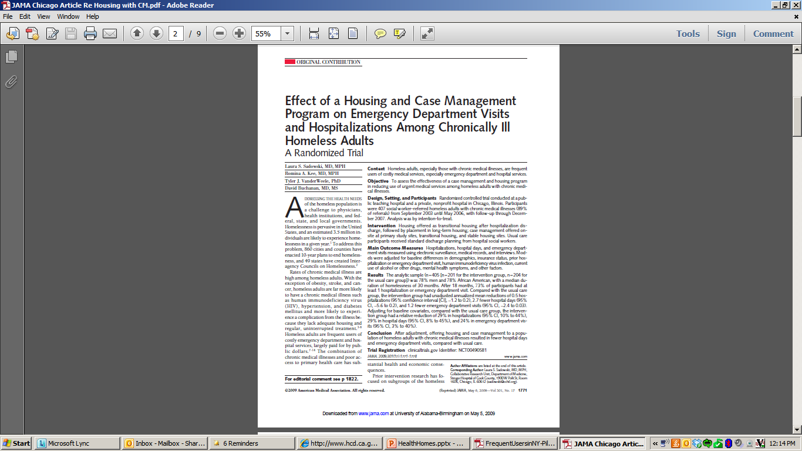
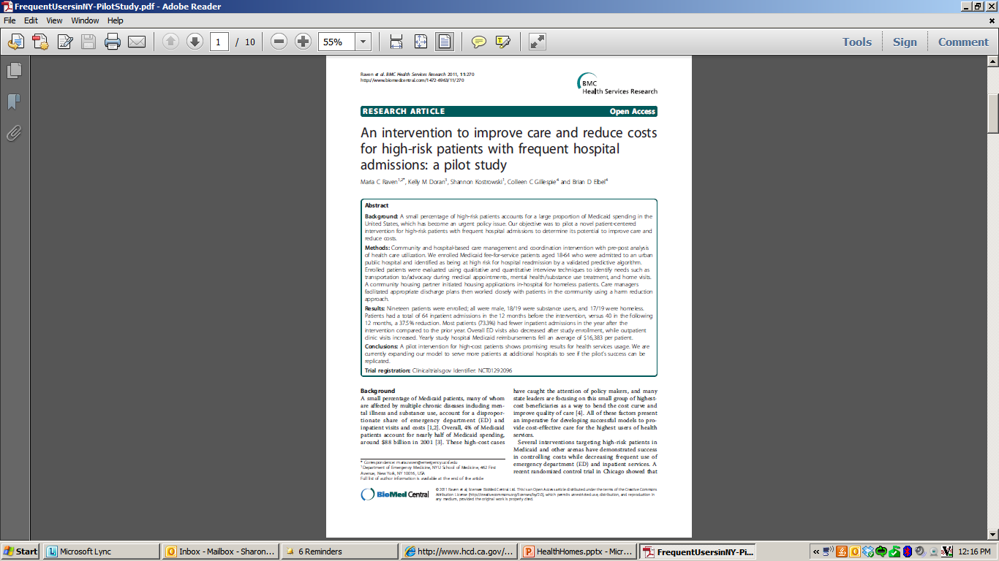
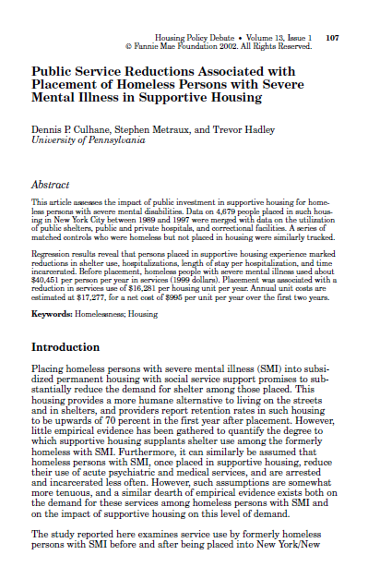
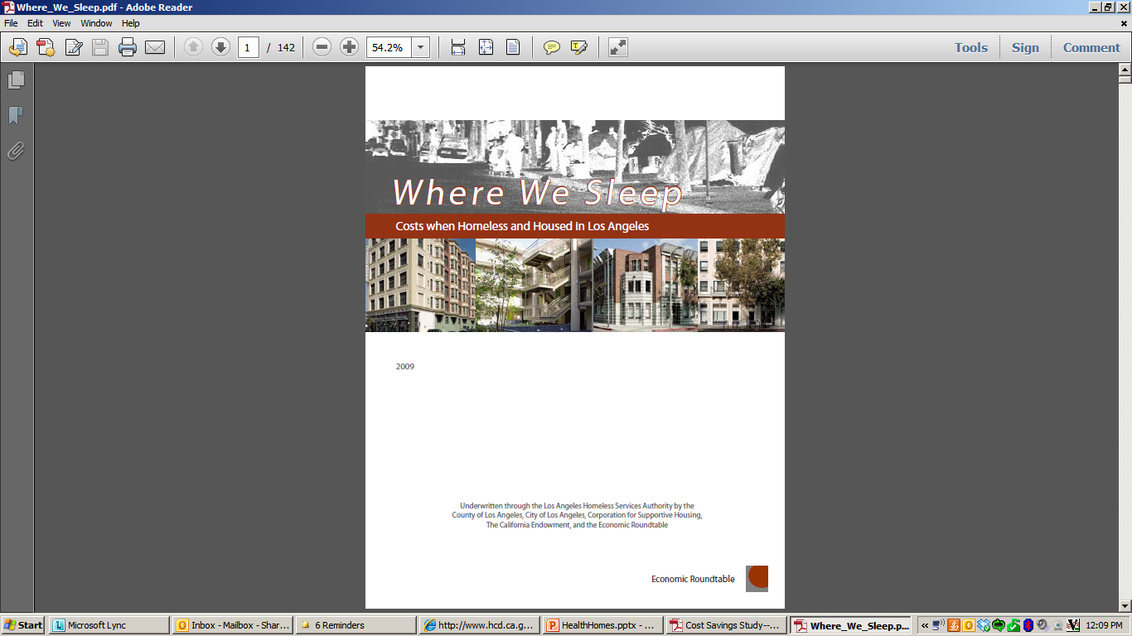
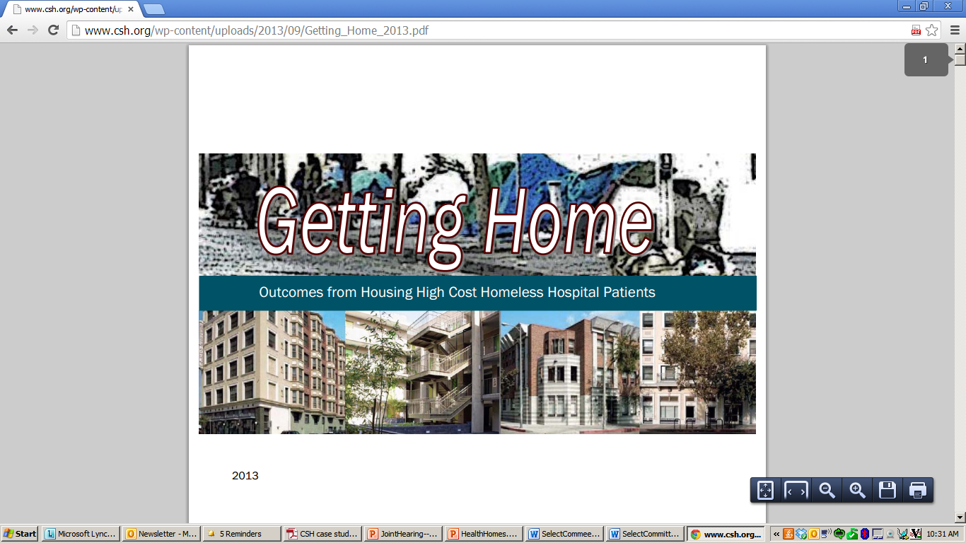
Research Data: Affordable Housing & Housing-Based Services Reduces Medicaid Costs
2008 2009 2011 2013

Slide 43



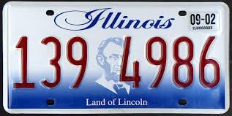

Gathering Data
Other States

Slide 44
Sharon.Rapport@csh.org
(323) 243-7424 (c)
(213) 623-4342, x18 (o)
\

