Slide 1

Current Workforce Development Efforts and Issues for Consideration for
California's Section 1115 Waiver Renewal
November 20, 2014
Sergio Aguilar, Senior Policy Analyst
Office of Statewide Health Planning and Development (OSHPD)
Healthcare Workforce Development Division (HWDD)

Slide 2
OSHPDs Role in Workforce Development
Has administered health workforce development programs and provided grant funding to address health workforce diversity, supply and distribution issues since the late 1970s
Administers programs which endeavor to implement the vision of “Access to Safe, Quality Healthcare Environments that Meet California’s Diverse and Dynamic Needs”
Promotes a diverse and competent health workforce

Slide 3
California's Healthcare Workforce Challenges
Increased demand for health care services
Shortage of health professionals
Maldistribution of health professionals
Lack of racial/ethnic and linguistic diversity
An aging workforce
Lack of clear career pathways
Constraints on capacity/slots of educational programs
Regulatory and scope of practice issues
Salary differentials by specialty/Reimbursement
A lack of formal integration and coordination of primary care, mental health, substance use treatment.
Delivery models
Burnout/Retention

Slide 4
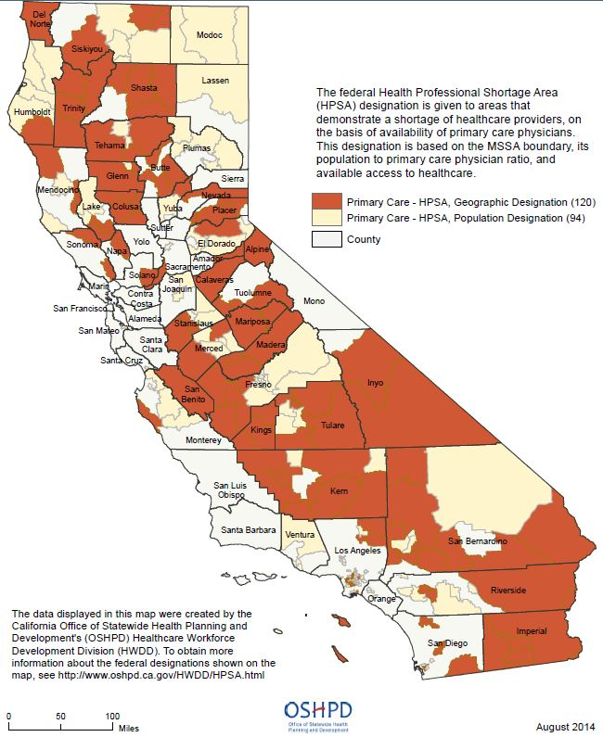
Health Profession Shortage Area, Primary Care
As of August 2014 there are:
  214 Primary Care HPSAs designated in California
  Approximately 5.7 million residents impacted in a Primary Care HPSA

Slide 5
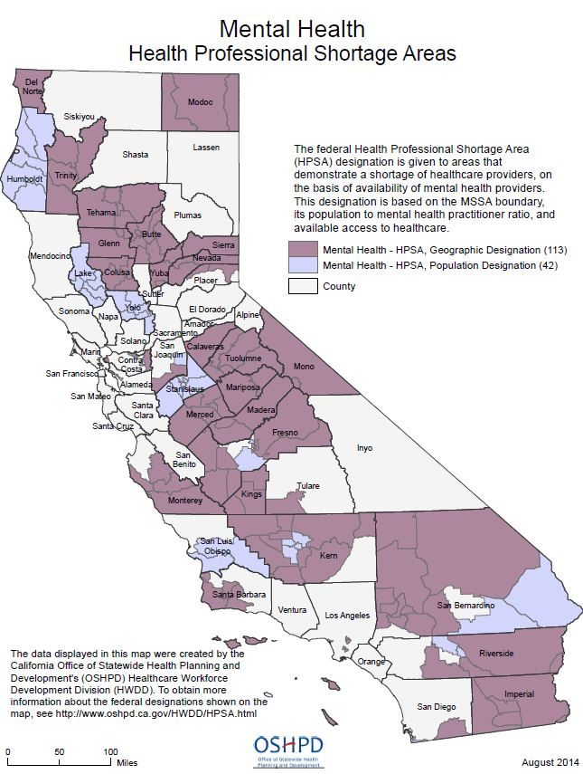
Health Profession Shortage Area, Mental Health
As of August 2014 there are:
  155 Mental HPSAs designated in California
  Approximately 4.4 million residents impacted in a Mental HPSA

Slide 6
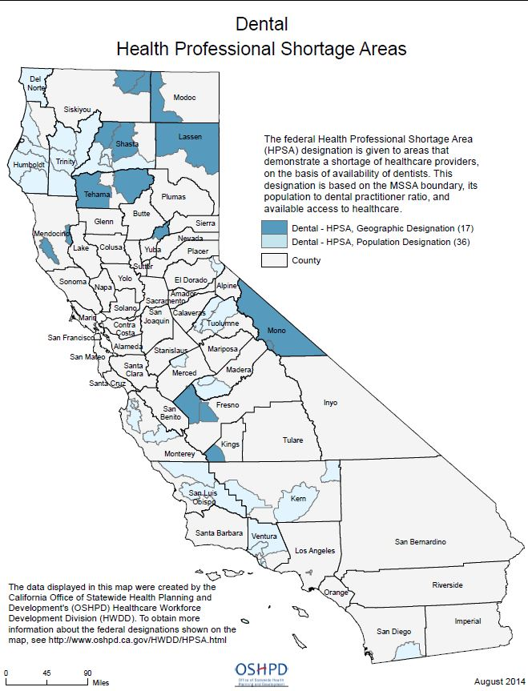
Health Profession Shortage Area,
Dental
As of August 2014 there are:
  53 Dental HPSAs designated in California
  Approximately 801,328 million residents impacted in a Dental HPSA

Slide 7
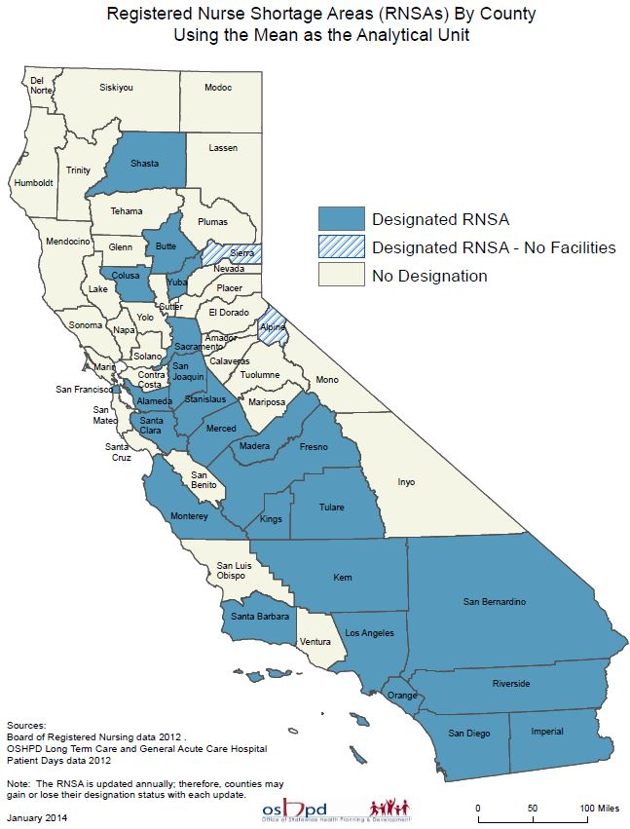
Registered Nurse Shortage Area
As of January 2014 there are:
  26 Registered Nurse Shortage Areas designated in California

Slide 8
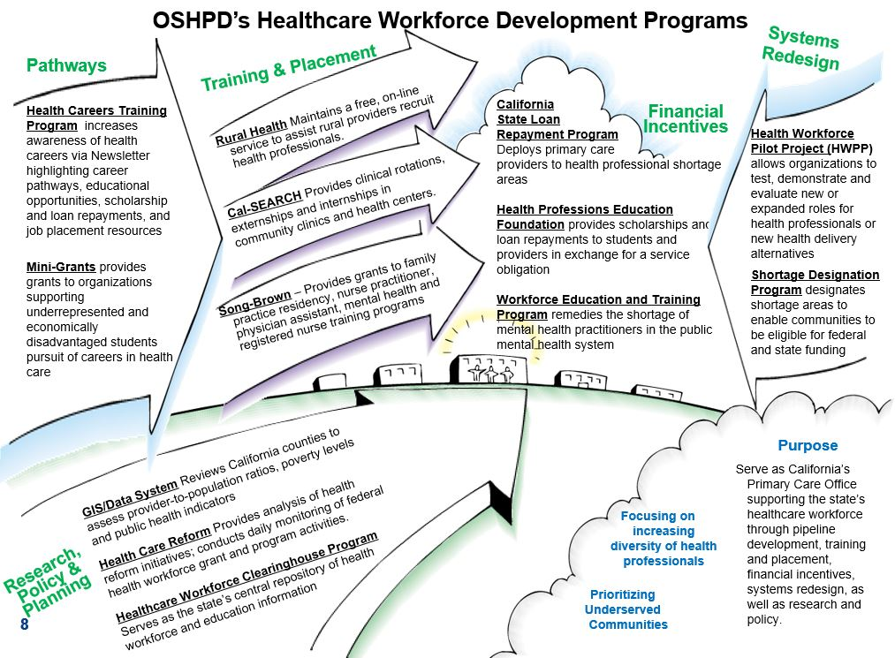
OSHPD’s Healthcare Workforce Development Program

Slide 9

OSHPD HWDD 2013-2015 Efforts to Respond to Healthcare Reform

Slide 10
Issues for Consideration
Educational Capacity Funding with Financial Incentives to Encourage Practice in Underserved Areas
Funding educational institutions and residencies to increase educational slots for advanced practice professions. Funded educational institutions and residencies can provide financial incentives to students in return for their commitment to provide direct patient care in an underserved area serving Medi-Cal and uninsured patients upon completion of their educational program/residency.

Slide 11
Issues for Consideration 2
Health Professions Recruitment and Retention Financial Incentive
Providing students, healthcare providers and/or sites with recruitment and retention financial incentives for health professions in high need in return for their commitment to provide direct patient care in underserved areas to Medi-Cal and uninsured populations for a specified period of time.

Slide 12
Issues for Consideration 3
Funding Eligible Healthcare Sites to Develop, Advance, and Retain Healthcare Workforce
Funding eligible healthcare sites in underserved areas to offer existing healthcare workforce with continuing education opportunities, career planning, development, and advancement opportunities. This grow-your-own strategy can help advance and retain workforce in underserved areas.

Slide 13
Issues for Consideration 4
Funding to Support Practice of Retired Healthcare Providers
Funding eligible healthcare sites in underserved areas to provide support to retired healthcare providers so that, when available, they can volunteer to provide direct patient care to Medi-Cal and underserved patients. This may help address the cost benefit of volunteering for retired health providers.

Slide 14
Issues for Consideration
Funding to Support Healthcare Workforce Training/Retraining
Funding the training of existing healthcare workforce in eligible sites on elements that can include but not be limited to: integration, collaboration, interdisciplinary and team-based care, and cultural and linguistic competence.

Slide 15
Cross Cutting Components for Considerations
Increasing racial/ethnic, cultural, and linguistic diversity of healthcare providers
Addressing distribution of healthcare providers
Encouraging educational institutions to train students in curricula that align with competencies needed to provide adequate care to California's diverse and dynamic population
Encouraging sites to implement collaborative, coordinated and integrated care delivery models

Slide 16
Examples of Other States Health Workforce Development Efforts
Health Workforce Career Awareness Grants
Educational Capacity and Graduate Medical Education Expansion Grants
Health Workforce Training and Retraining Grants
Healthcare Workforce Re-entry Programs
Retention Financial Incentives (loan repayment, grants to clinics/hospitals)
Recruitment Financial Incentives (scholarships, educational stipends, signing bonus)
Supporting Expanded Roles for Health Providers such as Nurse Practitioner, Peer Support Specialist, and Community Health Workers

Slide 17
Questions?
Contact:
Sergio Aguilar
Senior Policy Analyst
OSHPD HWDD
916-326-3699
Email: Sergio.Aguilar@OSHPD.CA.Gov

