Slide 1
MCHAP Sub-Committee:
Pediatric Dashboard
May 20, 2015
Anastasia Dodson, Associate Director
Linette Scott, Chief Medical Information Officer and Deputy Director

Slide 2
DHCS Dashboard Strategy
Develop overarching framework for integrated dashboard effort, both in display format and data elements
Develop, strengthen, and integrate public dashboards: overall DHCS dashboard, managed care, CCI, dental, mental health, SUDS, children’s health
Focus on cross-cutting issues & integrated care
Include process and outcome measures
Build on lessons learned

Slide 3
Governance Structure
Executive Dashboard Implementation Guide 201, December 2010
© 2010 Healthcare Information and Management Systems Society (HIMSS)

Slide 4
DHCS Dashboard Initiative Webpage

Slide 5
CHHS Open Data Embedded
Opportunities:
CHDP – Expanded
Provider Data (PMF)
Managed Care Enrollment Data
Pharmacy Utilization Data
Mental Health Performance Outcome Data

Slide 6
Recommendations for a Medi-Cal Children’s Dashboard
From California Children’s Health Coverage Coalition
Measures:
Eligibility & Enrollment
Access to Health Care
Access to Dental Care
Access to Mental Health Care
Access for Children with Special Health Care Needs (CSHCN)
Access to Maternal Health Care
Consumer Experience
Areas of Quality Improvement
Population Health Improvements

Slide 7
Recommendations for a Medi-Cal Children’s Dashboard2
DHCS Handout Measures Addressed:
Eligibility & Enrollment
Race/Ethnicity
Language Spoken
Delivery System
Access to Health Care
List that identifies the commonalities of indicators across HEDIS and non-HEDIS, CARTS, EQRO, National Quality of Care Indicators
Access to Dental Care
Preventative dental utilization by county (Sac county example)
Denti-Cal performance metrics
Consumer Experience
Other consumer satisfaction data available from health plans

Slide 8
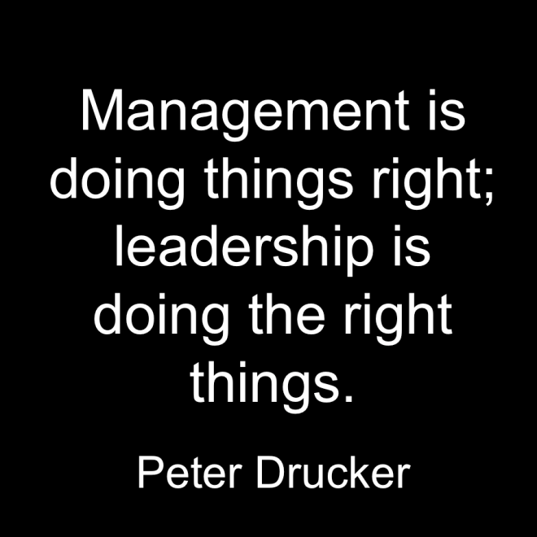
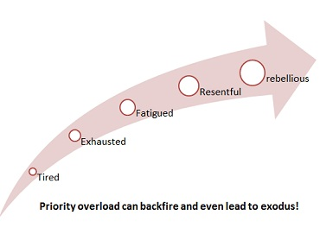
Prioritization
“If you have too many priorities, you have none”

Slide 9
.
Notes:
Thank you/Questions Slide

