Slide 1
Hearing Aid Coverage for Children Program (HACCP) Introductory Provider Webinar
July 30, 2021

Slide 2
HACCP Overview
Authority: California 2020-21 Budget
  State-only benefit
Phase I Implementation:
  July 1, 2021 launch
  English and Spanish application materials
  Application available in print and online as a fillable PDF
  Documents incorporate initial feedback from California Children’s Services (CCS) and pediatric audiology stakeholders

Slide 3
HACCP Overview
Phase II Implementation – Fall 2021:
  Stakeholder feedback received, DHCS review and incorporation in progress
  Materials expanded to threshold languages
  Online application portal
  Continued outreach

Slide 4
HACCP Eligibility
Children 0-17 years of age
Must reside in California
Not otherwise eligible for Medi-Cal
Not currently enrolled in CCS
Household income under 600% of the federal poverty level (FPL)
Referral or valid hearing aid prescription from an audiologist, otolaryngologist, or physician required

Slide 5
HACCP Eligibility
Does not have other health coverage for hearing aids and related services
  Denial of coverage notice from other health insurance/coverage
  Explanation of benefits from other health insurance/coverage
  Attestation of no other health insurance/coverage (see application)
Eligibility will be determined within 10 days

Slide 6
HACCP Covered Benefits
Hearing aid(s)
  Including externally worn bone conduction hearing aids when medically necessary
Hearing aid replacements
  HACCP will follow CCS’ replacement policy
Hearing aid supplies/accessories
Hearing aid-related audiology services
Other related post-evaluation services

Slide 7
Covered Benefits
Covered
  V5010: Hearing aid assessment
  V5298: Hearing aid (monaural, binaural)
  X4542: Binaural EAA
  X4532: Monaural EAA
  V5264: Ear molds
  Z5928: Functional gain testing
  V5014: Minor hearing aid repairs
  V5267: Hearing aid supplies/accessories
  This is not an exhaustive list.
  Treatment Authorization Request (TAR) required for hearing aids and supplies/accessories.

Slide 8
HACCP Providers
Enrolled Fee-For-Service (FFS) Medi-Cal providers may submit claims for covered benefits provided to HACCP clients through the FFS Medi-Cal fiscal intermediary (FI).
Medical Justification
  Hearing aid prescription (otolaryngologist sign-off required if under age 16)

Slide 9
FAQs for Authorization Process
  Does enrollment in HACCP and receipt of the HACCP ID Card identification give implied authorization for hearing aids and services?
  No, enrollment and ID card imply program acceptance, TAR approval is still required.
  Is the authorization tied to a particular center for all services or can a patient/family seek different services at different centers? If it is tied to one center, how do the families change providers?
  The provider who submits the TAR and receives the TAR authorization must also be the provider to submit the claim. If the client changes providers, the new provider must submit a new TAR for any further hearing aid(s) and supplies.
  What is the timeframe for TAR review?
  DHCS anticipates responding to most TARs within 2-5 days of receipt.
  How should providers confirm benefits are active or confirmation process to confirm that hearing aids have not been provided by another vendor rendering the patient ineligible for new hearing aids until current hearing aids reach their useful lifetime?
  Providers may check AEVS to confirm a patient’s HACCP eligibility.
  Duplicate hearing aid requests will be eliminated by the TAR process.
  Will authorizations be issued as a group (similar to SCG 04)?
  No.

Slide 10
Treatment Authorization Request (TAR) Process
Specific documentation is required with any TAR for the following
  New hearing aids
  Replacement of lost, stolen or irreparably damaged hearing aids
  Replacement of old hearing aids that no longer meet the needs of the recipient
  Hearing aid repairs
More information about documentation can be found in the provider manual:
  https://files.medi-cal.ca.gov/pubsdoco/publications/masters-mtp/part2/hearaid.pdf

Slide 11
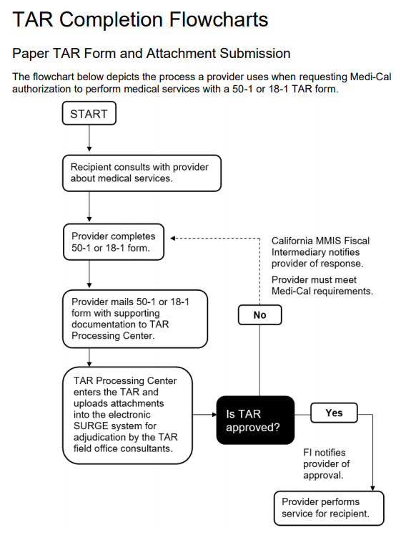
All paper TARs should be submitted to the TAR Processing Center at one of the following addresses:
Attn: TAR Processing Center California MMIS Fiscal Intermediary 820 Stillwater Road
West Sacramento, CA 95605-1630
Attn: TAR Processing Center California MMIS Fiscal Intermediary P.O. Box 13029
Sacramento, CA 95813-4029
Any additional questions?
Contact the California Medicaid Management Information System (California MMIS) Fiscal Intermediary Telephone Service Center (TSC) at 1-800-541-5555.

Slide 12
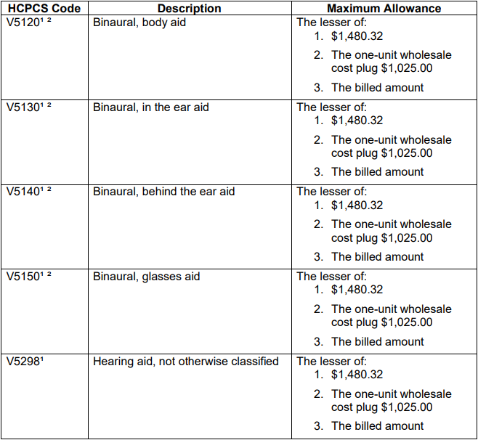
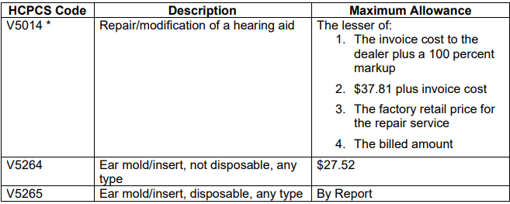
Reimbursement
  What is the HACCP reimbursement rate for standard hearing aids?
  Medi-Cal FFS rates will apply. More information can be found at
  https://files.medi-cal.ca.gov/Rates/RatesHome.aspx
Reimbursable Hearing Aids and Accessories: Binaural
Reimbursed Hearing Aids and Accessories

Slide 13
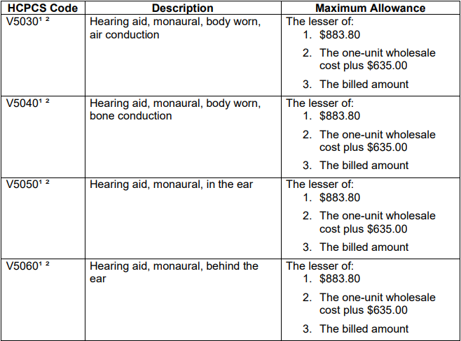
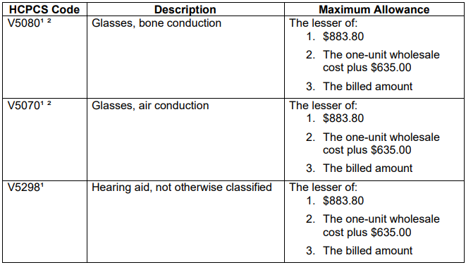
Reimbursement Cont.
Reimbursable Hearing Aids and Accessories: Monaural

Slide 14
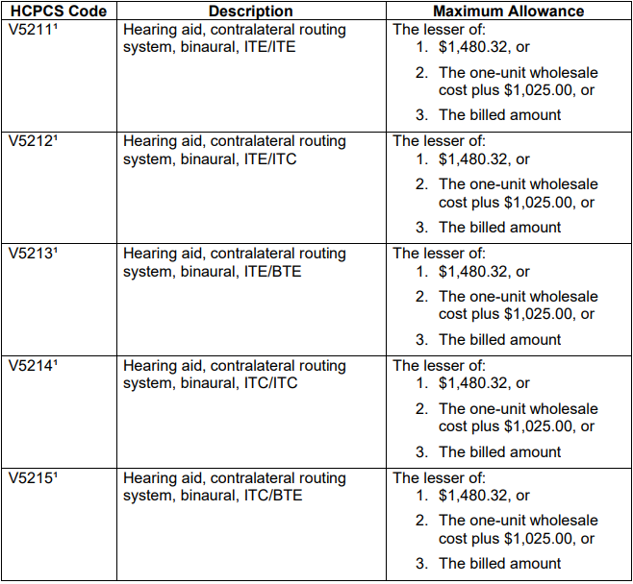
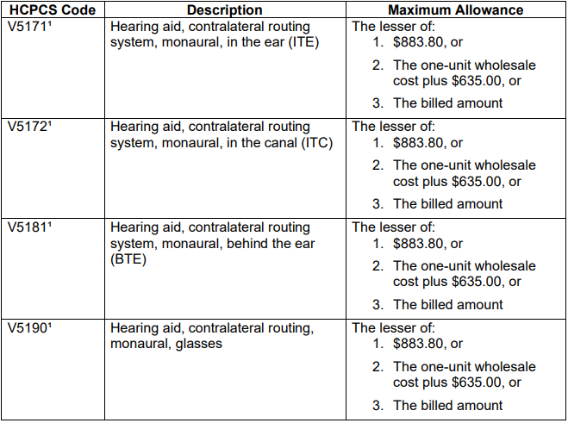
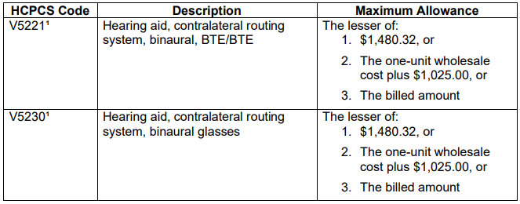
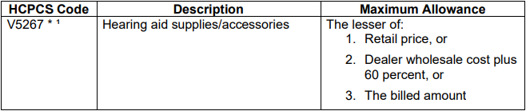
Reimbursement Cont.
Reimbursable Hearing Aids and Accessories: Contralateral Routing System: Binaural
Reimbursable Hearing Aids and Accessories: Contralateral Routing System: Monaural
Reimbursable Hearing Aids and Accessories: Accessories

Slide 15
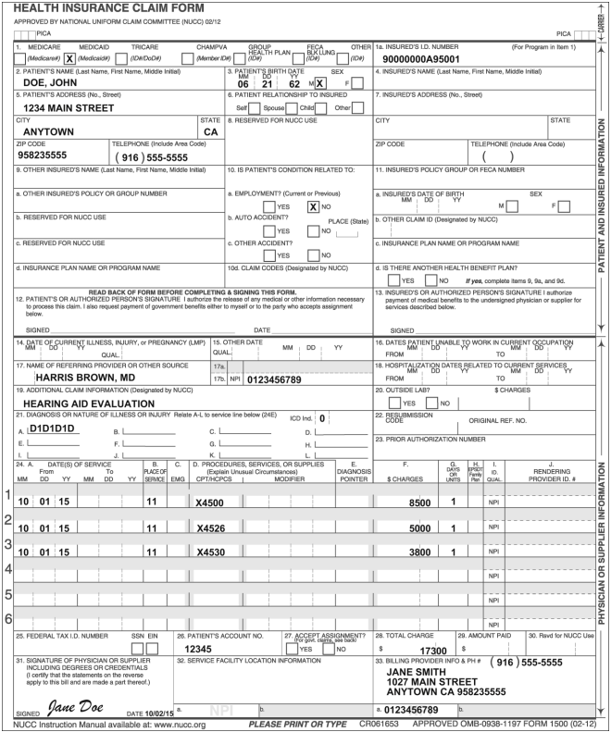
Billing Example

Slide 16
Non-Standard Hearing Aids
DHCS will provide additional information and specific HACCP coverage policies regarding bone conduction hearing aids and advanced technology hearing aids in Phase II.

Slide 17
Additional Resources
HACCP webpage: https://www.dhcs.ca.gov/services/pages/haccp.aspx
  Application
  Find A Provider
  Frequently Asked Questions: Coming Soon
  Billing Codes: Coming Soon
HACCP call center: 1-833-774-2227
Email: HACCP@maximus.com

