Slide 1


AB 1296 Stakeholder Meeting

Slide 2

Transfer of Coverage
Transfer of Coverage
Transfer of coverage between Medi-Cal and Covered California
DHCS and Covered California are reviewing processes for transferring individuals between programs when a beneficiary loses coverage in their existing program.
  We want to look at the various ways to transition individuals between the two programs without adversely effecting the beneficiary to the extent possible.
  We want to ensure we make the best use of the technology available so that the two programs can seamlessly share data back and forth.
  We would like to solicit stakeholder feedback on these processes as they are developed.

Slide 3
CalHEERS Report
Verifications
NOAs
eHIT, Add a person, Renewals
Foster Youth, Immigrants
Projected Income
Known Defects
RIDP

Slide 4
CalHEERS Functionality
Several major areas of functionality will be deployed through June 2014
March 2014 | April 2014
Medi-Cal Effective Dating/Discontinuances/Notices MEDS Transactions Defect Resolution Medi-Cal Pre-ACA Conversion Renewals - Report A Change Reporting - Add a person to Pre-ACA Medi-Cal or Non-MAGI case Medi-Cal Negative Action Medi-Cal Continuous Eligibility for Children (CEC) Medi-Cal Continuous Eligibility for Pregnant Women | Federal Poverty Level/COLA Processing Residency Verification (MEDS & Franchise Tax Board) MAGI-Based Medi-Cal Aid Code Hierarchy (Former Foster Care) eHIT Defect Resolution

Slide 5
CalHEERS Functionality2
May 2014 | June 2014
Medi-Cal Plan Selection Transitional Medi-Cal (TMC) Business Rules Split APTC Subsidized Enrollment RIDP | PRUCOL Four-Month Continuing Medi-Cal for Parent/Caretaker Relatives Inmate Program Residency Verification (DMV & EDD)

Slide 6

DHCS Report
Medi-Cal Health Plan Selection
  Roadmap for Implementation
  Medi-Cal Health Plan Selection Functionality in CalHEERS
  County and Certified Enrollment Counselor Training

Slide 7

Medi-Cal Health Plan Selection
Core Function to be included in Release 4.3:
Selection of Subplans, PCP, IPA
Display correct TLIHP plan cost
Allow pending applicants to choose plan
Redesign Medi-Cal Plan choice display: a) suppress cost-sharing information, b) show information about what services are currently offered and covered, c) provide information about carve-outs or what is not covered by the plan

Slide 8
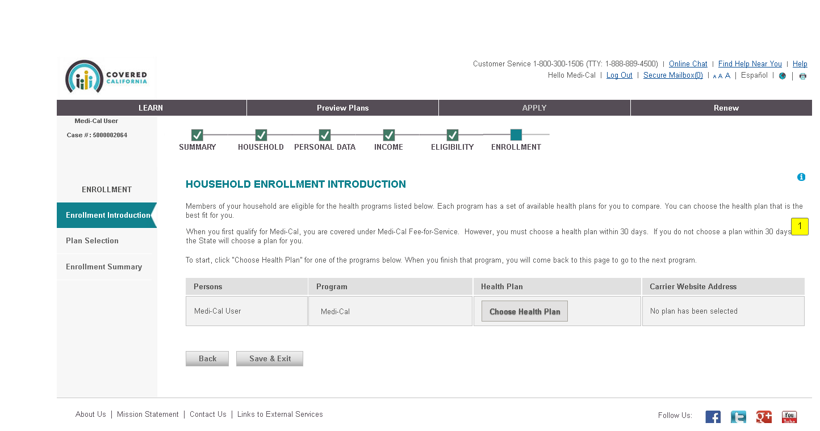
Medi-Cal Health Plan Selection2
  Plan Enrollment for 1 Member

Slide 9
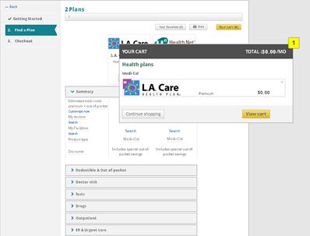
Medi-Cal Health Plan Selection3
Cart Preview

Slide 10
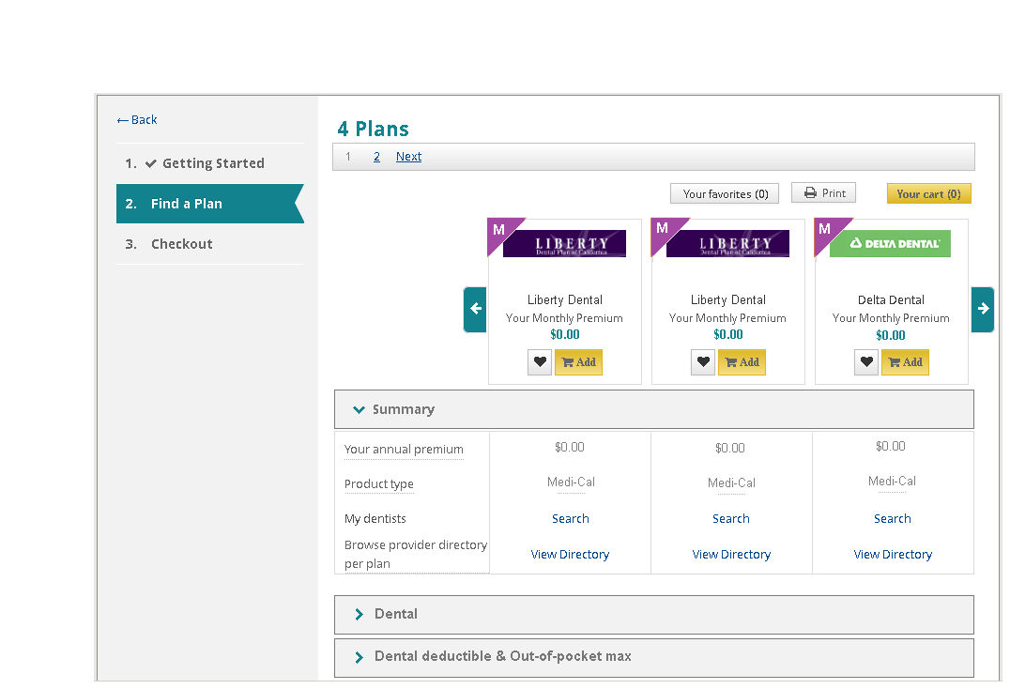
Medi-Cal Health Plan Selection4
Find a Plan: Dental

Slide 11
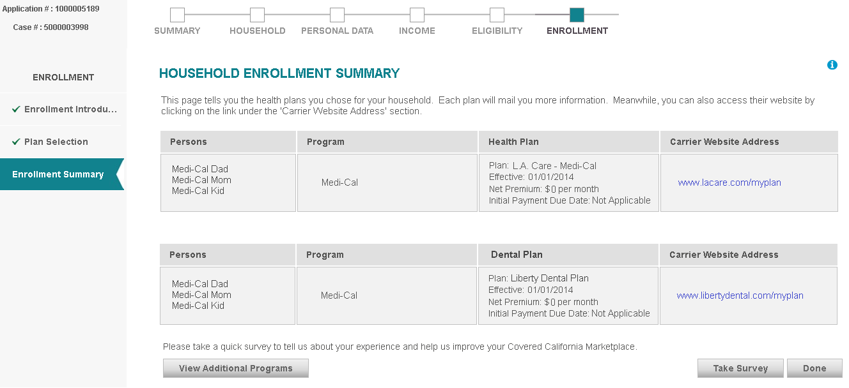
Medi-Cal Health Plan Selection5
Enrollment Summary: Combined Medical and Dental

Slide 12
Certified Enrollment Counselor Training Modules
Training Topics Include:
Introduction to the Affordable Care Act | Introduction into the Medi-Cal Program
Plan Options | Compliance Standards
Certified Enrollment Counselor Role | Privacy and Security
Eligibility for Individuals and Families | Providing Consumer Assistance

Slide 13
Certified Enrollment Counselor Training Modules2
CEC training on Plan Selection:
DO: | DON’T:
Present plan options fairly and equitably | Coach applicants on what eligibility information to include on the application
Be impartial | Invite or influence an employee to leave employer-based group health coverage
Only provide recommendations regarding specific plans, doctors or hospitals over another where permitted for the role (e.g. Certified Insurance Agents or Plan-Based Enrollers) | Accept money or other consideration from 3rd parties (unless as part of an Certified Insurance Agent or Plan-Based Enroller’s commission.
 | Coach or recommend one plan or provider over another.

Slide 14

Open Forum
Additional
questions, comments, or requests?

