Slide 1

Online pasrr training general topics for All users of the Online pasrr system
PASRR Section
Department of Health Care Services
Level I Training for Facilities
Rev: 8/10/15
Notes:
This PowerPoint is for training facilities to use the Online PASRR Level I screening.
It includes back ground and overview information of the PASRR program. The Job Aid for PASRR is a section by section walk through of a Level I screening. We recommend you print the Job Aid and put it in a convenient location for any user performing a PASRR screening.
Additional information is provided in the System Basics and Level I Training Manuals.

Slide 2
Introductions
Welcome to Online PASRR Training for Level I Screening
Introducing :
Department of Health Care Services Host
Mental Health Services Division
PASRR Section

Slide 3
Agenda
1. Welcome and Introductions
2. Online PASRR System
Module 1: PASRR Background and Overview
Module 2: Roles and Access to Online PASRR Computer System
3. Getting Help
Notes:
We thank you for helping us improve these materials and the system and we would very much appreciate your feedback on how to improve this training. We are going to give you information but we will periodically ask for your input.

Slide 4
Asking Questions
Phone Etiquette
Put your phone on MUTE unless you have a question.
Do NOT put your phone on hold!
On the conference call:
The moderator will periodically ask if there are questions
If you have any questions after the conference call:
1. Send an email to the PASRR Section - mhpasrr@dhcs.ca.gov
2. Call the DHCS dedicated phone line: (916) 650-6945

Slide 5
Module 1
PASRR Background and Overview

Slide 6
Background on Online PASRR
PreAdmission Screening and Resident Review (PASRR)
Project Sponsor:
The DHCS Preadmission Screening and Resident Review (PASRR) Section resides within the Program Oversight & Compliance Branch of the Mental Health Services Division of the Department of Health Care Services.
Project Objectives:
Automate all PASRR processes.
Eliminate faxed or mailed Level I forms - submit them on line.
Reduce the time it takes to issue a Level II Determination letter to the federally required annual average of 7 to 9 working days.

Slide 7
Background on Online PASRR
Why Change PASRR from Paper-Based to Online?
CMS informed the State that PASRR was out of compliance with Federal timeliness requirements (complete PASRR process in an annual average of 7-9 working days).
Create a web-based portal to manage all steps of the PASRR process to expedite receipt of determination letters.
Conduct a PASRR screening on each resident prior to admission.
Ensure that prospective facility residents with mental health or intellectual developmental disabilities receive the appropriate level of care and specified specialized services in an appropriate timeline.

Slide 8
TAR and PASRR-FAQ
1. Is there a change in how I process my TAR?
There are no changes to the TAR payment process. You can continue working with the TAR office to process your claims as usual.
2. How do I access my PASRR documentation required for TAR?
PASRR documentation is now easily and instantly accessible electronically. The Level I 6170 and Notice of Need/No Need letter is instantly available for you to print once the Level I 6170 is submitted online. The Determination Letter will be available electronically once it is completed by the DHCS clinical psychologist.
3. Is my TAR automatically submitted when I complete the Level I 6170 online?
No. The Level I 6170 is automatically available to you in PDF format to print when you submit it online, along with the Notice of Need/No Need letter. You can print the required documents and submit to the TAR office.

Slide 9
PASRR Process Overview
Level I Screening
Start
KEY:
Entry/Exit
GACH/ NF
APS
DHCS
Review (e.g., Significant Change in Condition) Resident
Level II Needed
Y
Evaluation
Review Level II
Make Determination
N
No Need Letter
Notification
End
Notes:
This provides a visual overview of the PASRR Process. The PASRR Process involves 4 parties – the individual being screened, the facility (GACH or NF), the Evaluators and DHCS.
1.The facility performs the Level I screening and with 2 possible outcomes.
N - The N is for Level II is not needed: the individual demonstrates no need for further screening and a letter of no need is created by Online PASRR.
Y - The Y is for Yes, a Level II Evaluation is needed: the individual demonstrates mental health illness and will be referred for a Level II evaluation.
An evaluator contacts the facility and makes an appointment to evaluate the individual. Then the completed Level II evaluation is sent to DHCS.
DHCS clinical psychologist staff review the Level II and issue a Determination Letter.
4. The Determination Letter will appear in the client’s file in Online PASRR.
Significant Change in Condition: CA PASRR recommends utilizing the change of condition protocol in the MDS 3.0. According to the MDS 3.0 manual, a “significant change” is a decline or improvement in a resident’s status that:
1. Will not normally resolve itself without intervention by staff or by implementing standard disease related clinical interventions, is not “self-limiting” (for declines only);
2. Impacts more than one area of the resident’s health status; and
3. Requires interdisciplinary review and/or revision of the care plan.

Slide 10
Process Steps – Level I
Step 1: Level I (Screening)
The Level I screen is administered to all NF applicants and should yield a positive result if the individual has a history of a mental illness or demonstrates symptoms of a mental illness or intellectual disability.
Who should complete a Level I?
Staff should be sufficiently trained in NF healthcare programs, medical terminology and the use of medical records that they can find the essential information necessary to accurately respond to the PASRR screening questions.
Facility staff access and enter the form online.
Staff conduct the screen using medical and psychiatric records, individual interviews, and/or direct observation, and consultation with personal care givers, conservators or family, treatment providers, and/or hospital discharge staff or the county mental health plan.
Staff submit the form via the internet.
The screening information is entered into Online PASRR and immediately available to DHCS and the Level II Contractual Evaluators.
Notes:
Who should do a Level I?
Staff should be sufficiently trained in NF healthcare programs, medical terminology and the use of medical records that they can find the essential information necessary to accurately respond to the PASRR screening questions.
For additional assistance:
PTAC - PASRR Technical Assistance Center (PTAC) which can be found at www.pasrrassist.org.

Slide 11
Process Steps –
Advanced Group Determinations /Categoricals
Categorical Determinations (No change from Title 42 CFR 483.130(f))
Advanced group determinations may mean the Level II Evaluation is unnecessary
Convalescent care
Terminal Illness
Severe Physical Illness
Respite Care
Emergency Situations
Delirium
Neurocognitive Disorders (formerly Dementia)
Note: The resident may still require nursing facility services for medical issues.
Notes:
DHCS will provide additional training on state and federal definitions of Categoricals.

Slide 12
30-Day Hospital Discharge Exemption
The hospital discharge exemption is the only true exemption from the requirements of PASRR. The exemption applies to individuals who are discharged from a hospital into a Medicaid-certified nursing facility (NF) and their stay is expected to last no more than 30 days. If an individual admitted to a NF under the hospital discharge exemption stays in the NF longer than 30 days, the PASRR process must be completed by calendar day 40 of admission.
Embedded logic in the online system will stop user if resident is transferring from a hospital and is expected to stay less than 30-days at the NF.

Slide 13
Process Steps – Level II
Step 2: Level II (Evaluation)
The Evaluators can see the results of a “positive” Level I in PASRR
Pursuant with Title 42 CFR Section 483.106 (d)(1), DHCS contracts with a third party entity (APS Healthcare) to perform evaluations.
APS contacts SNF or GACH to screen the referral and schedule an evaluation if necessary
What can SNFs and GACHs do to facilitate the evaluation?
SNF or GACH facilitates the Level II Evaluation by preparing records and notifying the resident, caregivers, and as appropriate, conservators of the scheduled Level II evaluation. They also provide a private location for the evaluation.
What happens when the evaluation is complete?
The Evaluator finishes the evaluation in Online PASRR and send it to APS for Quality Assurance review and MD review.
Once approved for release, the Evaluation data populates to the Determination Letter.

Slide 14
Process Steps – Determination
Step 3 : Determination
DHCS PASRR Clinical Psychologist make determinations including recommendations for placement and treatment
The Determination Letter is available to the facility to distribute to the resident, conservator, the attending physician, discharging hospital and retain in the resident’s file once electronically submitted. DHCS will not mail any PASRR documentation.
The facility arranges for recommended services. This may include seeking additional services from outside the facility such as:
Targeted Case Management
Individual Mental Health Rehabilitation
Physical Therapy
Residential Care Facility for the Older adult (RCFE)
Notes:
Targeted Case Management - May include plan development, communication, coordination, and referral; monitoring service delivery to ensure beneficiary access to service and the service delivery system; and monitoring of the beneficiary’s progress.
Individual Mental Health Rehabilitation - Includes assistance in improving, maintaining or restoring an individual’s functional skills, daily living skills, social and leisure skills, grooming and personal hygiene skills, meal preparation skills, and support resources, and/or medication education
Physical Therapy - Treatment prescribed by a physician, dentist or podiatrist of any bodily condition by the use of physical, chemical, and other properties of heat, light, water, electricity or sound, and by massage and active, resistive or passive exercise.
Residential Care Facility for the Older adult (RCFE) - A housing arrangement chosen voluntarily by the individual, the individual’s guardian, conservator or other responsible person, where varying levels of non-medical care and supervision are provided to adults over age 60 (under age 60 with compatible needs). Care and Supervision involves assistance as needed with activities of daily living and the assumption of varying degrees of responsibility for the safety and well-being of individuals.
Questions?

Slide 15
Complaints, Reconsiderations & Fair Hearings
Complaints - For general complaints or concerns, contact the DHCS Ombudsman – Toll Free: 1-800-896-4042 or Email: MHOmbudsman@dhcs.ca.gov
Reconsideration - If the individual, Facility, or Conservator is dissatisfied with the recommendations in the PASRR determination letter, they can request a Reconsideration or a State Fair Hearing at any time.
Request a reconsideration of a Determination Letter through DHCS by completing the Request for Reconsideration: http://www.dhcs.ca.gov/services/MH/Documents/PASRR_ReconReq.docx
Fax the completed form to: 916 440-5492
Fair Hearing - Individuals, Facilities, or Conservators can request a Fair Hearing at any time, using one of these methods:
Call the California Department of Social Services (CDSS), Public Information and Assistance Unit at 1-800-952-5253 for additional information
Write a letter to the CDSS requesting a State Fair Hearing.
Notes:
There may be times when you, the resident, conservator or someone else wishes to express a complaint or request either a reconsideration or a Fair Hearing.
Fair Hearings are available at any time.
Questions?

Slide 16
Module 2
Roles and Access to the Online PASRR Computer System
Two distinct roles:
Administrator
User

Slide 17
Facility’s PASRR Roles - Administrator
PASRR System Administrator
Each facility should have at least two Administrators- you always need a back up.
Contact point with DHCS for the next several months
Requests initial login information from DHCS for all new users and administrators
Administrators can:
View and print all cases for the facility (one physical location only)
Conduct a screen, and can complete other users’ unfinished Level I
Track that all required paperwork has been provided to the resident, conservator, and physician
Future Responsibilities: (Once fully automated)
Create user-id and passwords , reset passwords for users at the facility
Create/Delete access to PASRR system for users
Change a user’s role from User to Administrator or vice versa
Notes:
Next we’ll talk about the roles needed in each facility for Online PASRR. Of course, one role is the PASRR facility Administrator, and the other role is the user. The Administrator can do more things in the PASRR system. For example, the Administrator can see all cases for the facility, the user can see only the cases they have screened.
Each facility should have at least 2 Administrators – you always need a back up.
This person can see all the cases for the facility – the physical facility. If yours is a multi-facility organization, they can only see cases in their facility.
They also can go into all cases. For example, if someone starts a screen but then is unable to complete it, the facility Administrator can complete it.
The facility Administrator can also perform Level I screenings from start to finish.
The facility Administrator can see all cases and therefore can see if a Level II Evaluation has been completed and can check for Determination Letters. This enables them to track that the appropriate notifications occur.
In future, after the PASRR Enhancements, the facility Administrator will manage the Online PASRR System users for the IT system. The facility Administrator will be able to create new users, delete old ones and reset passwords.
If there is a reason to change a person’s role, they can do that too.

Slide 18
Facility’s PASRR Roles - User
PASRR System User
Each facility should have at least two Users- you always need a back up
Users can:
Complete the Level I screening online and electronically submit it to DHCS
View and print any DHCS letters generated for cases entered by the user
Access only cases that the particular user has entered
Notes:
The other role is the PASRR System User. This is the person who completes the Level I screening. You should have at least 2 Users, you always need a backup.
In your facility – you might choose for the User to put the letter of Need or No Need in the resident’s file – it is available online as soon as the Level I is completed.
For those users who receive a Level II evaluation, the Determination Letter will appear in Online PASRR within 4 business days after the evaluation.
Both the user who did the Level I screening and the Administrator can see the Determination Letter. One of them should have the responsibility to distribute the letter as appropriate.
In this presentation we have talked about the advantages of completing the PASRR screen on line. We have provided an overview of the PASRR Process and we have described the 2 PASRR roles for facilities. Each facility will make their own decisions about how to perform screenings, who PASRR administrators and Users will be and any business processes you may wish to make. However if you have questions, please ask.
Questions?

Slide 19

PASRR Online Enrollment Process
1
Request Log On from DHCS
2
Receive Encrypted E-mail
3
Log on to PASRR
4
Set up security questions
Enrolled!
Complete form
Email form to DHCS
Open encrypted message
Follow directions to create permanent password
Go to PASRR website
Enter username and password
Select five security questions

Slide 20
Request Log On
1
Complete the Enrollment Form:
http://www.dhcs.ca.gov/services/MH/Documents/PASRRIT_UID.xls
Must have at least one Administrator (Two are recommended)
Identify a role for each staff (Administrator or User)
Include a valid and unique e-mail address for each staff
E-mail the Form:
Email to: MHPASRR@DHCS.CA.GOV
Use the subject line: “Name of your facility”- REQUEST FOR PASRR ADMIN/USER ACCOUNTS
If your facility has more than one physical address, a separate form must be completed for Administrators and Users at each physical location.
What if I need to access multiple facilities?
The Administrator must send a separate enrollment form including a unique e-mail address for each
facility you need access to. You will be assigned a different user-id per facility.
Our facility already submitted an enrollment form, but now we have additional staff we want to add.
The administrator should submit a revised enrollment form to MHPASRR@dhcs.ca.gov. Highlight the correction or addition in the form.
What if a staff is no longer employed at the facility?
Please notify DHCS immediately when a staff member is no longer employed at your facility. E-mail DHCS at MHPASRR@dhcs.ca.gov or call DHCS at 916-650-6945.
Q&A
Notes:
Please follow the instructions carefully!
To enroll a user you must request each login and password. DHCS provides a form for you to use to do it.
To enroll each user you must specify if they are an Administrator or a User.

Slide 21
Administrator/User Request Form
1
Note: Please follow instructions carefully!
Notes:
This form is available on the DHCS Website. You will use it to request a login and password for your staff – you MUST specify a role – either User or Administrator – for each person.
- Please be sure that the facility address, names (both first and last) and e-mails are entered correctly.
- Each Administrator and User must have a unique email address.
For security reasons, the email with this form attached must come from the email of the Requestor who is listed at the bottom of the form. This is the person DHCS will call if we have questions about the information you give us.
Questions?

Slide 22
Receive Encrypted E-mail
2
You will receive an encrypted e-mail from DHCS for initial log on requests and password resets.
You must set up a permanent password within four days of receipt of the e-mail. This temporary password expires in four days.
Click the link in the e-mail.
Q&A
I can’t open the encrypted message.
Please consult your facility’s designated IT professional for assistance.
I forgot my password.
E-mail DHCS at MHPASRR@DHCS.CA.GOV to request a password reset or call DHCS at 916-650-6659. You will receive an encrypted message from DHCS. Please follow same steps outlined in slides 22-24 to create a new password.

Slide 23
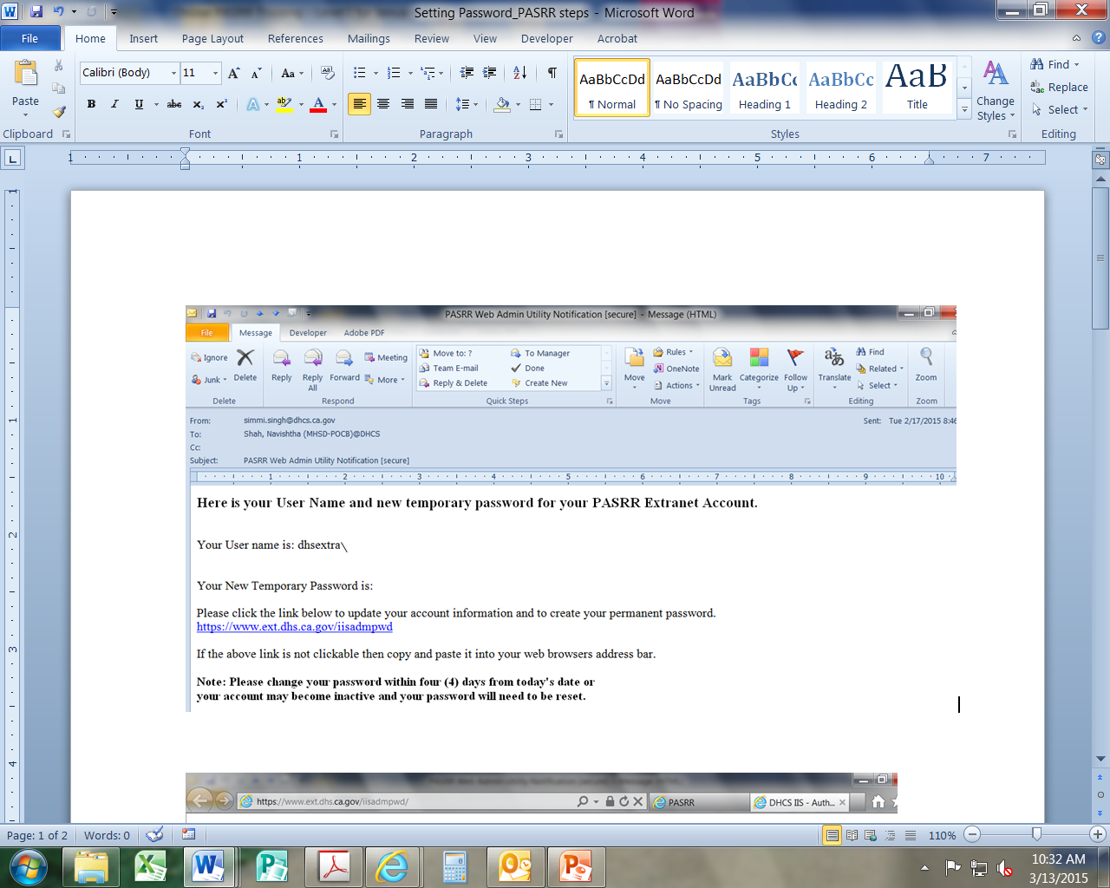
Receive Encrypted E-mail
2
Your encrypted e-mail message will look like:
example1
H3-^lzh)j!!
Click on this link to create a permanent password.
Notes:
DHCS will send each Administrator or User an individual email with their login information. For security purposes, the email must be encrypted.
Use the link provided in this e-mail to create a permanent password.
Write down your user name and temporary password. You will need this information on the next screen.

Slide 24
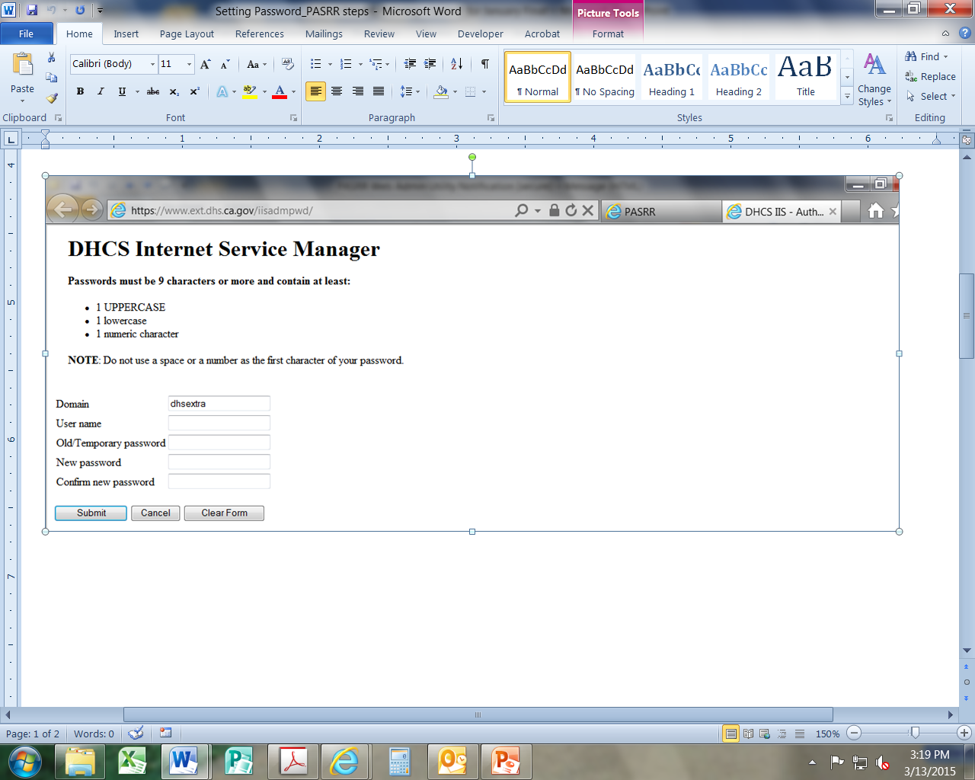
Receive Encrypted E-mail2
2
After you click the link from the e-mail, this screen will appear:
Do NOT include “dhsextra\” as a part of your user name

Slide 25
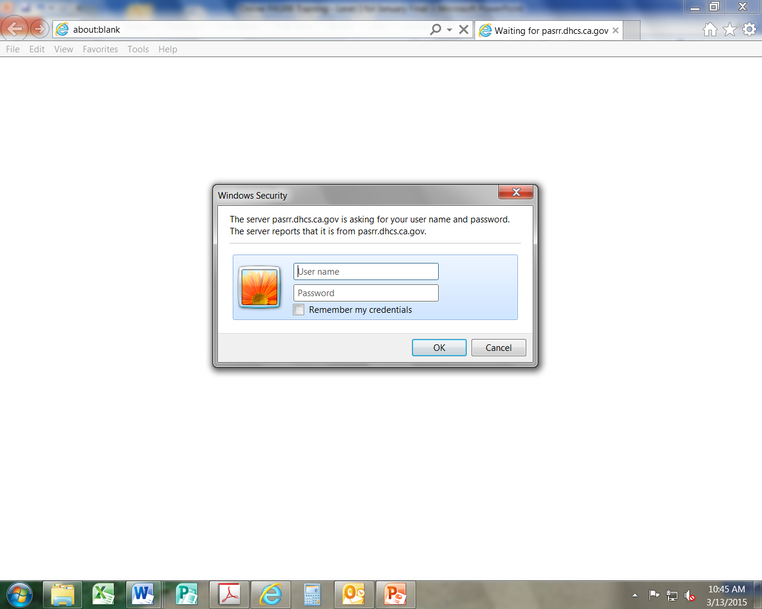
Log On
3
Go to https://pasrr.dhcs.ca.gov/
Enter full user name with the “dhsextra\” prefix
Note: Do not check “Remember my credentials.” This will result in an error message.

Slide 26
Set Up Security Questions
4
Next screen will ask you to select 5 security questions
Please remember the answer to each question. Your answers are case sensitive.
Select “Save” when done
.
Q&A
Failed to answer security questions correctly?
The system will lock you out after three failed attempts to answer a security question. Please e-mail DHCS at MHPASRR@DHCS.CA.GOV or call DHCS at 916-650-6945 and we will unlock your account remotely.
Notes:
You will be asked to set up your security questions. A list of possible questions drops down – you select 5 different questions and enter 5 different answers.
1. Select a question number and click the dropdown
2. Choose a question from the list and type a new answer (case sensitive)
3. Confirm the answer by retyping
4. Click ‘Save’
Questions?

Slide 27
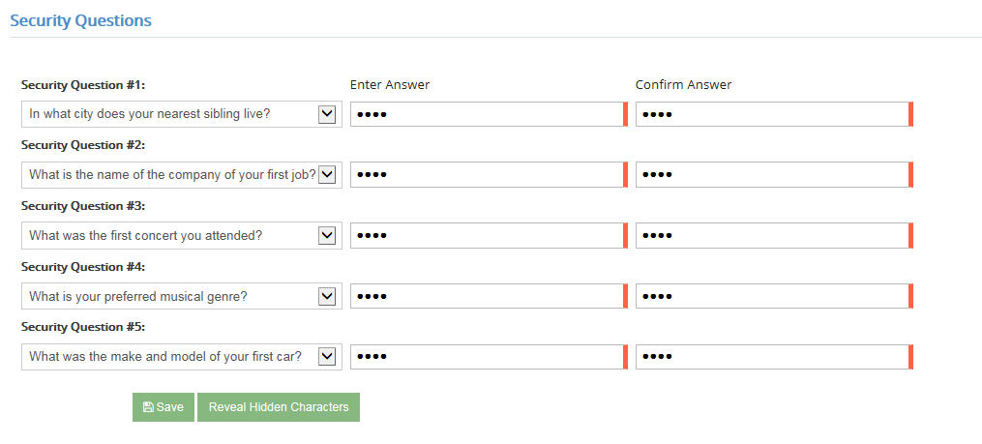
Set Up Security Questions2
4
3.
2.
1.
4.

Slide 28
Now You’re Enrolled and Ready to Use the Online System!

Slide 29
Next Steps
Please refer to the PASRR website for regular updates: http://www.dhcs.ca.gov/services/MH/Pages/PASRR.aspx
Dates for Level I Assistance Calls PASRR Level II Webinars
Aug 19, 2015 1:30-2:30 Sept 9, 2015 9:30-12:00
September 1, 2015 10:00-11:00
September 16, 2015 1:30-2:30
September 25, 2015 1:30-2:30
Call: 1-866-730-8370
Participant access code: 1666159
Q&A
Do I mail or fax the Level I 6170 once I submit it electronically?
No, you do not send anything to DHCS PASRR once your facility has been enrolled.
Note: Early enrollment is highly encouraged to prevent delays. Effective June 2015,
DHCS will no longer accept any fax or mailed PASRR forms. The 6170s will be
returned to the submitting facility with instructions to enroll in the online system.

Slide 30
Assistance Center is Available
PASRR users have multiple options to access help
Ask your Facility’s PASRR Administrator – He/she will contact DHCS
Send an email to the PASRR Section - mhpasrr@dhcs.ca.gov
Call the DHCS dedicated phone line: (916) 650-6945
You will receive a response within 24 working hours
For More Information
Go to the DHCS Website routinely to review FAQs
Refer to the training documents (routinely updated)
2 Training Manuals: System Basics and Level I
This PowerPoint with Job Aid

