Slide 1


Quality Improvement Projects for MOC
MOC Credit for the
Work You Do Every Day
* Additional notes added by CPQCC

Slide 2

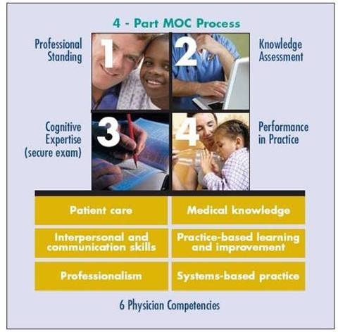
What is Maintenance of Certification?
(MOC)
Part 1 – Professional Standing
Patient care, Interpersonal & communication
skills, Professionalism
Part 2 – Knowledge Assessment
Patient care, Medical knowledge,
Practice-based learning &
improvement, Systems-based practice
Part 3 – Cognitive Expertise
Medical knowledge
Part 4 – Performance In Practice
Patient care, Practice-based learning
& improvement, Interpersonal
& communication skills, Professionalism,
Systems-based practice

Slide 3
MOC At-A-Glance
Part 1: Valid, unrestricted license
Part 2: Earn at least 40 points from approved
activities*
Part 3: Pass a secure exam every 10 years
Part 4: Earn at least 40 points from approved
activities*
*Choose activities from either Part 2 or 4 to earn the
additional 20 points you need to fulfill your 100 point
requirement.
Need 100 points total

Slide 4

MOC Overview
2010 brings many changes
Anyone who wants to maintain certification must now demonstrate QI competency (Performance in Practice a.k.a . Part 4)
Two versions of MOC:
  7 year cycle with one QI activity (certificates expiring 2010 – 2015)
  5 year cycle with point-based QI activities (minimum two per 5 year cycle) (Began 1/1/2010)
Details in your ABP portfolio at www.abp.org.

Slide 5
Physician Portfolio & Activity Profile

Slide 6
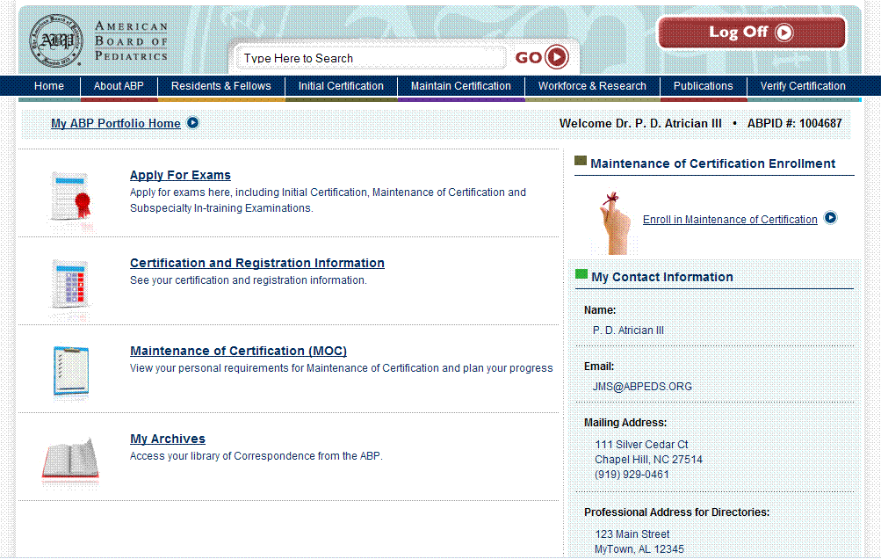
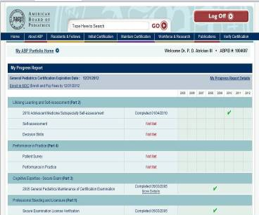
Physician Portfolio
The Physician Portfolio contains:
A list of your completed requirements
A list of outstanding requirements in your current MOC cycle
The timeframe in which you must complete your next required MOC examination.
Your ABP ID number

Slide 7
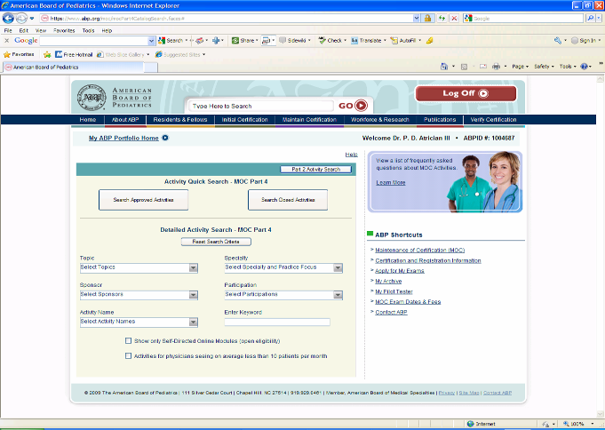
Physician Portfolio-Activity Catalog

Slide 8
MOC Credit &
Attestations

Slide 9
Completion data process flow via email
Physician/diplomate enrolls in Sponsor QI project
Physician/diplomate indicates to Sponsor intent to seek MOC credit project
Sponsor provides Completion requirements to physicians
Local Organizations identify Local Leader responsible for approving physician attestations of completion
Physician completes requirements and submits signed attestation to Local Leader
Local Leader verifies completion, submits attestation to Sponsor and retains copy of signed attestation
Sponsor submits completion data to the ABP in Excel spreadsheet (until Summer 2010)
ABP updates diplomate’s ABP Portfolio at www.abp.org indicating credit
Sponsor Collects needed information for ABP: Project name, Diplomates Full Name, ABP ID, Date of Birth, Business Mailing address, Date diplomate completed project

Slide 10
Hospital NICU Requirements*
(i.e., Local Leader)
Must assign a Local Leader for attestation and local adjudication.
Must have a minimum of 1 team member attend all 3 on-site learning sessions.
Must hold a 4th session 6 to 12 months after the 3rd Learning Session to assess whether or not gains have been held. This may be in person, via conference call or via WebEx.
Must submit assigned outcome, process and balancing measures monthly in specified format.
Must achieve IHI Level III by the end of Learning Session 3.
* Additional notes added by CPQCC

Slide 11
Hospital Requirements (cont.)*
(i.e., Local Leader)
Display certificate of successful completion.
Conduct a minimum of 4 local sessions that cover all of the material required for a participating diplomate to understand the goals, strategies, course and achievements of the local QI project. Session 4 must be held between project months 12 – 18.
Provide a list of local participants with all appropriate identifying information to CPQCC.
Attest to the validity of the participating diplomate’s attestation form and submit to CPQCC, who will submit to ABP on NICU’s behalf.
* Additional notes added by CPQCC

Slide 12
Diplomate’s Requirements*
Attend a minimum of 4 CPQCC or local learning (NICU-based) sessions.
Complete an attestation form that documents an understanding of the goals, measures, outcomes, achievements and next steps of the local collaborative, as well as the diplomate’s role in the QI and its incorporation into his/her clinical practice.
The attestation form must include an annotated run chart for the local, NCIU-based project.
* Additional notes added by CPQCC

Slide 13
Meaningful Participation
Active Role
Provide direct or consultative care to patients
Implement the project’s interventions
Collect, submit and review data
Collaborate actively by attending at least 4 meetings
Length of Participation
Project leader defines this based on project design
Typically 9 -12 months but not always.

Slide 14
SAMPLE: Physician Participation Tracking Tool

Slide 15
Image of a ABP Attestation Form

Slide 16
QIPA Leadership Points
Allowing QIPA Leaders to Obtain MOC Credit for Designing and
Implementing QIPA Projects
Criteria for MOC Credit
Physicians meeting all of the following criteria could be awarded Part 4 points appropriate to the project once in a five-year MOC cycle:
Physician was materially involved in the design of the project
Physician was materially involved in the implementation of the project
The project leader will attest that the physician understands the principles of quality improvement
Physician was involved in the project for a minimum of one year

Slide 17
CCS/CPQCC’s Role*
Conduct a QI project (collaborative) that meets ABP standards.
During the Learning Sessions, provide the goals, measures and outcomes information needed to guide the completion of the diplomate-level attestation form.
Develop a project synopsis/report, re: outcome, process and balancing measure results for submission to the ABP on behalf of the QI Collaborative participants.
Issue a certificate of completion to Hospitals that meet completion requirements.
Provide the ABP with a list of these hospitals, their QI participants and specialties.
* Additional notes added by CPQCC

Slide 18
Excel template

Slide 19
Notes on MOC Credit
Diplomates with 7 year certificates need one MOC approved Part 4 activity
Diplomates with 5 year certificates need two MOC approved Part 4 activities (40 points)
Point value for your project set by ABP depending on nature of project. (Typically 25)
Physician leaders of projects are eligible for MOC credit even if not caring for patients via the project.

Slide 20
2010
Start collecting attestation forms from diplomates NOW if you have participants that have met completion requirements.
Email completion data spreadsheet to ABP or enter completion data in web portal (upon availability) in a timely manner
Aim to have all completion data for 2010 submitted to ABP by November 1, 2010

Slide 21
Questions from Diplomates
Refer diplomates to their ABP Physician Portfolio
Contact ABP MOC Administration staff MOC@abpeds.org or 919.929.0461

Slide 22
Questions?

