Slide 1
Preventing Catheter-Associated Blood Stream Infections:
Getting To “Go”
David D. Wirtschafter, MD
Member, Perinatal Quality Improvement Panel, CPQCC
david.wirtschafter@juno.org
Janet Pettit, R.N., M.S.N., N.N.P.
Doctors’ Hospital
Modesto, CA
Member, Perinatal Quality Improvement Panel, CPQCC
jspettit@sbcglobal.net
Notes:
Understand how each of the three components of Quality Improvement
leadership commitment,
shared and accessible technical expertise and
micro-system development
contribute to building a successful QI intervention.
Understand how to efficiently manage a collaborative effort.

Slide 2
Overview: Project Operations, Challenges and Learnings
Process built on California Perinatal Quality Care Collaborative (CPQCC) QI experiences
        Wirtschafter NeoReviews 2004
  Informed by empirical studies of adoption
  “Jump start” learning with Quality Assurance software, i.e. Toolkits (cpqcc.org)-”SuperBundles”
Process modified in 3 major ways to include:
  Leadership commitment and involvement (IHI)
  Continuing relationship (network) established
  Efforts to address the social aspects of change
Notes:
Informed by Geertsma Medical Care 82: Empirical study of practice change
Priming: cognitive dissonance-sense of dissatisfaction
MDs agreed and understood, e.g. “benchmarking” role
Focusing: learning of alternative practice option(s)
Typically CME, but lack of knowledge does not explain lack of practice
Follow-up: obtaining further information or advice regarding the possible change (“rationalization”)
The most amorphous; the one in which inertia takes the greatest toll
Triggering: change implemented after clear communication
Importance understood by all
Evaluation: assessment of the practical result
Most often neglected step
Informed by Davis JAMA 1994
Pre-disposing strategies:
priming and focusing opinion leaders and team members on change
Practice-enabling strategies:
facilitators or facilitating materials that ease the change process
Reinforcement strategies:
feedback or reminders to provide positive reinforcement for the change

Slide 3
Reducing Nosocomial Infection in the NICU
CPQCC Toolkit 2003 and 2006 Revision
Writing Committee for 2003 Edition (on behalf of the PQIP)
  Courtney Nisbet, RN, MSN
  Janet Pettit, RN, MSN, NNP
  Richard Powers, MD
  Shukla Sen, RN, MSN
  David Wirtschafter, MD
2006 Revision: California Children’s Hospital Association NICUs-CCS-CPQCC NI Prevention Collaborative (P. Kurtin, M.D., PI)
  Search for “Potentially Relevant Publications” (PRPub) (JP, DW,CN)
  Writing Committee for 2006 Edition
  Susan Bowles, RNC, MSN
  Janet Pettit, RN, MSN, NNP
  Nick Micklas, MD
  Courtney Nisbet, RN, MSN
  Teresa Proctor, RNC, MSN
  David Wirtschafter, MD Chair

Slide 4
The Message:
The “BIG” Picture Priming
  Where are we?
  Where can we go?
Reading the road signs (aka Diagnosis) Evaluation
Finding one’s position on the map (aka Trending)
Places To Visit: Tour Guide Info On
  Hand Hygiene Focusing and Follow-up
  Lines and Hubs Focusing and Follow-up
  Getting Organized Triggering

Slide 5
The NI Challenge: How Much Is Preventable? Unchanging NI Rates, Highly Variable Rates and Clearly Distinguishable “Good” Performers

Slide 6
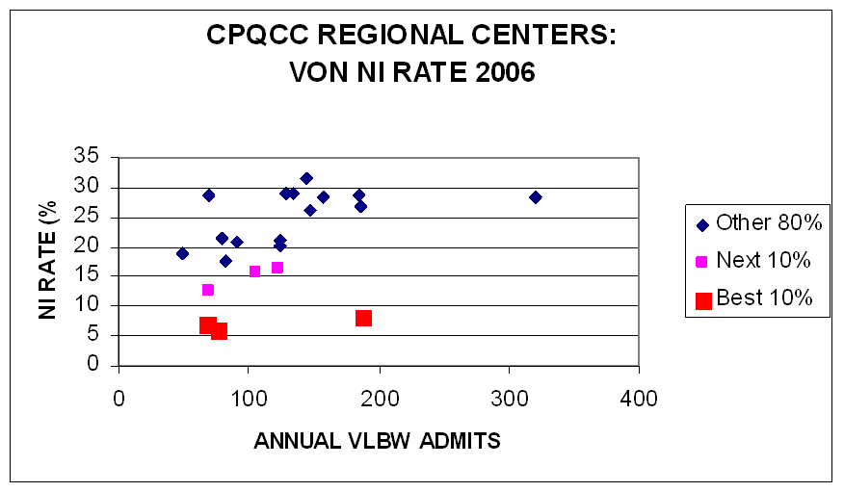
Achievable Benchmark of Care: The lowest infection rates among at least 10% of the NICU cohort Kiefe: Int J Quality in Health Care 1998

Slide 7
EXPLANATIONS FOR
“SUPERIOR PERFORMANCE”
  CHANCE
  FAVORABLE CASE-MIX
  FAVORABLE ENVIRONMENT
  UNDER-REPORTING OF ADVERSE EVENTS
  HIGH QUALITY CARE
  * William Edwards, MD/ VON/NIC/Q Phase I Report

Slide 8
The Message: … Picture yourself next year…Touting your journey toward near Zero infection rates
To do this:
You need to see the evidence that this is possible!
Understand how to diagnose, report and feedback your infection experience
Understand the “bundle” of initiatives for:
  Hand Hygiene
  Lines and hubs
Understand the related “bundles”
  Feeding and the use of human milk
  Teamwork development

Slide 9
NIC/Q 2000 Program Effect In 6 NICUs: CONS Rates Before and After Inter-ventions Described (Class III) Kilbride Pediatrics 2003
Standard Diagnostic Criteria
Hand hygiene
Standardized line management, closed vascular systems and entry methods
Earlier enteral feeds

Slide 10
Sustained Reductions in Neonatal NI Rates Following A Comprehensive Intervention Program (Class III) Schelonka. J Perinatology 2006
Physician and nursing education, at UAB NICU
Common improvement goals
Hand hygiene and environment care
Specialty nursing team for PICC placement, limits on umbilical catheter duration, increasing BM feeds, hastening feeding advancement
Baseline infection rate: 8.5/1,000 hospital days
Post-intervention: 1st year- i 26% (p=0.002)
2nd -3rd year- i 29% (p=0.001)
Much of decrease associated with CONS, but other bacteria/fungi also fell significantly

Slide 11
Summary of NICU Infection Prevention Projects Reported:
2003-2007
*CABSI/1000 line days; #BSI/1000 patient days; %NI as per VON definitions

Slide 12
Diagnosis,Trending and Feedback of Catheter-Associated Bloodstream Infections and Rates:
Understand how to diagnose, report and feedback your infection experience

Slide 13
DATA: Pre-meeting exercise
NI diagnostic process
Understand how to diagnose, report and feedback your infection experience

Slide 14
Engaging The People Who Count!
Diagnostic criteria and event trending
  The unit reputation factor!

Slide 15
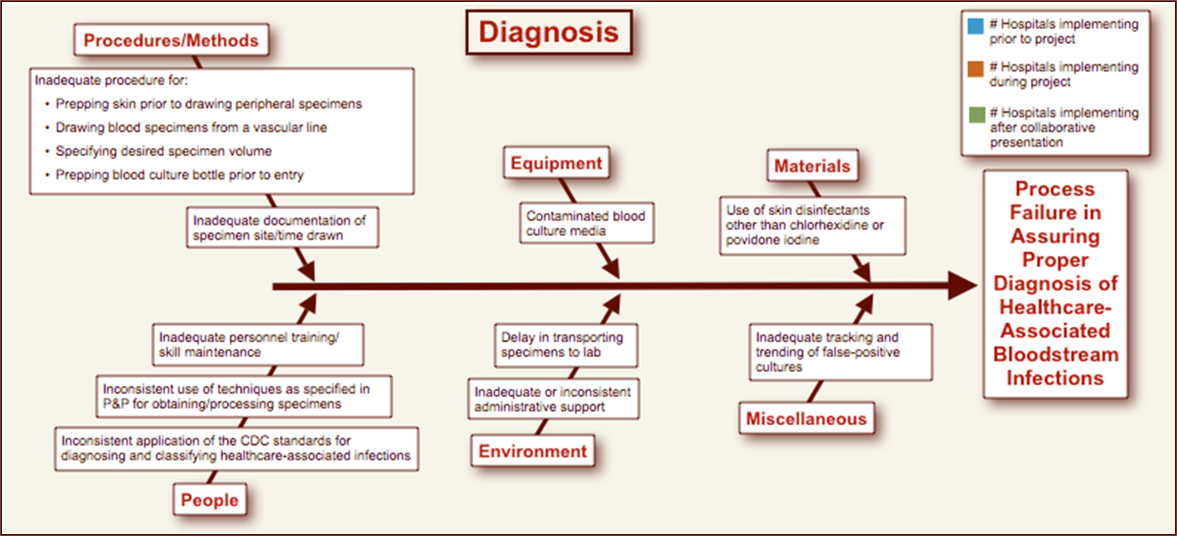
Consensus Practices (CaCHA NICUs): Diagnosis

Slide 16
Issues Related To Diagnosis And Trending:
Understand how to diagnose, report and feedback your infection experience
Dynamic nature of the CDC’s own experts, their definitions and their reception by our collaborative’s members
  NNIS metamorphosis into NHSN
  LC CABSI diagnostic criteria
    2006: Collaborative rejects “clinical sepsis” dx
    : augments temperature criteria
    : concerned about access and pain associated with BC
    2007: CDC excludes the use of the antigen test criterion
    2008: CDC excludes the use of the “single” culture criterion as it relates to organisms classified as “common skin contaminants”
  Denominator (Line Day) Counts:
    2007: Additional birthweight strata
    2008: Differerentiation between umbilical line days from central line days
Relationships with hospital’s Infection Control Department

Slide 17
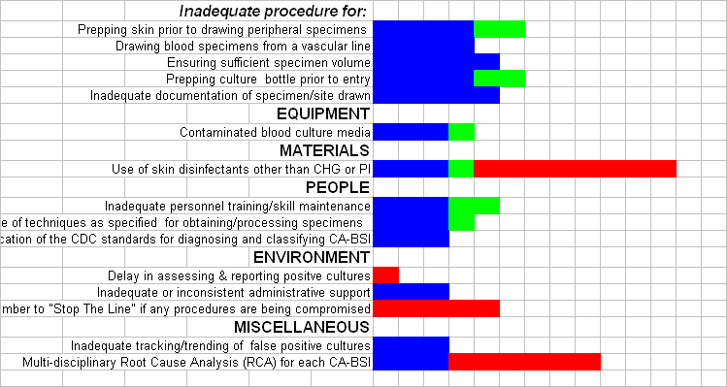
Self-reported Diagnostic “Best Practices” During CaCHA NICU Collaborative Project:
Present At Onset; Implemented During Project; Being Addressed As A Result Of Collaborative Meetings

Slide 18
SPC Charting Illustrated:
CLBSI in the NICU-Old School
Understand how to diagnose, report and feedback your infection experience

Slide 19
Annotated Run Charts:
Data That Tell A Story
Understand how to diagnose, report and feedback your infection experience

Slide 20
STUDY: Interval (in days) Since Last CABSI-The NICU Equivalent to “Accident Free” Days at the Worksite!
Case Number

Slide 21
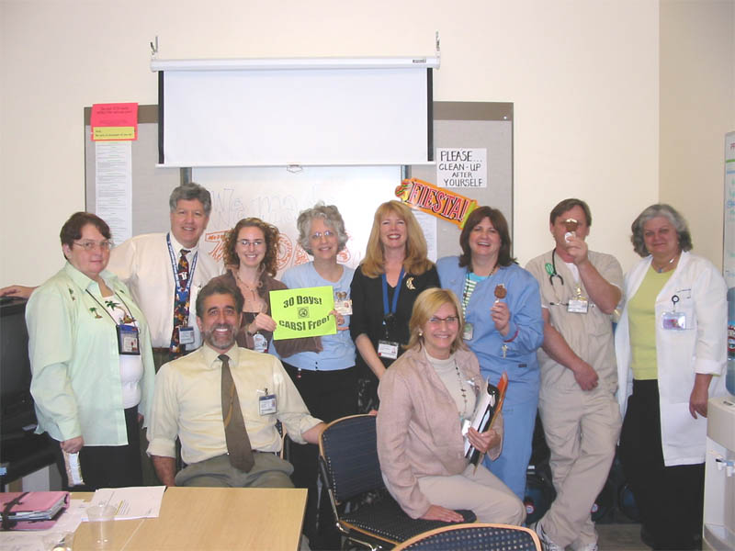
Celebrating Getting To Zero:
One Day At A Time
Ice cream celebration for every 30 consecutive CABSI free days

Slide 22
Engaging All The People Who Count!
Diagnostic criteria and event trending
  The unit reputation factor!
Recognizing this as a team game
Committing the effort and resources to win
Encouraging recognition and celebration
Empowering the staff to “stop the line”
  Requisites of a “safety culture”
Notes:
Eric Knox
Physician Exec. 1997 Sep-Oct;23(7):55-8. Links
Confronting the disruptive physician.
Linney BJ.
Ignoring disruptive behavior is no longer an option in today's changing health care environment. Competition and managed care have caused more organizations to deal with the disruptive physician, rather than look the other way as many did in years past. But it's not an easy task, possibly the toughest of your management career. How should you confront a disruptive physician? By having clearly stated expectations for physician behavior and policies in place for dealing with problem physicians, organizations have a context from which to address the situation
One of my articles that I've posted is, "How the Co-dependency Movement is Ruining Marriages." In that article I explain that the co-dependency movement was created for people just like you, and is very appropriate in situations like yours. But when it's applied to all marriages, it can have devastating effects.
The Co-dependency movement rightfully acknowledges that emotional needs cannot be consistently met by an alcoholic spouse, nor can someone meet an alcoholic's needs. It's also hopeless to try to "fix" alcoholic spouses. They either fix themselves, or they don't get fixed. With these realities in mind, if you want to remain married to an alcoholic, you must learn to raise emotional defenses in order to survive the pain of the marriage

Slide 23
Pronovost NEJM 2006
Teamwork Climate Across Michigan ICUs
No BSI 21%
No BSI 31%
No BSI 44%
% of respondents within an ICU reporting good teamwork climate

Slide 24
Safety Climate Across Michigan ICUs
Pronovost NEJM 2006
2004 :median 2.7/1000 line days 2006 :median 0/1000 line days
:mean 7.7/1000 line days :mean 2.3/1000 line days
% of respondents within an ICU reporting good safety climate
Notes:
Resutls. This shows the improvement in safety culture across Michigan ICUs. This is the first time, in any industry, to demonstrate on a large scale that culture is responsive to interventions.

Slide 25
Safety Attitude Questionaire Informs The Teamwork Score and the “Stop the Line” Maneuver
In this ICU, it is difficult to speak up if I perceive a problem with patient care. (SAQ)
      five-point Likert scale
        (Disagree Strongly, Disagree Slightly, Neutral, Agree Slightly, Agree Strongly)
      Sexton BMC Health Services Research 2006, 6:44
  This item is the strongest predictor of the teamwork score!
“Stop the Line”
  Empowers all personnel to speak up urgently about problems perceived to affect patient safety
  Adopted by 5 of 13 CaCHA NICU members
  The “disruptive physician”
    normalization of deviance as co-dependency

Slide 26
Issues Related To Hand Hygiene
Need for continuing surveillance
  Both overt and covert
Agents- use of alcohol-based gels
  Topics requiring continuing study
    Emergence of resistant organisms
    Understanding resident bacterial flora
Compliance by everyone in and visiting the NICU

Slide 27
DATA: Pre-Meeting Exercise hand hygiene observations
Issues related to designing and evaluating your hand hygiene processes

Slide 28
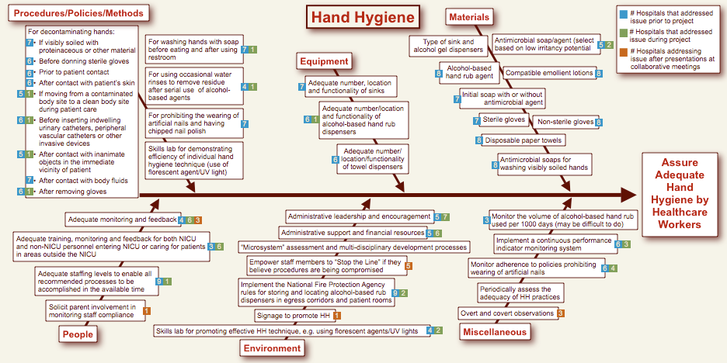
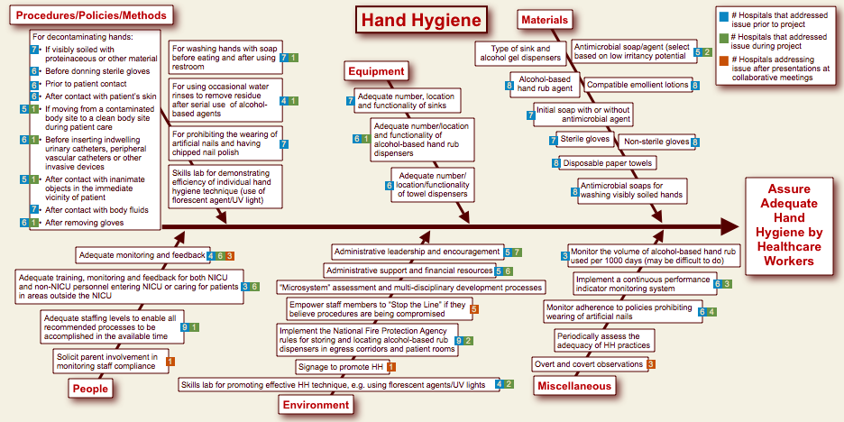
Hand Hygiene flowchart

Slide 29
DATA: Pre-meeting Exercise line set-up/blood draw
Issues related to the design, maintenance and entry of lines

Slide 30
DATA: Pre-meeting Exercise accessing lines
Issues related to the design, maintenance and entry of lines

Slide 31
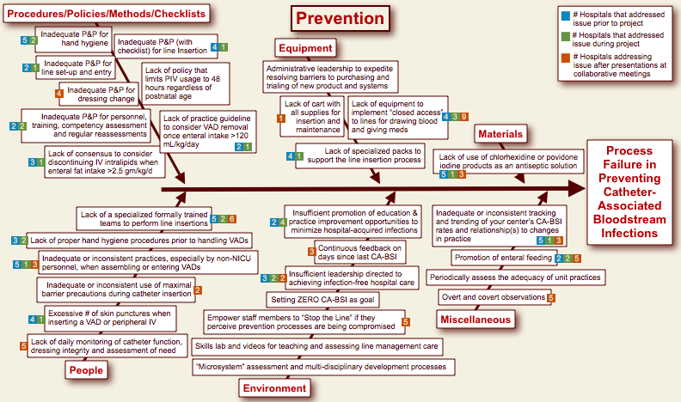
Prevention flow chart

Slide 32
Issues Related To Vascular Access Device Placement and Management:
Chlorhexidine- FDA approval excludes < 2 month old infants
  AAP Committee On Drugs: Uses of drugs not described in the package insert (Off-Label Uses) Pediatrics 2002;110:181
  “In most situations, off-label use of medications is neither experimentation nor research… the degree of acceptance among physicians of an off-label drug treatment may be an important issue to discuss with a patient or family.”
  “Use of approved drugs in an off-label manner to treat an individual patient does not require an IND application
Notes:
One frequently asked question is whether an off label use of an approved drug should be viewed as experimentation requiring formalized institutional review and informed consent. This question reflects a misunderstanding of what constitutes research. The FDA approval process does not determine whether treatment constitutes experimentation and research. According to federal regulations, “Clinical investigation means any experiment in which a drug is administered or dispensed to, or used involving, one or more human subjects. For the purposes of this part, an experiment is any use of a drug except for the use of a marketed drug in the course of medical practice.”6 In most situations, off-label use of medications is neither experimentation nor research. Any
medical intervention is based on consent, albeit implied in many instances. Whether institutional review, consultation, or written consent is required for a given intervention depends on the degree of risk or deviation from standard practices and the extent to which research, rather than individual patient care, is involved. The administration of an approved drug in a way that is not approved by the FDA is not research and does not call for special consent or review if it is given in the individual patient’s best interest. However, discussion about the off-label status of a drug may, as a matter of professional judgment, be part of the information provided to the patient or parents. Similarly, the degree of acceptance among physicians of an off-label drug treatment may be an important issue to discuss with a patient or family.
There seems to be confusion also about whether an off-label use requires submission of an investigational new drug (IND) application to the FDA. Use of approved drugs in an off-label manner to treat an individual patient does not require an IND application. The IND regulations “do not apply to the use in the practice of medicine for an unlabeled indication.” 7 In fact, the IND process regulates interstate shipment of the drug for investigation of an unapproved use in humans.

Slide 33
Issues Related To Vascular Access Device Placement and Management:2
Chlorhexidine: Scalded skin incidents
        Garland…Biopatch ® experience Ped Inf Dz J 1996
        Andersen…2% acq CHG in those > 1000 gm & > 14 d / 1% CHG ethanol for all other swabbing for IVs J Hospital Infection 2005
        Versus
        Garland..pre/post trial 10% PI vs 0.5% CHG for preventing colonization of PIV catheters. Ped Inf Dz 1995
        Upadhyayula…Safety of infective agents for skin preparation in premature infants. Arch Disc Child 2007
        Insufficient data; risk of burns related to alcohol as well as CHG; ensuring that there is no pooling may be the key.
Practice Survey
        7/12 rose to 9/13, with 2 more in process of adopting
        Limitations, e.g. not in periumbilical area, <28 wk GA, <7d old

Slide 34
Issues Related To Vascular Access Device Placement and Management:3
Catheter placement: Moving towards a systems approach
  Carts, CHG, competencies, and checklists
  Anticipates/convergent with new CDC Central Line Insertion Practices (CLIP) measure
  Special teams: (re)certification
Daily assessments of need, uses and dressings
Closed systems?
  ad hoc or purchased?
  Venous, arterial or both?
  Medication: distancing ports away from the bedside
Standardizing entry and fluid change processes
  clean or aseptic techniques

Slide 35
Issues Related To Administering A CABSI Reduction Project
Visible hospital leadership role
Staff feedback, e.g. essential for keeping “score”
Surveillance activities for critical processes, e.g. hand hygiene and line insertion, management and entry standards, both for infants in and out of the NICU:
  Adherence sustained proactively with checklists
  Correction applied concurrently with peer feedback
  Unit personnel support for the “Stop the Line” safety culture
  Challenges evaluated retrospectively with audits
Perform root cause analysis (RCA) of each CABSI
Building the unit’s culture

Slide 36
Checklists: The Sign Of High
Reliability Organizations
ICU care entails a high volume of discrete actions (~1-3 x10² per day)
1-2% error rate yields 1-6 errors/day
Checklists
  Ensure the routine (often in prescribed sequence) items are not forgotten
  Make explicit the minimum expected steps
  Used extensively and successfully in other “zero-defect” performance environments

Slide 37
Checklists: An Important Step On The Way To Zero
VAD Policy
Line Cart
Checklist
Daily Goals
Empower Nursing
Berenholtz et al. Crit Care Med. 2004;32:2014.
Notes:
Johns Hopkins is a learning lab to improve patient safety. We reduced infections at hopkins, packaged the intervention and offered it broadly.

Slide 38

Surveillence: Overt & Covert
Minimum # observations
Multidisciplinary personnel
Multidepartmental personnel
When to correct behavior
  would you let a medical professional harm a patient?

Slide 39
Organization Learning and Individual Learning Rates Are Different!
Bohmer & Edmondson Health Forum 2001
Learning as individual education (experience)
  Error detection/correction focuses on the individual
Learning as an organization (unit-based) event
  Increasing interactions challenges professional boundaries, status relationships and communications
  Institutional Structure poorly related to learning rates
  Volume poorly related to increasing expertise (efficiency)
  Rather prospective reflection on collective experience yields expertise.

Slide 40
Learning from Mistakes:
Why Each “Accidental” Infection Needs An Investigation (RCA)
What happened?
Why did it happen (system lenses)?
  Identify process variation(s) that may lead to error
What could you do to reduce risk?
  Spur development of prevention strategies
  Spur building a “Culture of Safety”
    Focus is on the system, rather than the individual
How to you know risk was reduced?
  Create policy/process/procedure
  Ensure staff know policy
  Evaluate if policy is used correctly

Slide 41
Root Cause Analysis:
A Developing Process
Sepsis Presentation and Blood Culture Information
  Date/Time drawn: Sites: Time to positive?
  Reason for sepsis work up:
Line Information
  Line type: Date line placed/inserter name: Site:
  Line tip position originally: At time of sepsis presentation:
  Phlebitis noted at any time during life of line?
Events within the last week:
  Dressing change?
  Medications infused (name, #/day):
  Blood infused (# infusions/week; via CL?):
  Line leaking events? Line repaired?
  Registry staff shifts (#/week):
  Off-NICU events, e.g., Surgery/Radiology:
Patient Information
  1. Mulitple IV starts in the last week?
  2. Amount of enteral feeds (ml/kg/d);
  3. Apnea/bradycardia spells (#/day in last 7 days):

Slide 42
The NICU as a Social Learning System
Internal Relations:
Microsystem Development-
Batalden Jt Comm J Qual Safety 2003; http://www.clinicalmicrosystem.org
  Nelson EC, Batalden PB, Godfrey MM Quality by Design San Francisco, Jossey-Bass, 2007
Focus on front-line units to realize their full potential and attain peak performance; requires purposeful acts
      Dartmouth-Hitchcock NICU case study. Edwards J Qual Safety 2003
Integrated program:
  organizational assessment
  staff development using “action-learning” theory
  catalysts based on patient needs
  evaluation and feedback

Slide 43
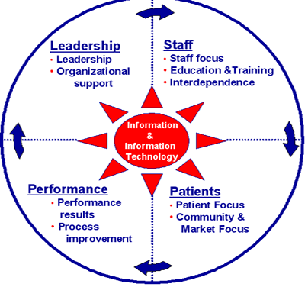
Success Characteristics of High Performing Clinical Microsystems

Slide 44
Micro-System Assessment Scores
Explanation
Description of intervention
Links to additional references/materials
Results

Slide 45
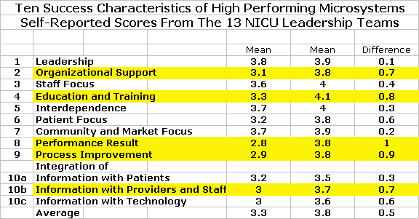
Ten Success Characteristics of High Performing Microsystems Self-Reported Scores From The 13 NICU Leadership Teams

Slide 46
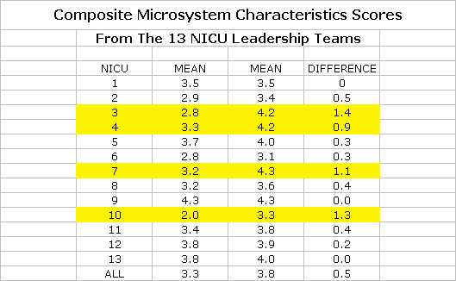
Composite Microsystem Characteristics Scores

Slide 47
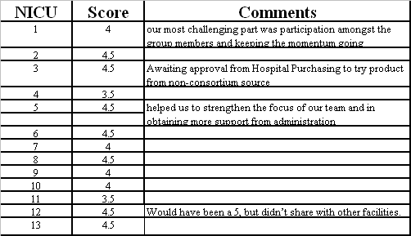
Institute Of Healthcare Improvement: Assessment Scale For Collaboratives
1.0 Forming Team 2.0 Activity, but no changes 3.0 Modest Improvement 4.0 Significant Improvement 4.5 Sustainable improvement 5.0 outstanding sustainable results

Slide 48
13 California Childrens Hospital NICUs
Implement CPQCC Bundles:
All Birth Weight LC-CLBSI Rate i 29% (Class III)

Slide 49
Year 01 Accomplishments:
Decreased CABSI rate by 30%
Refined the care processes for:
  diagnosing CABSI
  improving Hand Hygiene compliance and
  defining line entry and management
Facilitated each NICU’s microsystem improvement process

Slide 50
Year 02 Goals:
Sustain The Gains
Refine a CABSI prevention bundle for NICUs
Develop additional aids to address on-going and emerging technical challenges in line management
Foster implementation of additional systems associated with High Reliability Organizations
  Checklists
  “Stop the line” safety culture
  Root Cause Analyses
Support member’s educational and dissemination activities

Slide 51
Year 02 Goals:
Broaden The Prevention Process To All HAIs In The NICU
Validate total antibiotic days/1,000 pt days as an alternative aggregate metric of the NICU’s infection burden
Evaluate a NICU-specific VAP bundle
Evaluate a NICU-specific SSI bundle
  Prophylactic antibiotics ?
  Normothermia ?
Evaluate infections in surgical patients
  Feeding methodologies

Slide 52
Conclusions:
Decreasing infection is possible
“Zero infections” is an attainable goal
Collaborative work energizes the community of practice and practitioners
Communication and celebration of your progress is important

