Slide 1
Department of Health Care Services – Mental Health Medi-Cal Administrative Activities
Claiming Plan Training

Slide 2
Welcome ……
Mental Health Medi-Cal Administrative Activities (MH MAA)

Slide 3
Questions

Slide 4
Overview of DHCS’ Role in MH MAA
The State oversees the Mental Health Plan’s MAA plan by reviewing the Mental Health Plan’s claiming plans, and amendments to the claiming plans, reimburses MAA activities, training on the MAA program, and conducts site visits.

Slide 5
Presentation Agenda
Overview of the MH MAA Program
The MH MAA website and mailbox
The MH Implementation Plan

Slide 6
Presentation Agenda (cont)
Time Study
SPMP
M/C discount percentage

Slide 7
Presentation Agenda (cont.)
Invoicing
How to complete the Quarterly Claims Worksheet

Slide 8
Authority
The Code of Federal Regulations, 42 CFR Section 433.15 authorizes the Federal government to reimburse states for the cost of activities that the Secretary of Health and Human Services finds to be necessary for the proper and efficient administration of the State plan.

Slide 9
Purpose
The Mental Health Medi-Cal Administrative Activities program allows county Mental Health Plans to claim federal reimbursement for the cost of administrative activities that support the Medi-Cal program.

Slide 10
MH MAA Established in 1995
The Mental Health MAA program was established in 1995. It has had two major revisions, one in August 2002 and the latest is the October 1, 2016, Implementation Plan.
The current 2016 Implementation Plan has had some minor changes. The current plan is dated July 1, 2021.

Slide 11
Participation in MAA
Any county may participate in the Mental Health MAA program by submitting a claiming plan to DHCS for review and approval. The effective date will be the first day of the quarter in which the plan was submitted to DHCS. Quarter 1 is an exception to this; an extra month is added so the cutoff for the first quarter is November 1.

Slide 12
Why Participate in MH MAA
Reimbursement for administrative expenses capped at 30%

Slide 13
Claiming Plans and Amendments
Claiming Plans and amendments are basically one and the same. They will be used interchangeably in this presentation. The Claiming Plan is the first submission of a new MAA plan. Any time a substantial change to the plan is made, the MHP will submit an amendment to the plan.

Slide 14
Claiming Plan vs. Claiming Unit
A Mental Health Plan’s Claiming Plan may consist of one Claiming Unit, which can be considered as a site location, or any number of Claiming Units, each with their own Claiming Plan. For instance, County AZ may have 10 Claiming Units, each with an approved Claiming Plan and which comprises that county’s overall MAA program.

Slide 15
MAA Programs
MH MAA
C-MAA
S-MAA
Tribal MAA

Slide 16
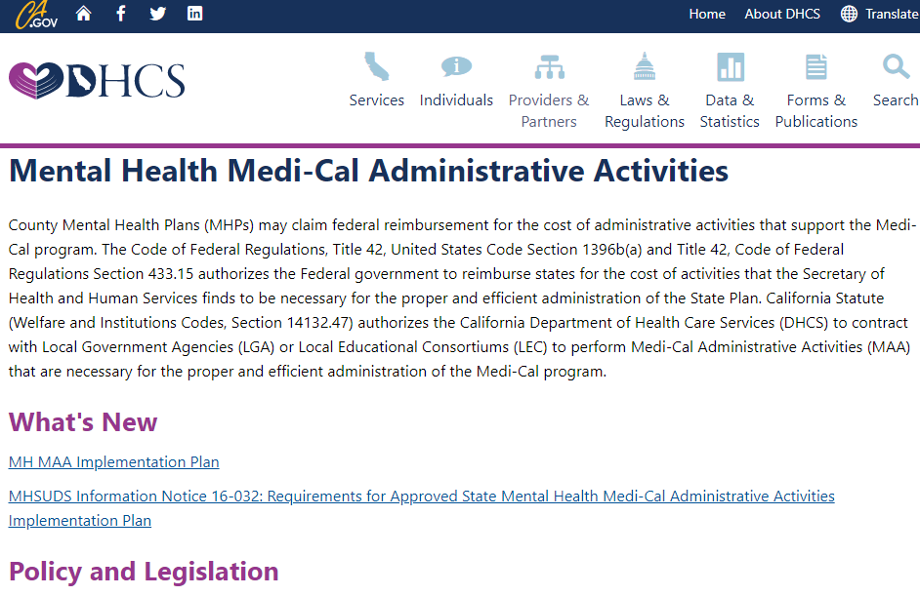
MH MAA Web Site

Slide 17
MH MAA Website
MH-MAA (ca.gov)

Slide 18
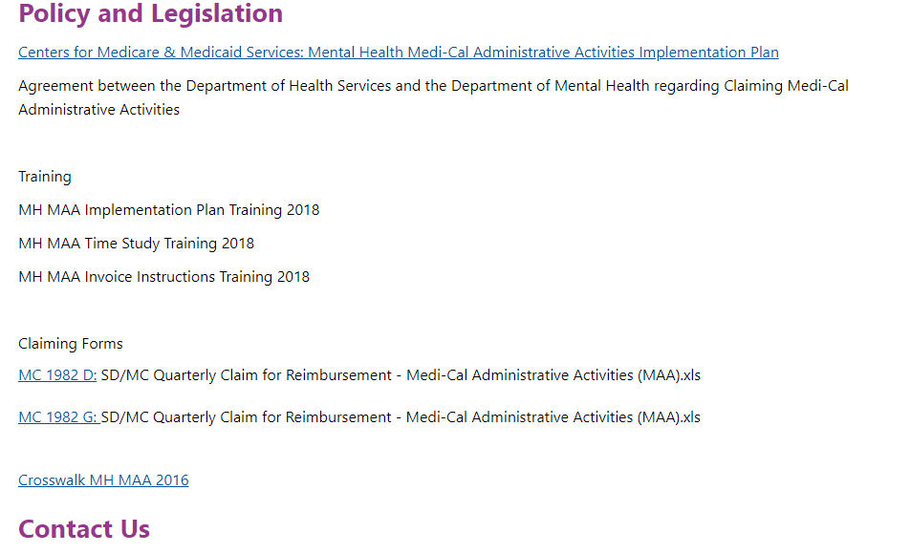
MH MAA Web Site (cont)

Slide 19
MH MAA Mailbox
MHMAA@dhcs.ca.gov

Slide 20
Activity Codes
There are 18 activity codes.
10 activity codes are MAA claimable.
8 activity codes are parallel codes not claimable for MAA.

Slide 21
Activity Codes (cont)

Slide 22
Activity Codes (cont.)
Here is a table of the activity codes. Highlighted in green are the activities that are claimable for MAA. The other 8 are parallel activities.
Of the MAA allowable codes, there are those designated as Total Medi-Cal for an activity that is 100% allowable.
And there are activities designated as PM, or Partial Medi-Cal, to indicate the activity is allowable, but which a share of costs will be determined by applying the Medi-Cal discount percentage.

Slide 23
Preparing a Claiming Plan
Documents to Submit:
  1. Cover Page
  2. Claiming Plan Checklist
  3. Certification Statement
  4. Claiming Unit Functions Grid (continued to next slide)

Slide 24
Preparing a Claiming Plan (cont)
Documents to Submit (cont):
  5. Activity Sheets
  6. Duty Statements
  7. Other documents as needed

Slide 25
Components of a Claiming Plan
1) Cover Letter
2) Checklist

Slide 26
Claiming Plan

Slide 27
Checklist
The top section of the Checklist shows whether this is a new Claiming Plan, Box A, or an amendment, Box B.
Other sections of the Checklist are DELETIONS, CHANGES, and ADDITIONS.
To complete the Checklist, check whichever boxes that apply. Then on the right lists what documents are required to submit.

Slide 28
Claiming Plan (cont)

Slide 29
Claiming Plan (cont.)

Slide 30
Certification Statement
3.) The Cert page is intended to ensure that the information contained in the Claiming Plan is true, correct, and accurately reflects the performance of the Mental Health MAA activities.

Slide 31
Certification Statement (cont)

Slide 32
Claiming Unit Functions Grid
4.) The purpose of the Grid is to provide detailed information about each claiming unit.

Slide 33
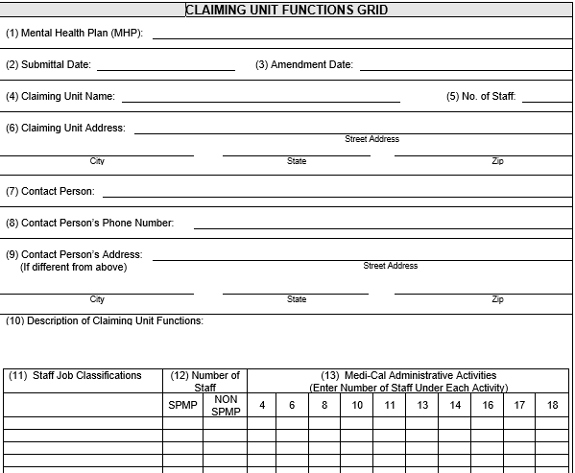
Claiming Unit Functions Grid (cont)

Slide 34
Grid (cont)
Numbers 1 through 9 are for basic information of the amendment, such as the name of the Claiming Unit, contact person, address.
Number 10 is for a narrative description of the claiming unit’s functions.
Number 11 is where the Job Classifications are entered.
Number 12, is where SPMP and non-SPMP staff are identified.
And number 13, please enter the number of staff performing the indicated activity codes.

Slide 35
Claiming Unit Functions Grid (cont.)
5.) Activity Sheets are the next component of a Claiming Plan

Slide 36
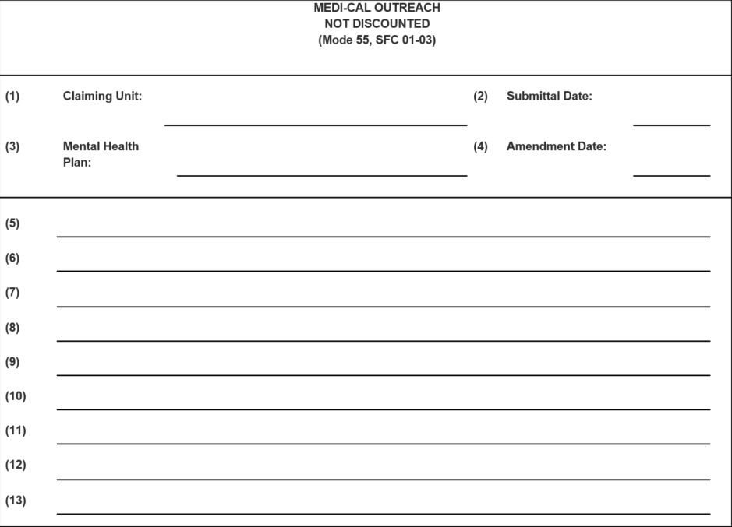
Outreach Activity Sheet

Slide 37
Outreach Activity Sheet (cont)
1. Enter the name of the claiming unit.
2. Enter the date the amendment is submitted.
3. Name of the claiming plan.
4. Amendment Date. If the claiming plan is a new claiming unit, this should be left blank.
5. This is where the types of activities are listed. These are the types of activities that the claiming unit will perform. A Mental Health Plan’s amendment may include any or all of the activities of Outreach.

Slide 38
Activity Code 4 – M/C Outreach
There are 5 Outreach Activities that may be performed:
  1. Informing individuals and persons who have frequent contact with those individuals who are eligible or potentially eligible about Medi-Cal services, including specialty mental health services.
  2. Assisting individuals who are at-risk and are eligible or potentially eligible for Medi-Cal to understand the need for mental health services covered by Medi-Cal.
  3. Actively encouraging individuals who are reluctant and are eligible or potentially eligible for Medi-Cal to accept needed mental health and health services.

Slide 39
Activity Code 4 – M/C Outreach (cont)
Outreach Activities (cont)
  4. Assisting individuals with access to the Medi-Cal healthcare system by providing referrals, follow-up and transportation, if needed, to engage them in needed care.
  5. Gathering information on the individual’s health and mental health needs and Medi-Cal eligibility.

Slide 40
Outreach Activity Sheet (cont.)
6. Number 6 of the components of the Outreach Activity sheets requires a number of items to address:
  Provide a clear description of how each type of activities will be performed.
  The description should identify the staff who will be performing each type of Outreach.
  Also state when and where the tasks will be performed.
  Finally, describe how each task furthers the objectives of each type of activity.
7. Number 7 asks for a description of the population of individuals to whom each type of Outreach will be provided.
8. Number 8 asks for the length of time that each type of Outreach will be performed. For example, Outreach may be performed every day or only on certain days of the week and may be performed during certain hours or on an ad hoc basis.

Slide 41
Outreach Activity Sheets (cont)
9. A list of locations where each type of utreach is conducted. For example, Outreach may be conducted in one or more offices (e.g., telephone calls or walk-in) or in one or more particular communities.
10. The number of times each type of Outreach is conducted during a fiscal year or whether outreach is an ongoing activity.
11. A description of the methodology the claiming unit uses to develop and document the costs associated with the activity.

Slide 42
Outreach Activity Sheets (cont.)
12. The names of any subcontractors, if applicable. If the mental health plan chooses to direct charge the Outreach performed by the subcontractors, the contract should also clearly describe the Medi-Cal Outreach activity to be performed, the method used to determine the direct charge claim, and the dollar amount to be paid to the subcontractors.
13. The location where flyers, announcements, or other materials that describe Medi-Cal Outreach may be viewed if those materials are not included with the claiming plan.

Slide 43
Activity Sheets
Some other items required on Activity Sheets may include a description of the methodology the claiming unit uses to develop and document the costs associated with the activity. This is Time Tracking.
Also may be required is a description of the methodology that will be used to calculate the Medi-Cal discount percentage.

Slide 44
Contract
A claiming unit that is operated by an Mental Health Plan may direct charge the cost of performing Medi-Cal activities when performed by a subcontractors. If a Mental Health Plan chooses to direct charge these costs, the Mental Health Plan will submit the sections of the contract it has with the subcontractors that clearly describe the activity to be performed, also the method used for determining the direct charge claim, and the dollar amount to be paid to the subcontractors.

Slide 45
Contract (cont)
A contract is required when the Mental Health Plan contracts with a contractor for MAA activities. The MAA activities that may be contracted are:
  Code 4 – Outreach
  Code 6 – Eligibility Intake
  Code 8 – Referral in Crisis Situations
  Code 13 – PP&PD (non-SPMP)
  Code 17 – MAA Coordination and Claims Administration

Slide 46
Duty Statements
Each claiming unit must submit a duty statement for each job classification listed in Box 11 of the Grid. The description does not need to be an official county document for the particular county job classification.
Some guidelines when preparing duty statements are:
  Include the name of the mental health plan.
  Include the name of the claiming unit.
  Clearly distinguish MAA duties from duties that are not MAA.
  Use only one activity code for each MAA duty description.
  Clearly identify the MAA activity that relates to each duty description.

Slide 47
Common Oversights
1). Similarities between Outreach and Case Management of Non-Open Cases. The major distinction is that Case Management is performed by and SPMP and that that Code 16 is for non-open cases.
2). The titles on the Grid, Activity Codes, and the Duty Statements must all be exactly the same.
3). The descriptions on the Duty Statement should clearly identify the MAA code to which each MAA duty relates. There should be only one code per Duty Statement description.

Slide 48
Common Oversights (cont)
4). Similarities between Contract Administration code 10 and code 11. Activity Code 10 is not discounted whereas Activity Code 11 is discounted.
  Additionally, the description for Activity Code 10 not discounted and Activity Code 11 are very similar. The language for code 10 reads, in part, … identifying and recruiting community agencies as mental health service providers exclusively serving Medi-Cal
  clients ....
  And code 11 reads in part, … identifying and recruiting community agencies as mental health service providers serving Medi-Cal and non-Medi-Cal clients ….

Slide 49
Common Oversights (cont.)
5). Similarities between Program Planning and Policy Development, PP&PD – Non-SPMP (code 13) and PP&PD – SPMP (code 14). The descriptions are identical, however only SPMPs can code to 14.
6). Activity Code 8 – Referral in Crisis Situations for Non-Open Cases. Any description of Code 8 must include that the activity is for non-open cases.
7). Training: With the Implementation Plan, training is no longer coded to the particular MAA activity. Training should be coded as:

Slide 50
Common Oversights – Code 17
Activity Code 17 – Training
  Training of Mental Health Plan staff and subcontractor staff members on MAA activities and claiming.
  Provides training on time survey. Note that filling out time survey is Code 18.
  Attending training sponsored by DHCS for preparation of a Claiming Plan or amendment.
  Attending training sessions related to MAA.

Slide 51
Common Oversights – Code 18
Activity Code 18 – Training
  Participates in training on how to perform a MAA activity.
  Attending or facilitating meetings or training.

Slide 52
Time Study
The purpose of Time Study is to document the time performing MAA activities.
Mental health plans must be able to document the amount of time that authorized staff members spend performing specific MH MAA.

Slide 53
Time Study (cont)
1 unit of service = one minute
The county time tracking system should be designed so staff members are able to record their time in actual minutes.
Claiming units performing Mental Health MAA will be required to utilize a time-tracking system where staff members perpetually record the number of minutes spent performing specific Mental Health MAA.
Claiming units will claim reimbursement for Mental Health MAA on a minute-by-minute basis throughout the time-tracking period, which is the fiscal year.

Slide 54
Time Study (cont.)
Resources:
  Implementation Plan
  MH MAA website

Slide 55
SKILLED PROFESSIONAL MEDICAL PERSONNEL
SPMP staff may claim Federal Financial Participation at a rate of 75%. This also applies for their directly supporting staff.
Two MAA activities allow the enhanced rate for SPMPs. These are Activity Code 14 (PP&PD) and Activity Code 16 (Case Management of Non-Open Cases).

Slide 56
SPMP (cont)
SPMP coding to all MAA activities
Activities performed by an SPMP in Activity Code 14 and 16 are allowable due to the training and skill possessed by the SPMP.
It is useful to note that an SPMP may claim for other activities, but not at the enhanced rate. This is because for the other activities it is considered that the training and skill possessed by the SPMP are not necessary.

Slide 57
SPMP (cont.)
SPMP coding to all MAA activities
Resources:
  Implementation Plan
  MH MAA website

Slide 58
Medi-Cal Discount Percentage
The Mental Health MAA claiming process reimburses mental health plans only for the costs that are associated with the Medi-Cal program.

Slide 59
Medi-Cal Discount Percentage (cont)
Five Mental Health MAA codes benefit Medi-Cal clients as well as non-Medi-Cal clients.
The Medi-Cal Discounted Percentage must be applied to these activities on a quarterly basis.
  Activity 8: Referral in Crisis Situations for Non-Open Cases
  Activity 11: Medi-Cal Contract Administration
  Activity 13: Non-SPMP PP&PD
  Activity 14: SPMP PP&PD
  Activity 16: SPMP Case Management of Non-Open Cases

Slide 60
Medi-Cal Discount Percentage (cont.)
Calculating the M/C Discount Percentage
The discount percentage is equal to the ratio of Medi-Cal individuals who received a mental health service to all individuals who received a service. The number of individuals must be unduplicated.

Slide 61
Medi-Cal Discount Percentage Calculation
The numerator is equal to the total number of individuals enrolled in the Medi-Cal program and received a mental health service and are included in the claiming unit’s clinical health records and are an open case.

Slide 62
Medi-Cal Discount Percentage Calculations
The denominator is equal to the total number of individuals who received a mental health service who both reside in the claiming unit’s clinical health records and are an open case.

Slide 63
Overview of SCHEDULE A through SCHEDULE G
Schedule A – Time Study results
Schedule B – Salary and Benefit Costs
Schedule C – Allocation Percentages for Salary and Benefit Costs
Schedule D – Allocated Salary and Benefit Costs
Schedule E – General and Administrative Costs
Schedule F – Allocated General and Administrative Costs
Schedule G – Determination of Federal Reimbursement

Slide 64
Schedule A Purpose
The purpose for Schedule A is to report 100% of the time each staff classification worked during the claiming quarter by activity.

Slide 65
Schedule A
The staff classifications listed on the invoice must match the staff classifications listed on the Grid of the claiming unit’s approved Mental Health MAA claiming plan.
All classifications must be listed whether or not the individual in the classification performed a reimbursable activity.
The time reported must match each individual’s signed personnel activity reports for the months within the claiming quarter.
Claiming units must actively update their claiming plans to ensure the classifications listed are current.

Slide 66
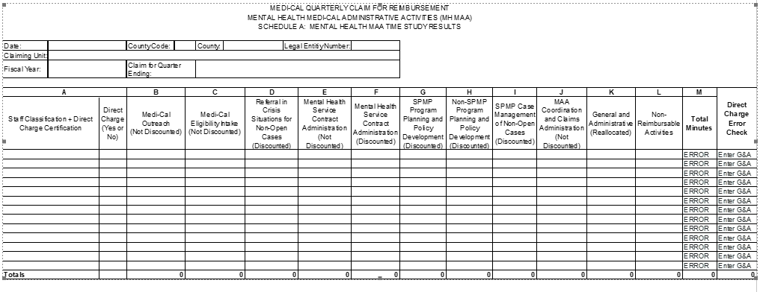
Schedule A

Slide 67
Schedule A – ENTER DATA
Column A lists all staff classifications identified on the claiming plan’s Grid. Also in Column A indicate yes or no for direct charge.
In Columns B through L, report the number of minutes the person in each staff classification spent performing activities within each cost center as recorded on his/her time study.
Column M is equal to the total minutes the person in the staff classification worked in that quarter.

Slide 68
PowerPoint Invoice Training
Will be posted on MH MAA website.

Slide 69
Conclusion
This concludes our presentation. I hope it will prove to be useful.
When the Mental Health MAA website is updated, it will be a good source for your MAA program.
Thank you for attending this training.

Slide 70
QUESTIONS ??

